Slide 1
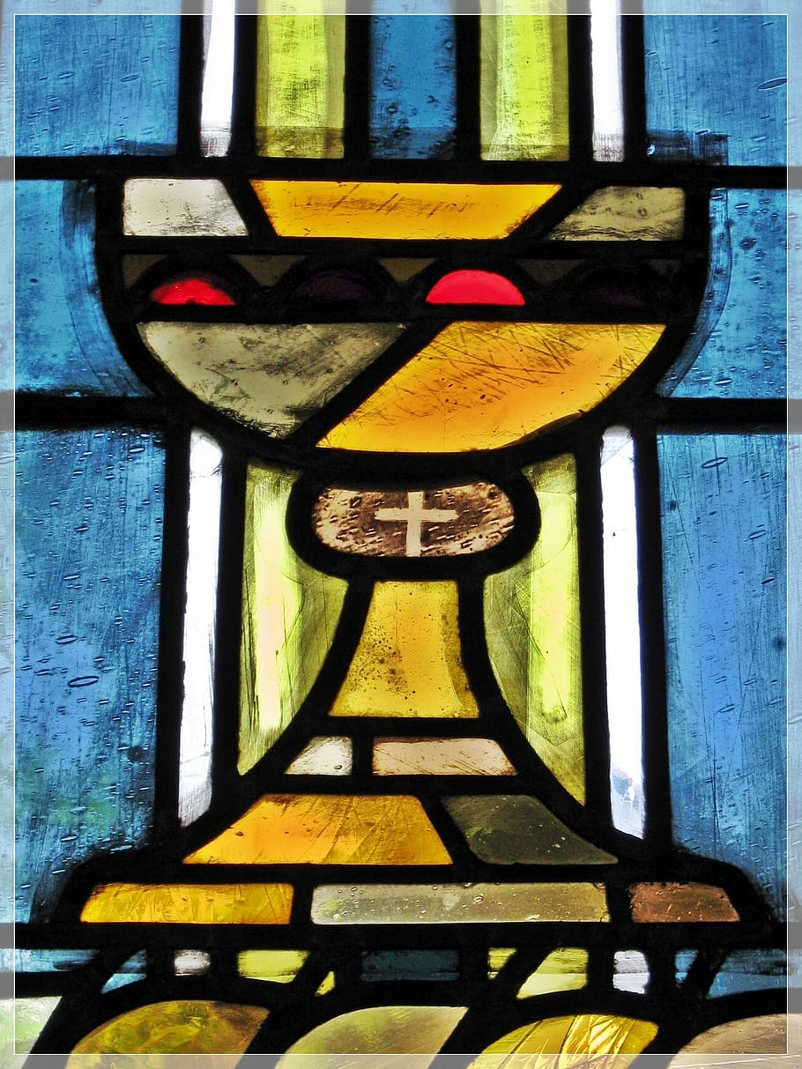
Imlitir 10
6th November 2023
CONFIRMATION MESSAGE
For 6th Class Parents
A Chairde,
We would like to extend a very warm welcome to our new Principal, Mr Fergal Kelly. We know we are in good hands and we look forward to lots of exciting times ahead with him at the helm.
Fáilte romhat Mr Kelly!
Parent Teacher Meetings take place on Tuesday and Thursday. Please be mindful that our aim is always to promote respectful, dignified dialogue and communication between staff and parents/guardians. Please note, that to be fair to all, meetings need to finish at the prescribed time. If further discussion is required, a separate meeting can be arranged. Meetings may not be recorded and you are asked to switch off or mute your phone. Thank you. We hope that it will be a positive and productive meeting for all.
A meeting for all 6th class parents of children who wish to make their Confirmation next year will take place in Trim Parish Church next Monday 13 November at 6pm. Confirmation will take place on Friday 26 January and this meeting will help us with some final preparations for the occasion.
Fr. Paul
Christmas Shoe Box
Appeal 2023
Just a reminder that Monday, 13th November is the last day for shoeboxes to be dropped in to Room 2. Team Hope will collect them Monday afternoon!
See below for more information from. Thank you for your continued generosity.
Book Fair Update
An mí seo, cuimhnímís orthu siúd atá imithe ar shlí na fírinne.
This month we remember those who have died. May they rest in peace.
St. Mary’s School Book Fair will take place in the School Hall on Tuesday 8th and Wednesday 9th of November. Please see full details below.

Slide 2
CREDIT UNION
MONEY CLUB
SPORTS
NEWS
We have some excellent news to share. Our School's Money Club has just received an All Ireland Credit Union Award for Best Social Impact Award. A massive "Thank You" to all parents and teachers involved.
Please note that the next Money Club date will be Tuesday the 14th of November @ 12.15am .
To know more about the Money Club membership, please call into Trim Credit Union branch.
The girls football team are playing in the Cumann na mBunscoil Division 1 Semi Final, this Thursday in Kentstown.
The girls won their group, going unbeaten, winning 5 out of 5 matches- something the school has never done before!!
They now face St.Paul’s Ratoath in the semi final, looking to book a place in the Final for the first time in the schools history!!
Best of luck girls!
HOMEWORK CLUB
Homework Club is started this Monday, the 6th Nov and will run until the 21st Dec, for children from 1st-6th class. It runs Monday, Tuesday and Thursday from 2.50-3.50.
Please Note: Children with siblings attending homework club in St Michaels or the secondary schools are welcome to wait until 4.00.
Cost is dependent on how many days you attend, but works out at €5 a day, full details on forms, available in the school.
Thank you,
Ms Carr
Sadbh O’Neill, room 31, is competing in the European Championships in gymnastics this Thursday, in Spain.
This is a 1 day event and Sadbh will be looking to bring home a medal in her category!
Best wishes to Sadbh, we have no doubt you will do the school extremely proud!
Please note there is no camogie training this week. Camogie training will start next week as we will be having our mini-7s.
Our Annual Admittance Notice has been updated on our website. It lists the various dates associated with enrolling new pupils in our school. Please click here to download an application for enrolment form.
Completed forms together with a birth certificate can be returned to the office. Please phone the office if you need assistance or have any queries on 046/9431919.

Slide 3
Book Fair in the School Hall
TIME | TUESDAY NOVEMBER 7th | WEDNESDAY NOVEMBER 8th
9.10-9.40 | Rooms 23, 24 & Room 18-Language Unit, and Fourth Class | Room 12-First Class
9.40-10.10 | Room 10-First Class | Room 13-First Class
10.10-10.40 | Room 9-First Class | Room 16-Third Class
11.10-11.40 | Room 31-Sixth Class | Room 20-Third Class
11.40-12.10 | Room 35-Fourth Class | Room 30-Sixth Class
12.50-1.20 | Room 27-Fifth Class | Room 26-Fifth Class
1.20- 2.20 | Rooms 1, 2, 3 & 4 Junior Infants (accompanied by their parents) | Rooms 5, 6, 7 & 8 Senior Infants (accompanied by their parents)
2.20-2.50 | Rooms 14 & 15 Second Classes | Pupils with money for books from any classes
2.50-3.50 | Open to the public | Open to the public
St. Mary’s School Book Fair will take place in St Mary’s school hall, after the mid-term break,
on Tuesday, 7th and Wednesday, 8th of November.
The school runs the Book Fair, in conjunction with our local bookshop, Antonia’s
Bookstore. Antonia kindly donates 20% of her book sales back to the school in the form of
books and resources for our classrooms and our School Library.
We are also running some competitions in school to promote our Book Fair and to encourage
more reading at school and at home.
Parents/guardians of children in Junior and Senior Infants need to collect their children
from their classes, at their allocated times, and bring them to the Book Fair, if they wish
them to attend.
Many thanks for your continued support of our School Book Fair.
Mary O’Hare School Book Fair Coordinator

Slide 4
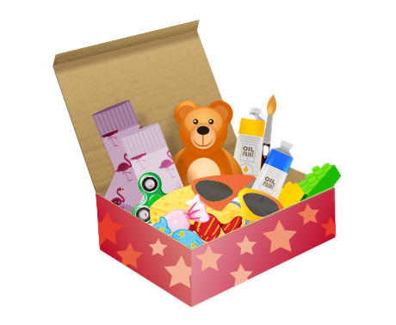
Christmas Shoebox Appeal 2023 | St. Mary’s Primary School, Trim
It is that time of year again and the families in St Mary’s are once again invited to join in the shoebox appeal sharing Christmas with children who may not receive gifts otherwise.
Last year our 175 shoeboxes were delivered to children in Transnistria who were delighted to open up the beautiful gifts. Thank you!
Good things come in small parcels and there are few parcels shared that are as small as a shoebox. Through the Christmas Shoebox Appeal children in Africa and Eastern Europe can enjoy this special time of year. Children in St Mary’s and in Ireland are lucky to have lovely things at home and at school and we have an opportunity to share some kindness with these children who have little and will be so grateful and excited to receive the gift.
The shoebox appeal is based on children/families filling a shoebox with 4 W's- something to Wear(hat, scarf, hairbands etc) something to Write with (crayons, pencils, notebooks etc) something to Wash with(toothbrush, facecloth etc) and something to WOW (teddy, small toy, sunglasses etc). Follow the link to see how to fill a shoebox – click here.
The appeal also asks for a small donation of €5 to cover the transport cost of the gifts. It is a lovely way for children in our school to share with less fortunate children in another country.
As previously, it is optional for the children of St Mary’s to get involved with the Shoebox Appeal. Families or friends can pool together gifts to fill one box if they prefer.
Children will get a leaflet today with more information.
The shoeboxes will be collected from the school after the Halloween holidays. We will begin collecting them the week after Halloween holidays 6th Nov -13th Nov. Shoeboxes can be dropped into the school/Room 2.
Míle buíochas for always being so generous with these appeals for very worthy causes.
Thank you for your kindness.
Ms. Dalton

Slide 5
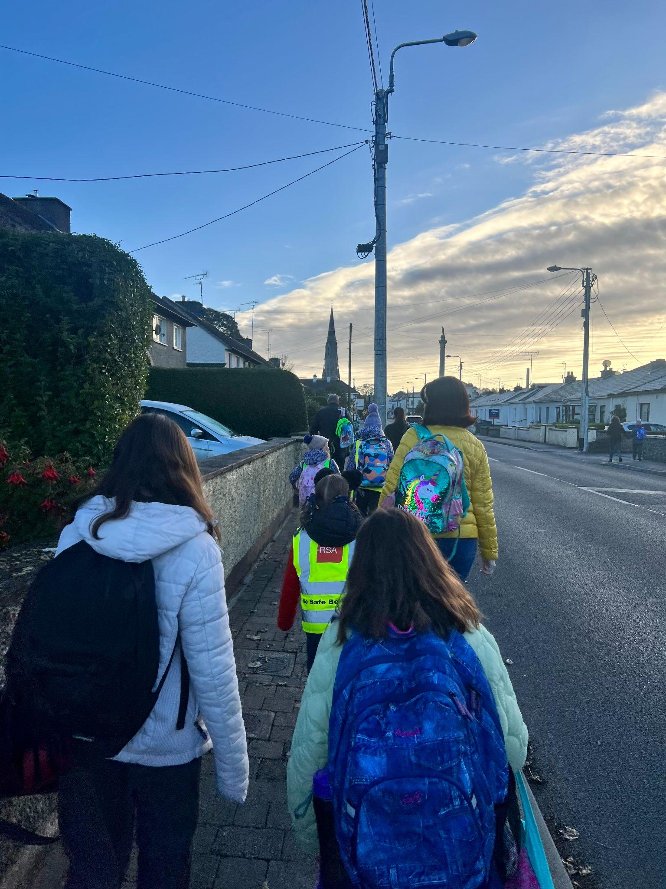
Banna (School Band): Tuesdays Rehearsal for 3rd - 6th Class 2:50 - 3:30pm
Football: Wednesdays 2.50 - 3.50 for 4th - 6th Class
Camogie: Date TBC – will start next week
Rounders: FINISHED FOR THE YEAR
Confirmation: Friday Jan 26th @ 2pm
Communion: Saturday 11th May @ 2pm
Nathanna na Seachtaine: Tá sé fuar/Tá sé gaofar (It is cold/It is windy)
Seanfhocal na Míosa: Is glas iad na cnoic i bhfad uainn! (Far away hills are green)
November Green News
Even though the weather is getting cooler, WOW continues this Wednesday. Meet at Gullivers at 8:50am Thank you Mr Carmody and Ms Mallon who keep this initiative. Any parents who would like to park and walk up with the St Mary’s group are welcome to do so. The children are fresher as they start the school day after their little walk up to school and the traffic is lighter around the school drop off area.
The Walking Bus has been going really well from the Gallops! Well done all. Perhaps this week if the weather allows, the ‘Bus’ will depart from the car park up on the Athboy Road. Any volunteers who are available, please let the school know asap.
Mr Hegarty the Travel Officer will take the Green Flag committee for a Travel audit and a walkability survey. He will conduct other workshops during the term. We are very fortunate to have the support of an Taisce as we carry out our Green Flag initiatives.
Recycling continues at St Mary’s. We accept small plastic bottles, batteries, cardboard, toilet rolls and postage stamps. Lots of charities benefit from our recycling.
GREEN
NEWS
Remember green is cool at home and at school!

Slide 6
Our Green Flag theme is Global Citizenship - Travel. This is National Walk to school week. Of course our Walking on Wednesday, WOW will go ahead on Wednesday but we are asking that everyone try to walk to school even more this week. Let’s walk, cycle and scoot more to reduce carbon emissions and keep our air clean.
Unfortunately the weather has made it challenging to get our WOW and COW campaigns started. WOW will resume on Wednesday if it is dry. Meet up at Gullivers at 8:50 am. We will also resume On Foot Friday on Friday (Walking to school from Gullivers down at the castle car park).
Walking is such a mindful activity. We miss so much when we are travelling in a vehicle. As we walk to school this week let us take note of all we see, hear and smell along the way. Autumn offers many lovely sights.
Next week we will concentrate on Cycling. We have a lovely new Bike shed so let’s put it to good use when the weather picks up and it is safer to cycle.
WOW

Slide 7
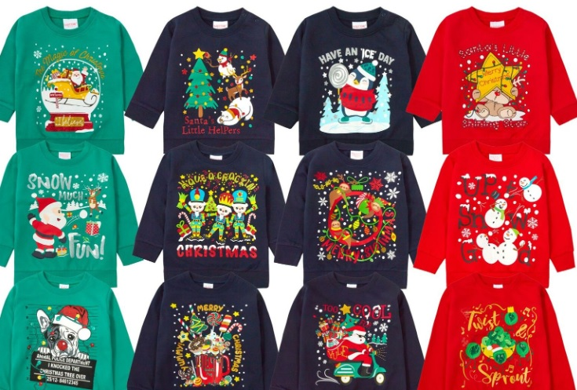
Christmas Cards 2023 has now been sent to the printers.
HALL0WEEN
A big ‘Thank You’ to our lovely helpers, handy bakers and supporters. We had a great time during the bun sale and we hope you did too.
We hope you all had a great Mid-term Break and a Spooktacular-fun Halloween.
We are all so excited for the new school term. We hope you are too!
CHRISTMAS JUMPER SALE
We are looking forward to collecting all of your pre-loved Christmas wear.
You are welcome to leave it in the office, and we will collect it from there.
We hope to have our sale at the end of November.
We will keep you posted!
Thank you for all your support
Many thanks,
Adri O’Dea
Chairperson
E. pa@stmarystrim.ie
Parents Association
Facebook Page

Slide 8
