Slide 1
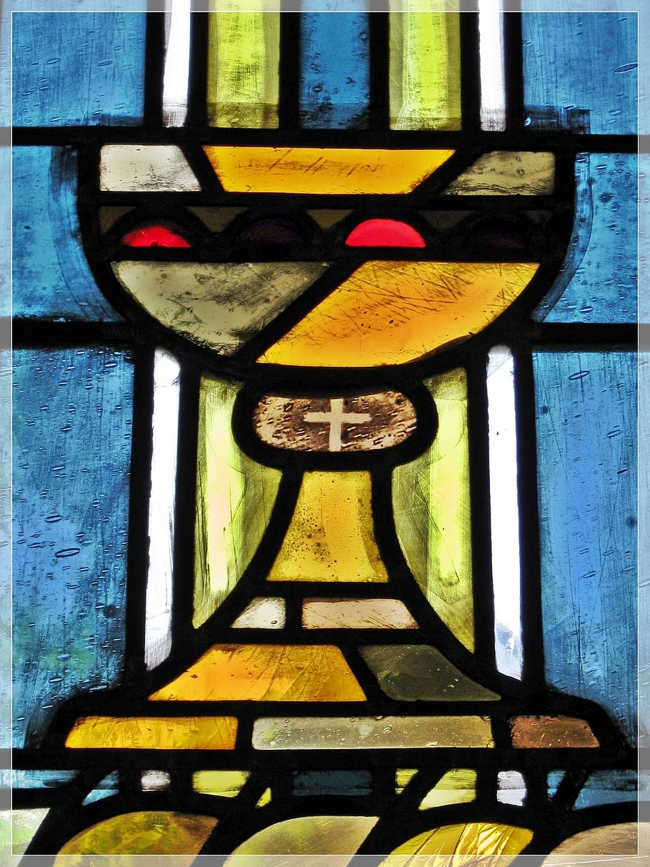
Imlitir 11
13th November 2023
Fergal Kelly M.Ed
Dear Parents/Guardians,
As I start my second week as principal in St Mary’s, I would like to thank you all for the warm welcome I have received from the school community. It is a privilege to have been appointed principal to such a wonderful school. It will take some time of course to get used to the routines and workings of the school but I am sure it will become second nature before too long. Already it is apparent that the children love coming to school here and I look forward to getting to know them and working with you all in partnership over the next number of years. With a dedicated staff and resources that are second to none, we are indeed representative of all that is good in our education system. I look forward to meeting you at various events and occasions over the next few weeks and months.
Fergal Kelly
Principal
ACTIVE DAILY CHALLENGE
Today we begin a new daily Active Challenge in our school. Dare to Believe and the Active School Flag Programme are using the Olympic Movement Breaks to encourage schools to take part in a four-week ‘Active Break Every Day’ challenge (that will run from November 13th-December 8th). Regular movement for children brings many benefits to the teaching and learning process. We will follow these high-performance athletes, completing daily short movement breaks in the classroom. It is a great way for young people to see some of the athletes who will represent Ireland in the 2024 Paris Olympic Games next summer. - Mrs O’Brien
CONFIRMATION MESSAGE
For 6th Class Parents
A meeting for all 6th class parents of children who wish to make their Confirmation next year will take place in Trim Parish Church this evening, Monday 13 November at 6pm. Confirmation will take place on Friday 26 January and this meeting will help us with some final preparations for the occasion.
COMMUNION MESSAGE
For 2nd Class Parents
A meeting for all parents of children in second class who wish to make their First Holy Communion next year will take place in Trim parish church on Monday 20 November at 6pm (for St Marys and Gaelscoil) and at 7pm (for St Michaels and Boardsmill). This meeting will help us to start making some preparations for the occasion.
DT News:
This week 6th classes will continue to work on their websites using HTML. I cannot reiterate how proud I am of them as this is not easy to do on the Chromeboxes. Watch this space for the link to the websites in a few weeks time. I am currently working on ‘listening skills’ with most of the classes - they are given instructions to follow and research to do on the internet.
Debby Walsh

Slide 2
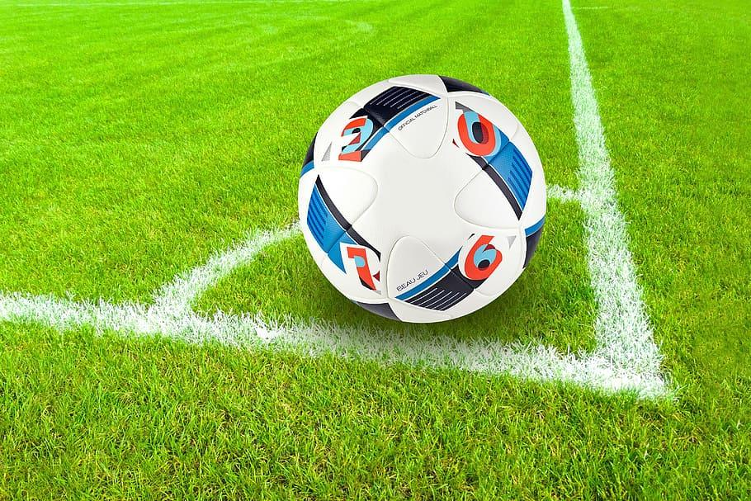
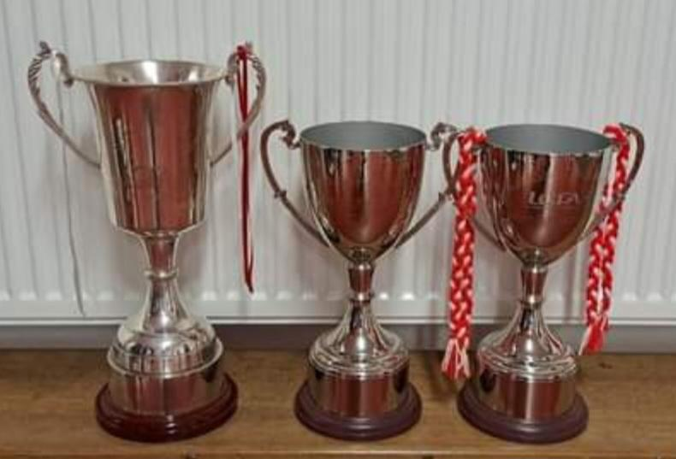
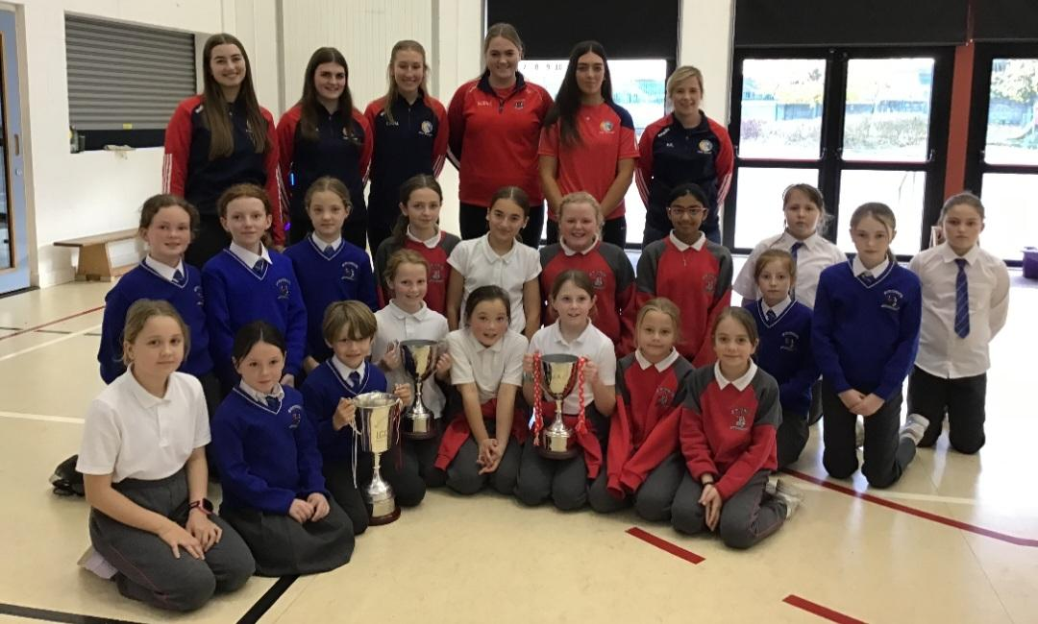
SCIENCE WEEK
SPORTS
NEWS
This week is Science Week. There are many events organised regionally. Check out the following link for details: https://www.sfi.ie/engagement/science-week/
As well as Science sessions in Trim Library they are offering the following online events throughout the week.
Videos are scheduled to be premiered on our social media accounts and YouTube channel at 10am, Monday - Saturday inclusive.
These videos can also be viewed by clicking onto Meath Libraries Facebook page or visiting the Meath library YouTube page: https://www.youtube.com/@meathcountylibrary1602
The girls football team narrowly missed out to a strong St Paul’s Ratoath team last Thursday in the Cumann na mBunscoil Division 1 Semi Final.
It was an enthralling encounter, played in St Paul’s Navan, in horrendous conditions. The girls trailed by by 16 points at one stage, but clawed their way back to 2 points, narrowly missing out on a place in the final.
The girls won their group, going unbeaten, winning 5 out of 5 matches- something the school has never done before!!
The girls football will take a break for the winter, but many of them will be in action again in 2024 for the mini 7s, and before that, they will attempt to perform to as high a standard in the camogie.
We have no doubt they will do the school proud again! Well done girls what a fantastic year!
The players from the intermediate camogie team visited our school last Friday. They recently won the Meath intermediate county final beating a very strong Navan O'Mahony's team. This win means they are now promoted to a senior camogie club which is a huge achievement for these young players and for the club overall.
We are extremely proud of this young team many of whom are past pupils of St. Mary's. They are fantastic role models for the children in our school.
PLEASE NOTE:
Flu Vaccination which was scheduled for today 13th November was cancelled due to weather. New dates to be determined.

Slide 3
PARENT TEACHER MEETINGS
CREDIT UNION MONEY CLUB
Parent Teacher Meetings take place this Tuesday and Thursday. Please be mindful that our aim is always to promote respectful, dignified dialogue and communication between staff and parents/guardians. Please note, that to be fair to all, meetings need to finish at the prescribed time. If further discussion is required, a separate meeting can be arranged. Meetings may not be recorded and you are asked to switch off or mute your phone. Thank you. We hope that it will be a positive and productive meeting for all.
We have some excellent news to share. Our School's Money Club has just received an All Ireland Credit Union Award for Best Social Impact Award. A massive "Thank You" to all parents and teachers involved.
Please note that the next Money Club date will be tomorrow, Tuesday the 14th of November @ 12.15am .
To know more about the Money Club
membership, please call into Trim
Credit Union branch.
Christmas Annuals 2023
Súgradh, Spraoi, Siamsa and Sonas Christmas Annuals: Orders for the Christmas Annuals this year will be online. We are sending the link today. The cost of the Annual is €4.50. All orders must be placed by Friday 24th November. Annuals will be given out on Thursday 30th November.
Rainbows provides peer group support for children experiencing grief and loss as a result of bereavement or parental separation. Rainbows is a listening service only. Rainbows is not a counselling service. Attending the nine week programme provides children with an opportunity to meet with other children of a similar age and loss experience. If we have sufficient numbers, the weekly programme will begin in November. It takes place after school from 2.50pm -3.45pm for nine weeks with two trained staff members who facilitate the sessions. Participants must be in 1st – 6 th class and min. age 7 years. (There are no rainbows sessions available for Junior and Senior Infants at the present time)
Further questions or queries please contact the school co-ordinator Fiona O’Brien.
Our Annual Admittance Notice has been updated on our website. It lists the various dates associated with enrolling new pupils in our school. Please click here to download an application for enrolment form.
Completed forms together with a birth certificate can be returned to the office. For more information please phone the office at 0469431919.

Slide 4
Banna (School Band): Tuesdays Rehearsal for 3rd - 6th Class 2:50 - 3:30pm
Football: FINISHED FOR 2023. Will restart after Christmas break
Camogie: Mini 7s game this Wednesday 12nn in Dunderry
Rounders: FINISHED FOR THE YEAR
Confirmation: Friday Jan 26th @ 2pm
Communion: Saturday 11th May @ 2pm
Nathanna na Seachtaine: Tá na duilleoga ag titim ( The leaves are falling)
Seanfhocal na Míosa: Is glas iad na cnoic i bhfad uainn! (Far away hills are green)
November Green News
Our Green Flag theme is Global Citizenship - Travel.
WOW continues this Wednesday as the weather promises to be a lot calmer. Meet at Gullivers at 8:50am Thank you Mr Carmody and Ms Mallon who keep this initiative. Any parents who would like to park and walk up with the St Mary’s group are welcome to do so. The children are fresher as they start the school day after their little walk up to school and the more people who participate in WOW the less traffic around the school drop off area. Let’s walk, cycle and scoot more to reduce carbon emissions and keep our air clean.
The Walking Bus has been going really well from the Gallops! Well done all. Perhaps this week if the weather allows, the ‘Bus’ will depart from the car park up on the Athboy Road. Any volunteers who are available, please let the school know asap.
Mr Hegarty the Travel Officer will take the Green Flag committee for a Travel audit and a walkability survey. This week. He will conduct other workshops during the term. We are very fortunate to have the support of an Taisce as we carry out our Green Flag initiatives.
Recycling continues at St Mary’s. We accept small plastic bottles, batteries, cardboard, toilet rolls and postage stamps. Lots of charities benefit from our recycling.
GREEN
NEWS
Remember green is cool
at home and at school!

Slide 5
Have a look at the 17 Global goals. We really need to make progress in Ireland. This video presents them well.
https://greenschoolsireland.org/green-schools-stay-home-global-citizenship/
WOW

Slide 6
Christmas Cards 2023
If your child recently designed and returned their own unique Christmas card, they will be
bringing their free sample card home this week.
If you wish to purchase, the cards will come in packs of 12 plus envelopes.
The cost per pack of 12 cards is €10. You may purchase as many packs as you like. Once sample cards have been brought home, cards can be purchased through Aladdin and the school will send you a payment link shortly to facilitate this.
All orders must be placed on or before Friday 17th November 2023. We thank you for your support with this fundraiser!
Parents Association Meeting
We will be holding our monthly Parents Association meeting this coming Thursday 17th November at 9:30am in the school. Everyone is welcome to attend. We look forward to seeing you there.
Many thanks,
Adri O’Dea
Chairperson
Christmas Clothing Event
We are going to REDUCE, REUSE AND UPCYCLE our Christmas clothing this year!
Please donate your unwanted Christmas jumpers and festive wear to support our event.
You can leave all your items in the office and we will collect them there.
Looking forward to receiving all your pre-loved Christmas clothing!
Parents Association
Facebook Page

