Slide 1
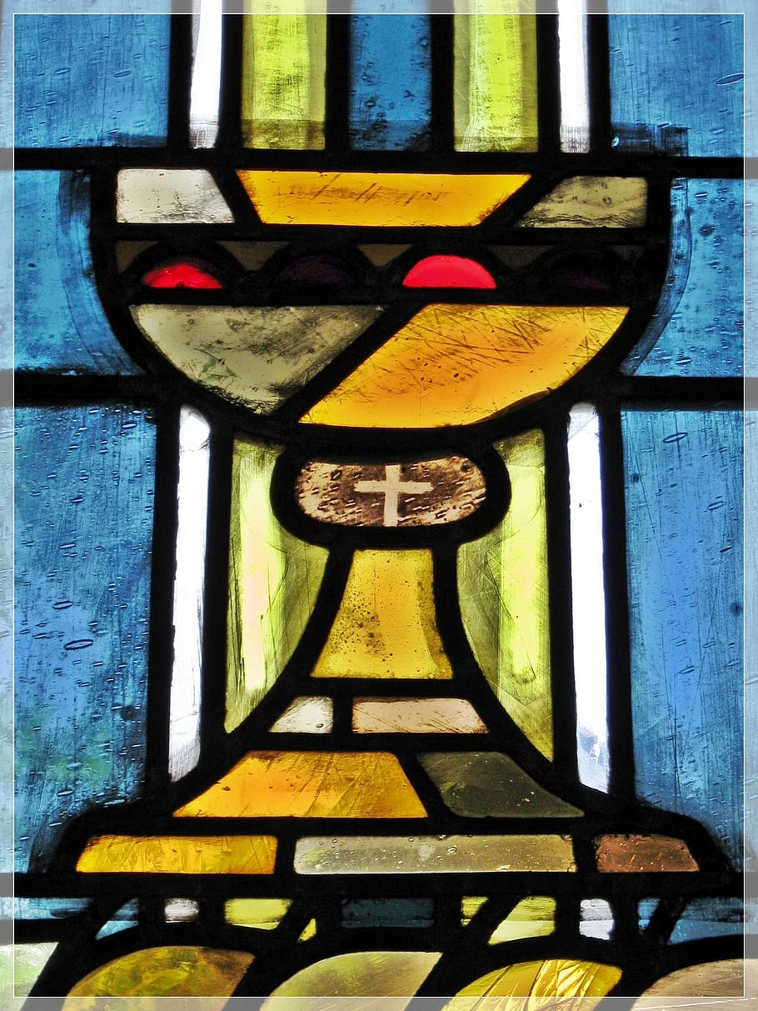
Imlitir 12
27th November 2023
Fergal Kelly M.Ed
Dear Parents/Guardians,
It certainly has been a very busy month for the school with Parent teacher meetings, assemblies, sporting events, book fairs and environmental activities all taking centre-stage over the past few weeks. Our athletics team takes pride of place with a magnificent 2nd place last week in what was a hugely competitive event for all the primary schools in Meath. A great achievement!
It was also nice to meet some of you as you visited the school for the parent teacher meetings this month. This feedback from the staff is very important at this time of year.
We are now looking forward to our Christmas Activities and school is always a very exciting place during this festive period. We will send out further details later. Our events start next Monday, 4th December when our hard working parents association will have a sale of Christmas wear. So if you have any Christmas jumpers or suchlike that are now out of circulation please hand these into the school.
We anticipate a very busy but productive month!
Kind regards
Fergal Kelly
Principal
COMMUNION MESSAGE
For 2nd Class Parents
Congratulations to the girls from 2nd class who participated in the Do This In Memory Mass yesterday. They represented the school very well. A huge thank you to all parent volunteers who were there to help and encourage the girls. We will be thinking of them over the next few months as they prepare for their First Penance and First Holy Communion.
Our Annual Admittance Notice has been updated on our website. It lists the various dates associated with enrolling new pupils in our school. Please click here to download an application for enrolment form.
Completed forms together with a birth certificate can be returned to the office. For more information please phone the office at 0469431919.

Slide 2
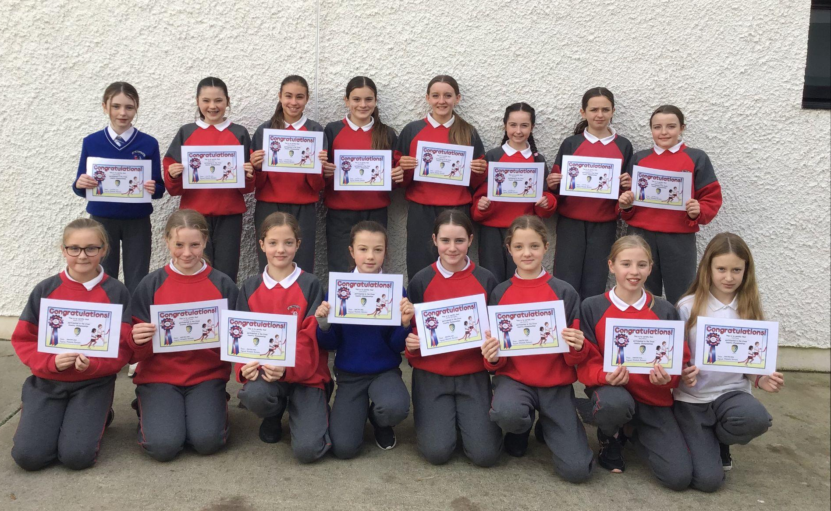
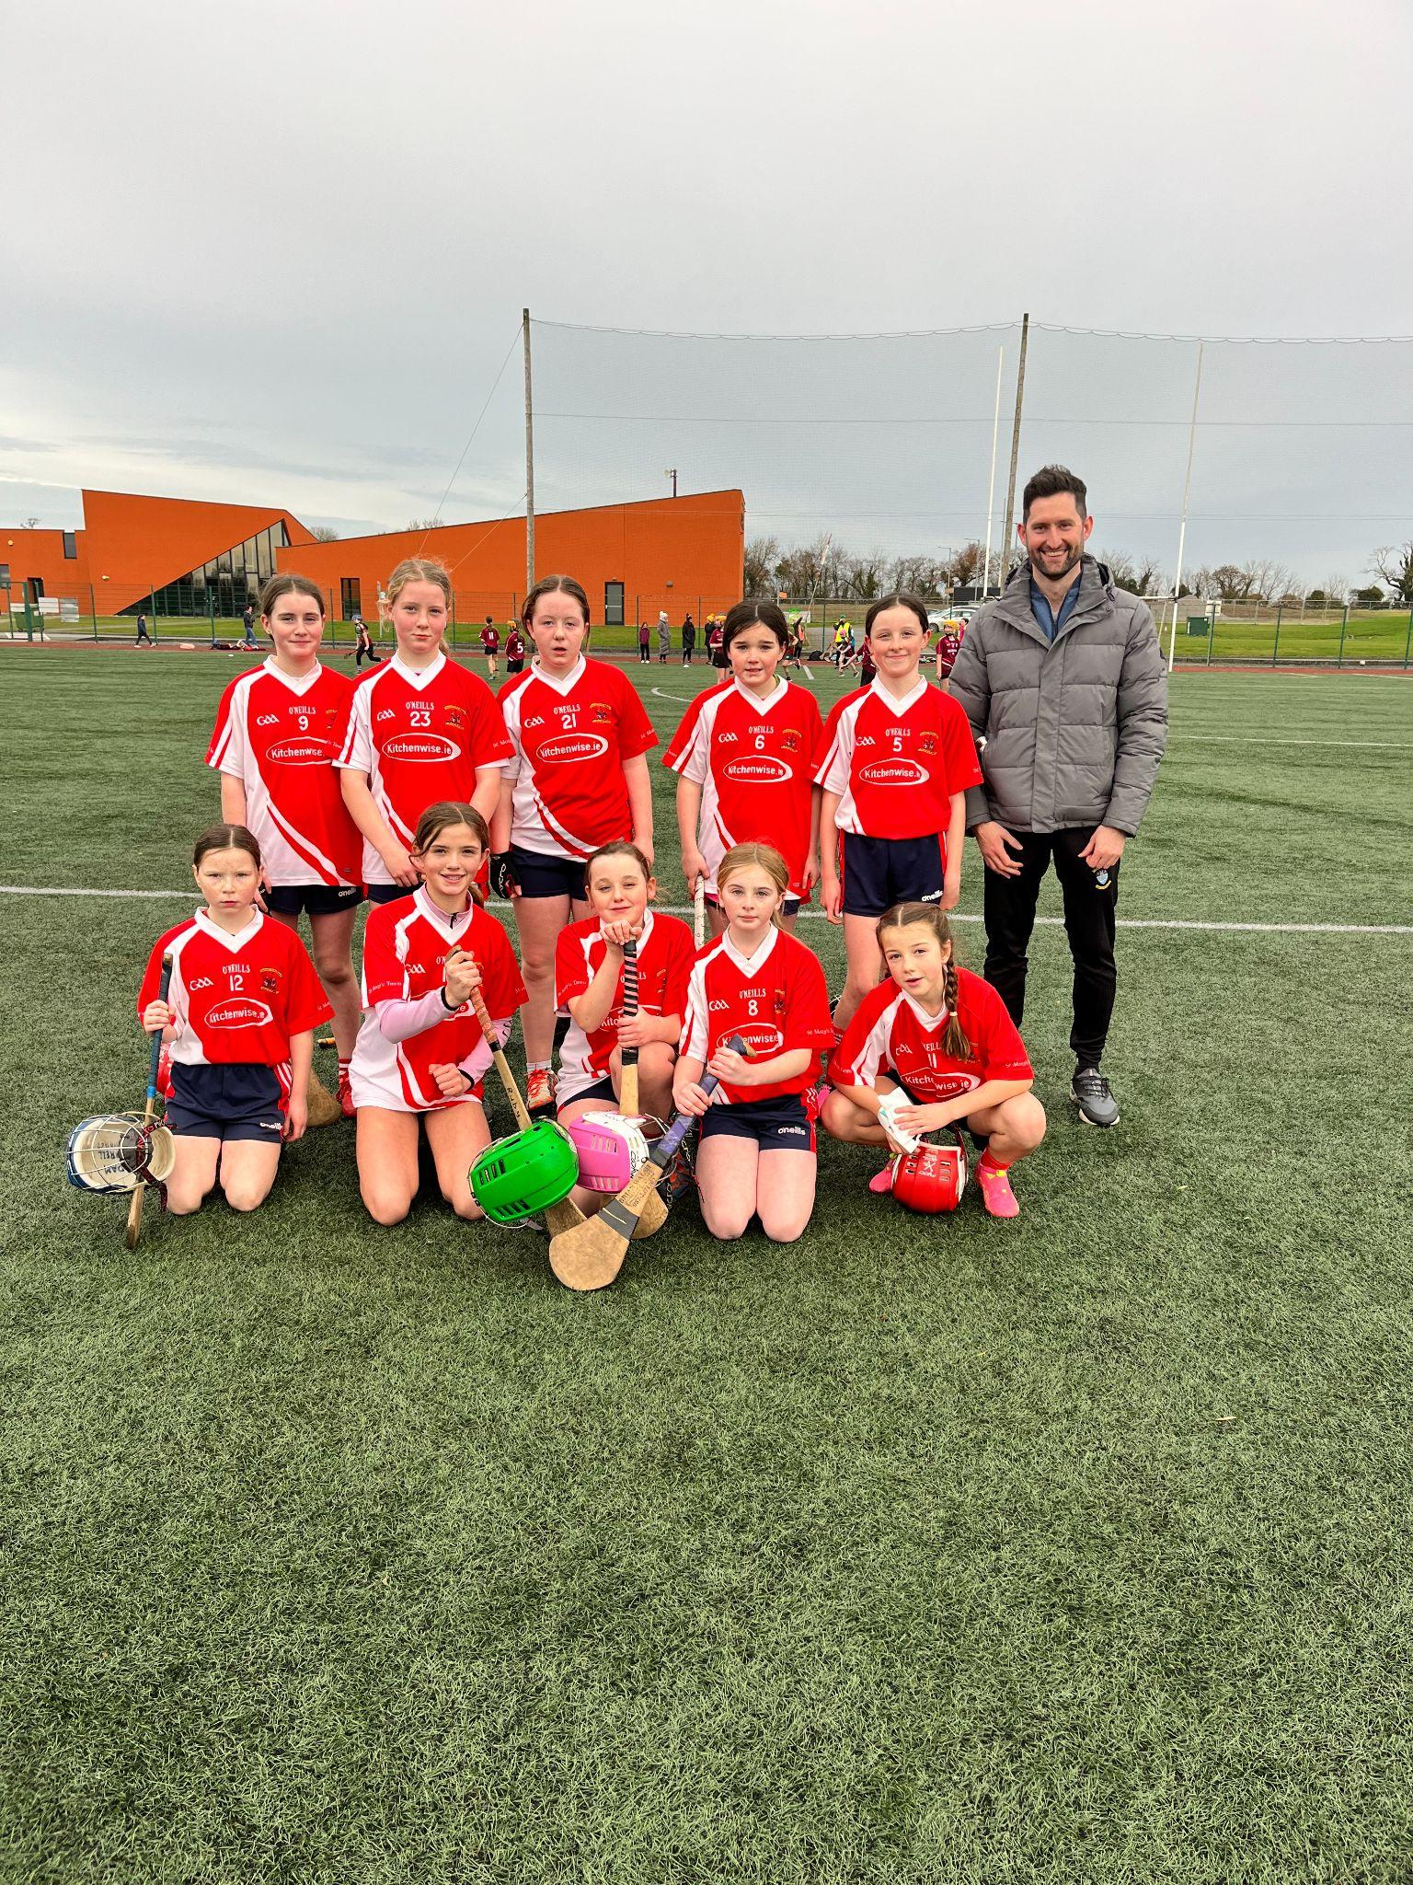
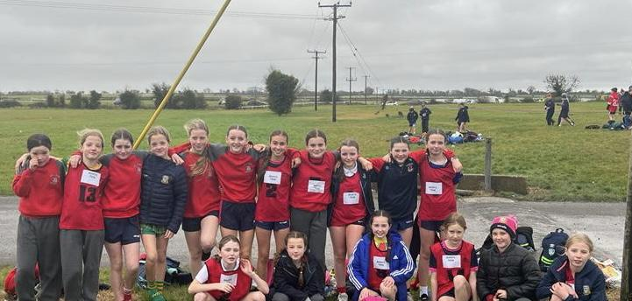
ACTIVE NEWS
SPORTS
NEWS
CROSS COUNTRY
A huge congratulations to our Cross Country Teams (U11 and U13) who competed in Fairyhouse last Wednesday 22nd November 2023.
The U11 team came in 2nd place which is a huge achievement. There were over 2000 children competing there on the day - Well done to all who took part. Maith sibh!
CAMOGIE
Our camogie team took part in the mini 7's competition recently. In the first round we had wins over Cannistown, Rath Cairn and Boyerstown. After topping the group we moved onto the regional knockouts in Dunganny. Unfortunately Baconstown and Kiltale proved too strong for us on the day. After two narrow defeats we were knocked out. Our girls can be very proud of their performances, they displayed all the skills of camogie. We look forward to seeing them representing the school again in Spring.
December 12 will be next Money Savings Club session. The Credit Union will be coming to our school

Slide 3
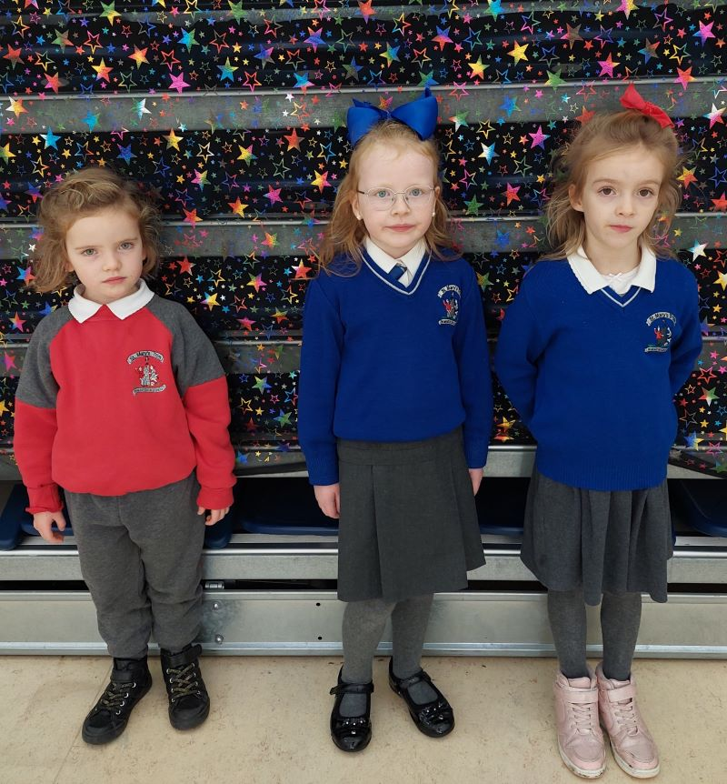
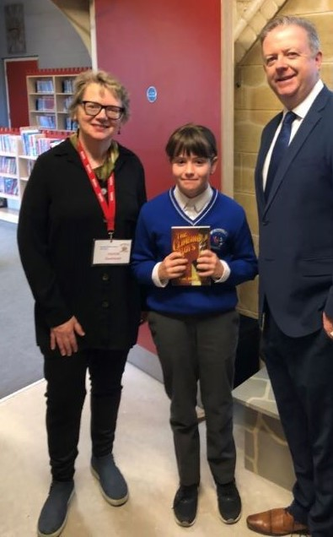
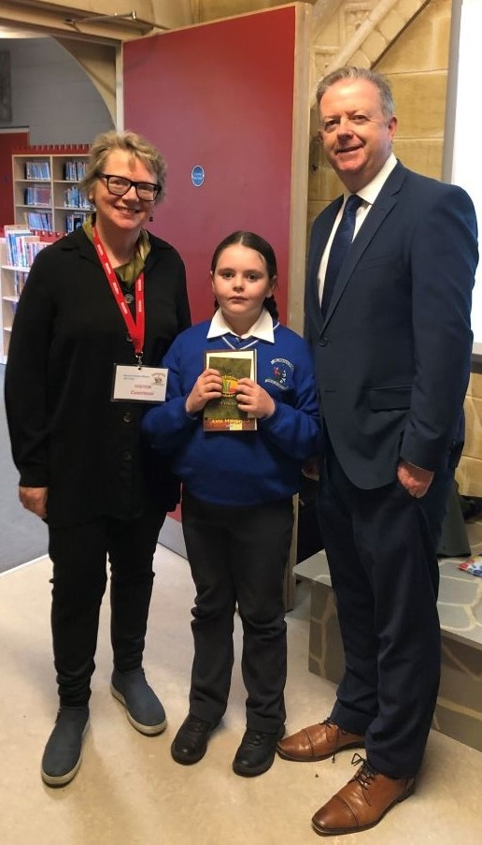
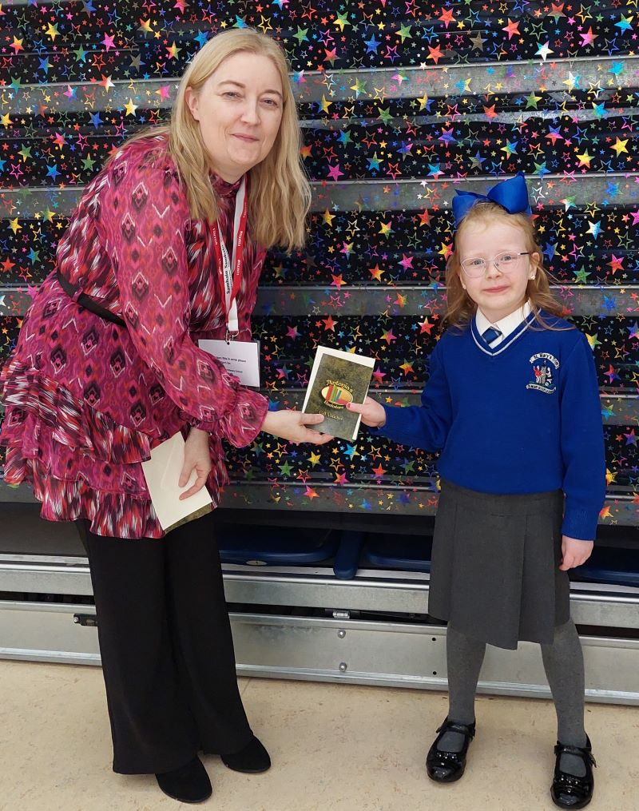
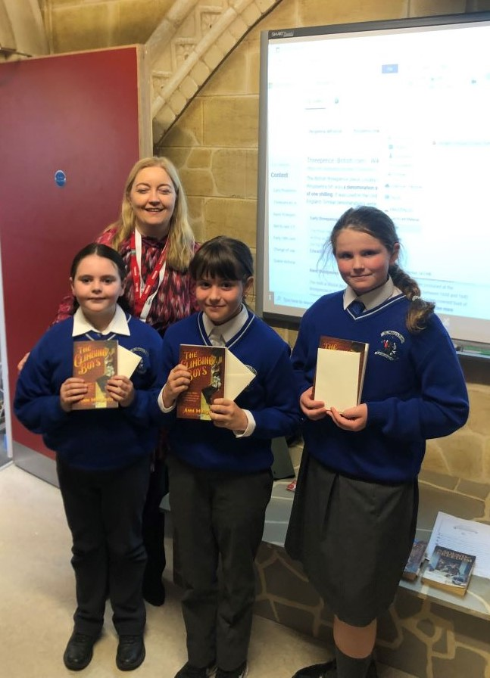
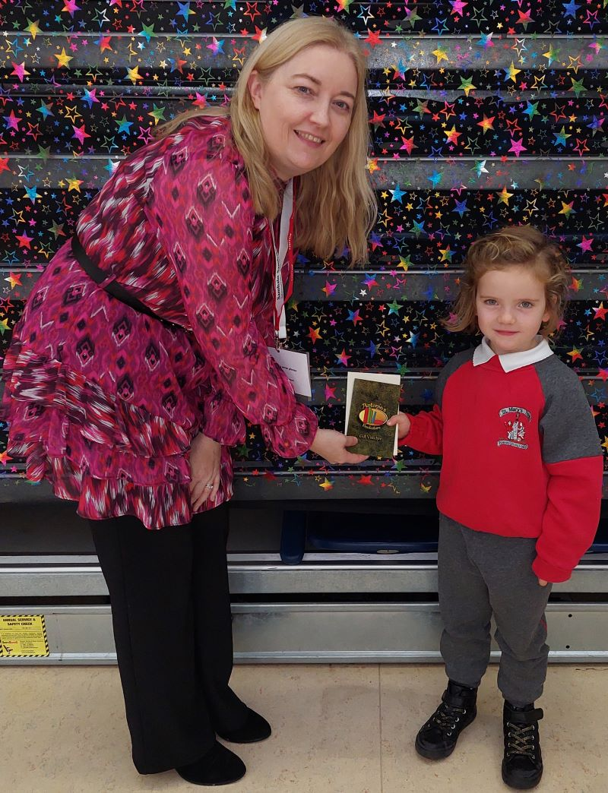
BOOK FAIR COMPETITION
Many thanks for supporting our School Book Fair earlier this month. Thanks also to all the children who participated in our competitions and to Antonia for providing the prizes.
Congratulations to Mia (Room 10), Mollie (Room 5), and Holly in (Room 3) for winning prizes in the Colouring Competition.
Well done to Leah, Maeve and Alexandra (Room 35) for receiving prizes for their entries in the Poetry Competition.
The pupils in Room 35 also had a visit from, Ann Murtagh, author of the book ‘The Climbing Boys’, as their overall class prize.
Mary O’Hare - Book Fair Coordinator

Slide 4
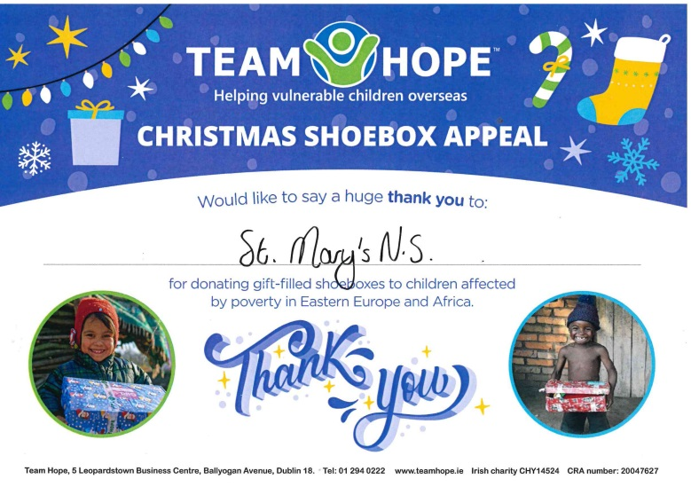
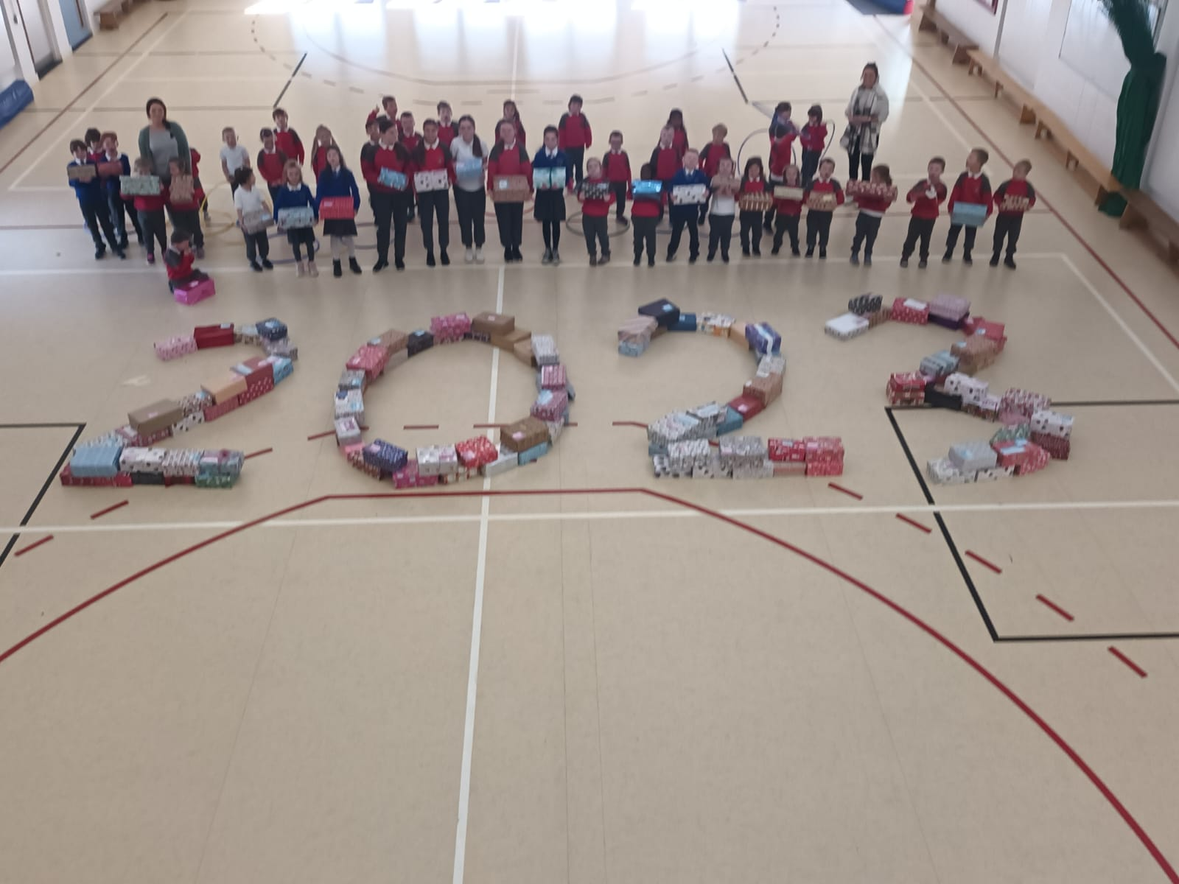
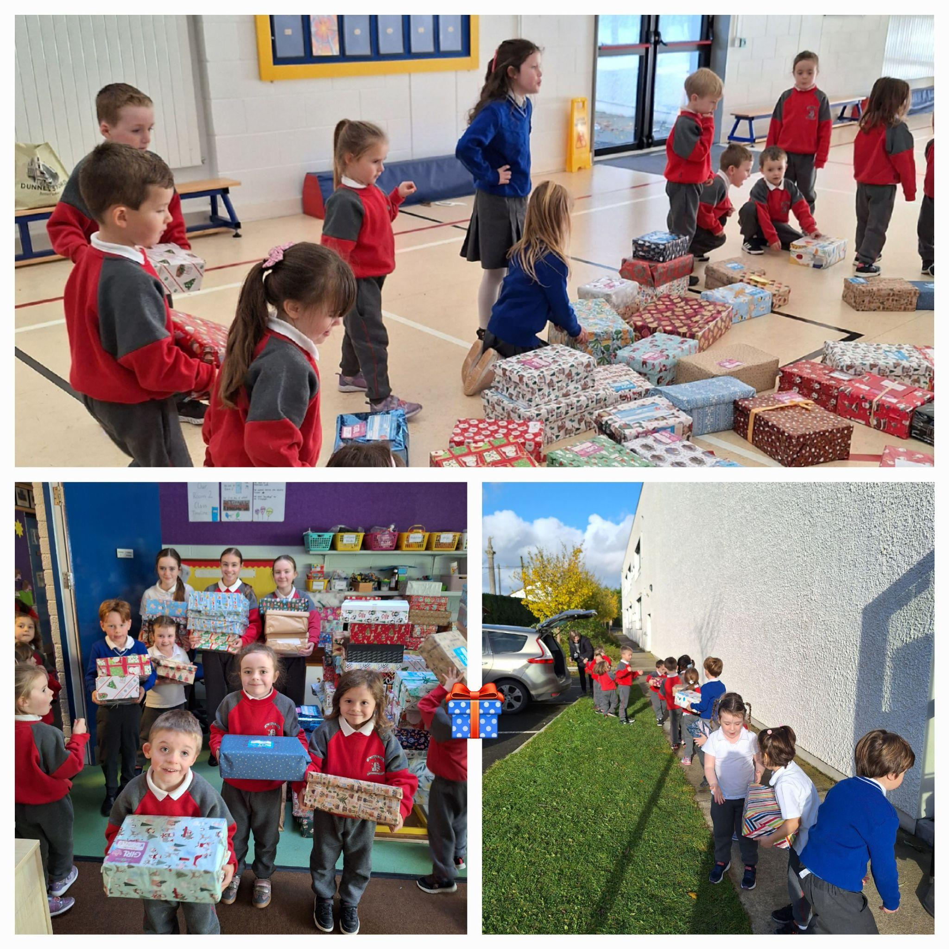
Christmas Annuals 2023
LAST DAY TO ORDER
Súgradh, Spraoi, Siamsa and Sonas Christmas Annuals: Orders for the Christmas Annuals this year will be online. The cost of the Annual is €4.50. Today is the last day to order. Annuals will be given out on Thursday 30th November.
Míle Buíochas to everyone from St Mary's, Trim who carefully wrapped and packed up a beautiful Christmas shoebox this year. We had brilliant response to the Christmas Shoebox Appeal in St Mary's and there will be 144 very happy, smiling faces this year because of you and your kindness. This wonderful annual initiative is always well supported in our St Mary's school community and highlights the generosity of our parents, pupils and staff! Ní neart go cur le chéile! Thank you, Ms Dalton
Watch the excitement as the kids open their shoebox! Click on the link below.
https://www.tiktok.com/@santa.shoebox/video/7300103397615750405?_t=8hMg3wA6EzQ&_r=1

Slide 5
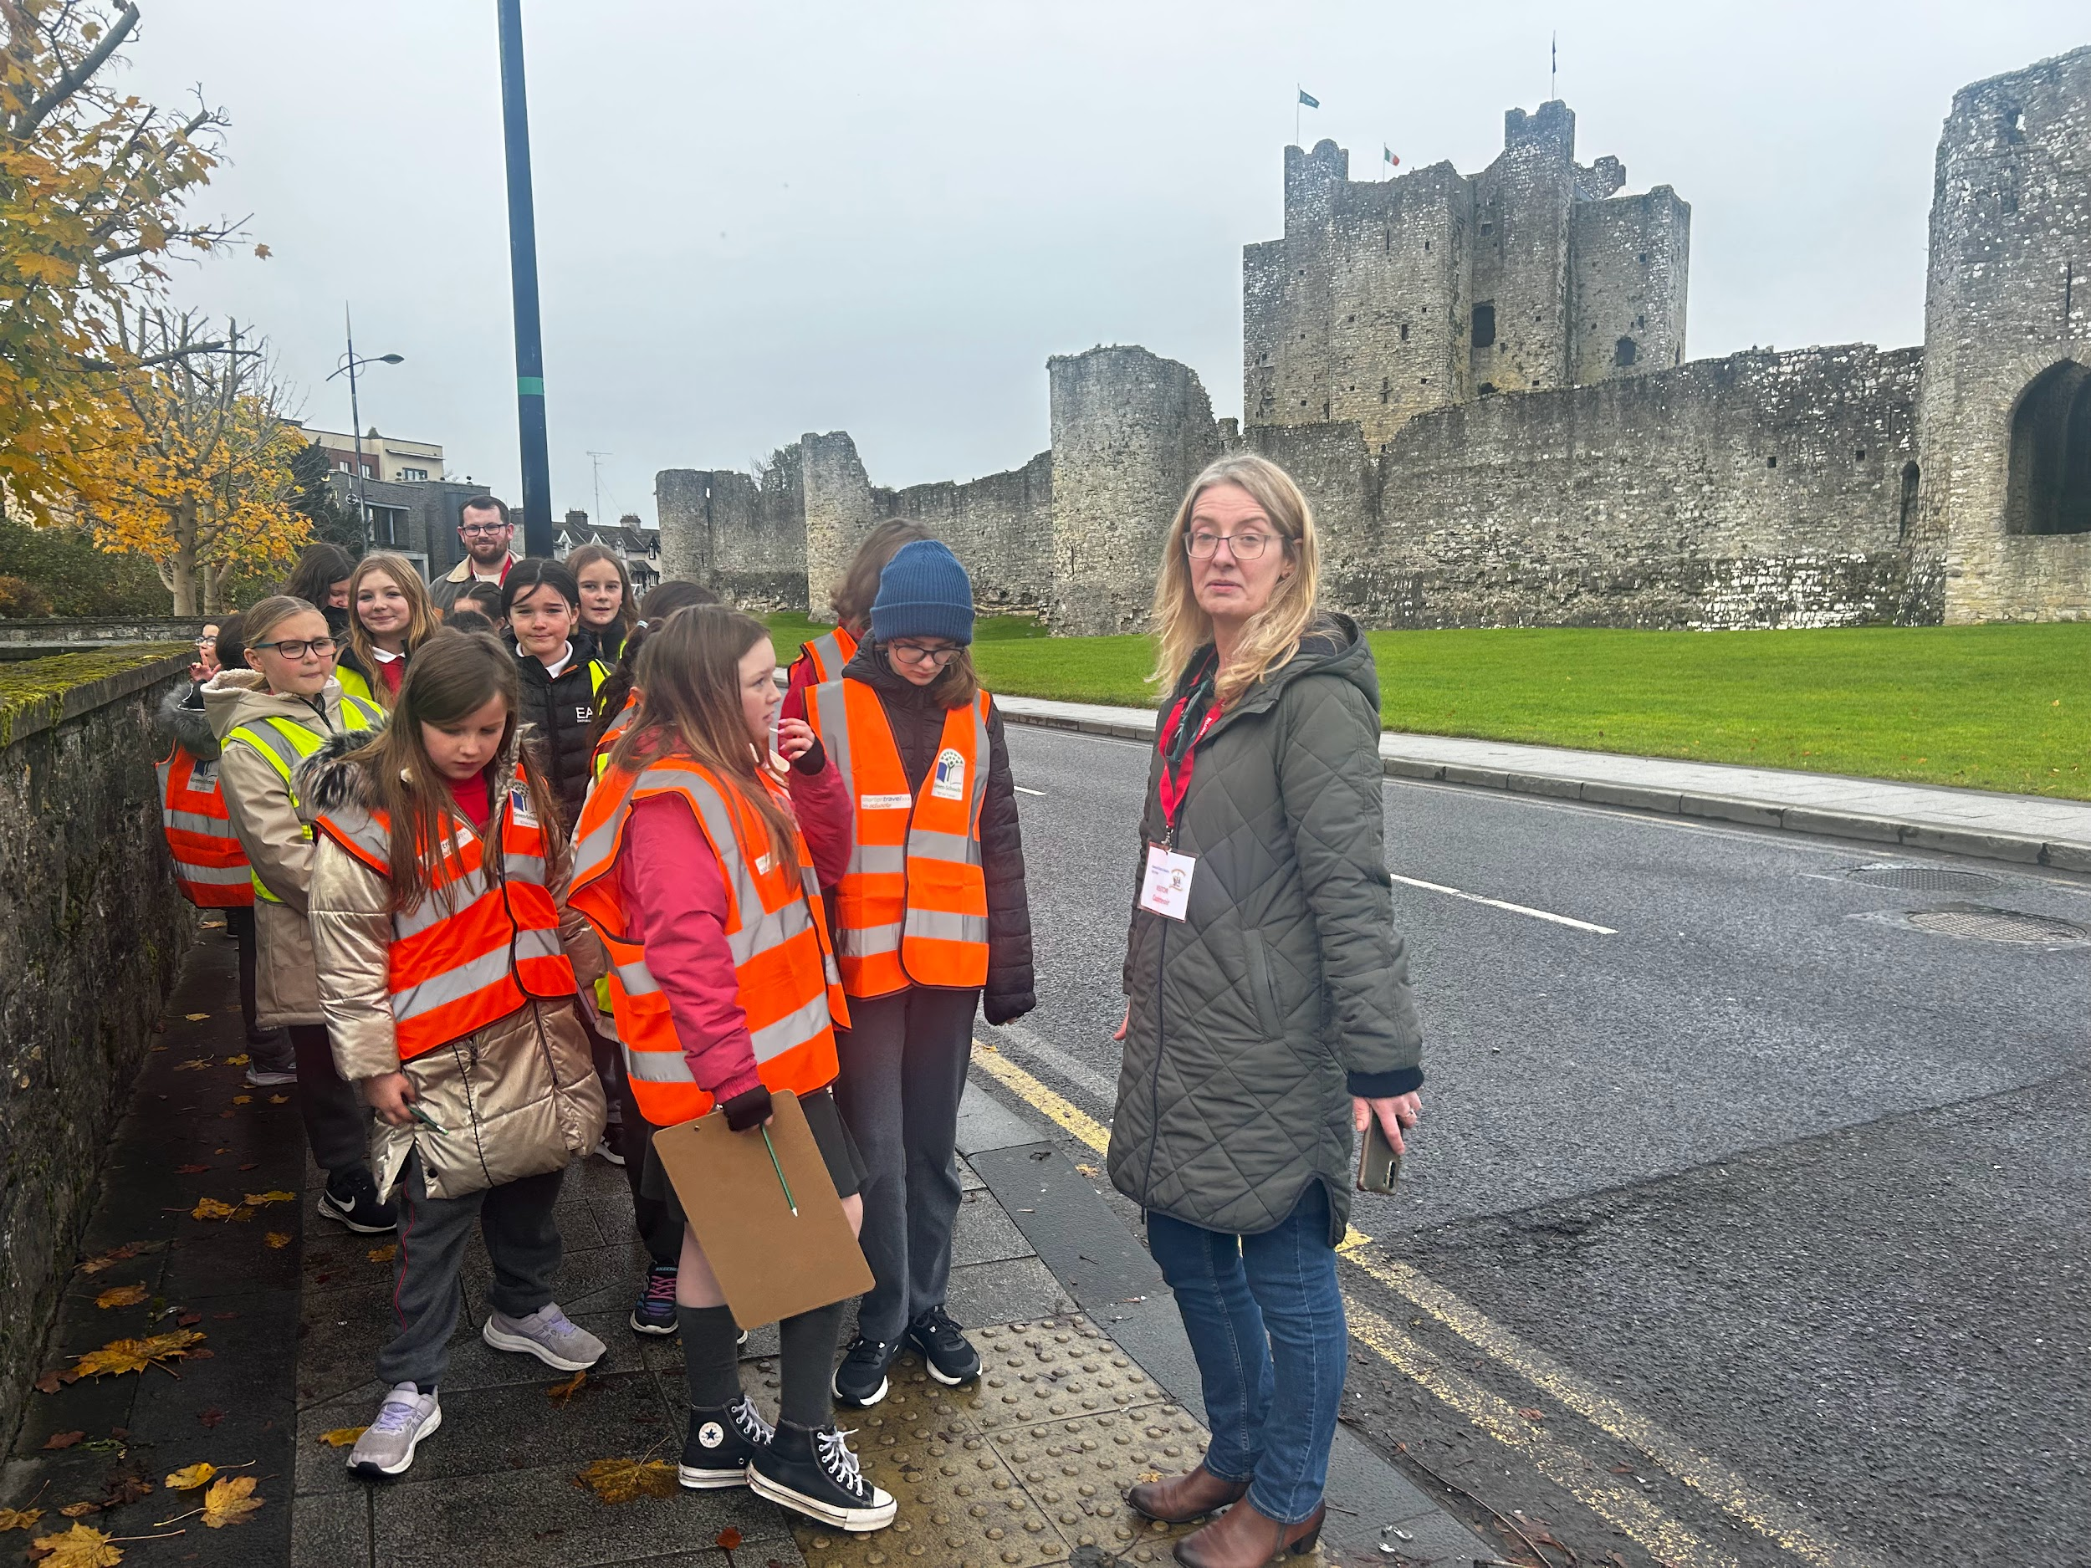
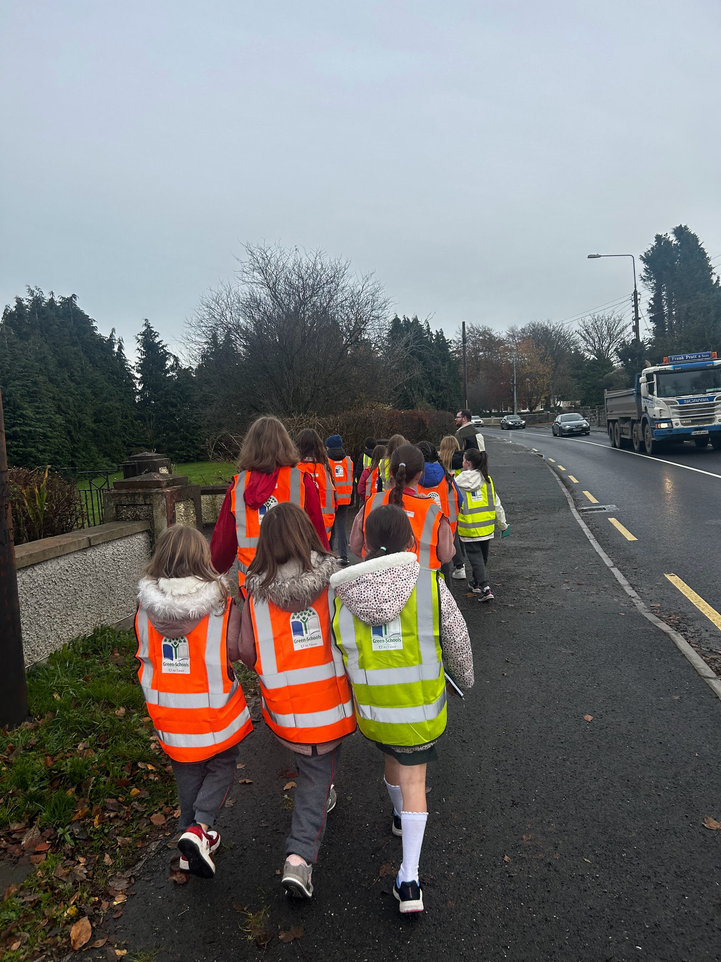
Banna (School Band): Tuesdays Rehearsal for 3rd - 6th Class 2:50 - 3:30pm
Football: FINISHED FOR 2023. Will restart after Christmas break
Camogie: Training today 3:00-4:00 after school for the next two weeks
Rounders: FINISHED FOR THE YEAR
Confirmation: Friday Jan 26th @ 2pm
Communion: Saturday 11th May @ 2pm
Nathanna na Seachtaine: An bhfuil cead agam dul go dtí an leithreas? Can I go to the bathroom
Seanfhocal na Míosa: Is glas iad na cnoic i bhfad uainn! (Far away hills are green)
November Green News
Our Green Flag theme is Global Citizenship - Travel.
Two weeks ago, Ciara and Thomas from An Taisce came to Trim to carry out a walkability Survey with the pupils on the Green Flag committee. We walked along a few approach routes to Trim observing the signage and road markings in place to make it safer for walkers. The committee will write up a report and make requests for improvements.
We are very fortunate to have the support of an Taisce as we carry out our Green Flag initiatives.
GREEN
NEWS
Remember green is cool
at home and at school!

Slide 6
Cleaner Air week
Last week is National Clean Air week. We asked all Parents and Guardians to make a conscious effort to switch off their engines when they are waiting in the car park instead of leaving their cars idiling. We will be requesting that the buses follow suit. Idling increases the amount of exhaust fumes in the air. These fumes contain a number of harmful gasses including carbon dioxide, which is bad for the environment and contributes towards climate change, as well as a range of other harmful gasses including nitrogen dioxide, carbon monoxide and hydrocarbons which are linked to asthma and other lung diseases. An idling engine can produce up to twice as many exhaust emissions as an engine in motion and international studies have found that idling for over ten seconds uses more fuel and produces more carbon dioxide than restarting your engine.
WOW continues this Wednesday. Meet at Gullivers at 8:50am Thank you Mr Carmody and Ms Mallon who keep this initiative. Any parents who would like to park and walk up with the St Mary’s group are welcome to do so. The children are fresher as they start the school day after their little walk up to school and the more people who participate in WOW the less traffic around the school drop off area. Let’s walk, cycle and scoot more to reduce carbon emissions and keep our air clean.
The Walking Bus has been going really well from the Gallops! Well done all. This week if the weather allows, the ‘Bus’ will depart from the car park up on the Athboy Road. (Not the Lidl car park) Any adult volunteers who are available, please let the school know. We have on e but would need a few more. The link to the form is as follows for any pupils who would like to join the ‘bus’ along the way. https://forms.gle/Zk2GxDFWVRFjBXuF9
Recycling continues at St Mary’s. We accept small plastic bottles, batteries, cardboard, toilet rolls and postage stamps. Lots of charities benefit from our recycling.
WOW
Have a look at the 17 Global goals. We really need to make progress in Ireland. This video presents them well.
https://greenschoolsireland.org/green-schools-stay-home-global-citizenship/

Slide 7
CHRISTMAS JUMPER SALE
It is nearly time for our Christmas Jumper Sale!
We will see you next Monday 4th December from 8:50 am in the school hall.
We will be collecting more Festive wear through this week, so please support us and donate your pre-loved items. You can leave all your items in the office and we will collect them
There. All items on sale will be free, but donations are very welcome. All proceeds will be donated to St. Vincent de Paul.
Let us REDUCE, REUSE AND UPCYCLE our Christmas jumpers this year!
Parents Association Meeting
We will be holding our monthly Parents Association meeting this coming FRIDAY 1st December at 9:30am in the school. Everyone is welcome to attend. We look forward to seeing you there.
Many thanks,
Adri O’Dea
Chairperson
Parents Association
Facebook Page
Rainbows provides peer group support for children experiencing grief and loss as a result of bereavement or parental separation. Rainbows is a listening service only. Rainbows is not a counselling service. Attending the nine week programme provides children with an opportunity to meet with other children of a similar age and loss experience. If we have sufficient numbers, the weekly programme will begin in November. It takes place after school from 2.50pm -3.45pm for nine weeks with two trained staff members who facilitate the sessions. Participants must be in 1st – 6 th class and min. age 7 years. (There are no rainbows sessions available for Junior and Senior Infants at the present time)
Further questions or queries please contact the school co-ordinator Fiona O’Brien.

