Slide 1
Imlitir 13
11th December 2023
Fergal Kelly M.Ed
Dear Parents / Guardians,
Preparations are now in full swing for our Christmas season and we are delighted that many of you will be visiting the school over the next few days for Christmas plays and activities. It is a very busy time of the year for everyone but there is nothing like being in school to get a real sense of the atmosphere of Christmas. Last Friday, Mr Carmody’s class hosted assemblies for the whole school to celebrate Advent while many other activities abound in the classrooms and corridors. Our classes have been attending events outside the school as well such as Trim Library activities and our 6th Classes visit to the Helix last week. Our parents Association have also been very active with the Christmas jumper sale and it is nice to see the various jumpers around the school. I would like to take this opportunity to wish you all a very Happy Christmas and look forward to meeting you at our festivities.
Nollaig faoi shéan agus athbhliain faoi mhaise daoibh go léir.
Kind Regards,
Fergal Kelly
Principal
Photography
With regard to taking photos at our events, we remind you that our policy is not to deny parents the opportunity to take photos of their child performing but parents/guardians are not permitted to post images of children (other than their own) on social media. Please adhere to this as we want to avoid unnecessary upset.
A note from Fr. Paul…
Blessing of the ‘baby Jesus figures’ for family cribs on Sunday 17 December
Children are invited to bring the baby Jesus figures from their crib at home to any Mass next weekend (16 – 17 December) in Trim and Boardsmill.
Fr Paul and Fr John will bless the baby Jesus figures at all Masses (Trim Saturday evening 7pm, Sunday 9am, 11am and 12.30pm and Boardsmill 10am).
This tradition is called the ‘Bambinelli Blessing’ and it asks God to bless all the children in their homes at Christmas time. All are very welcome.

Slide 2
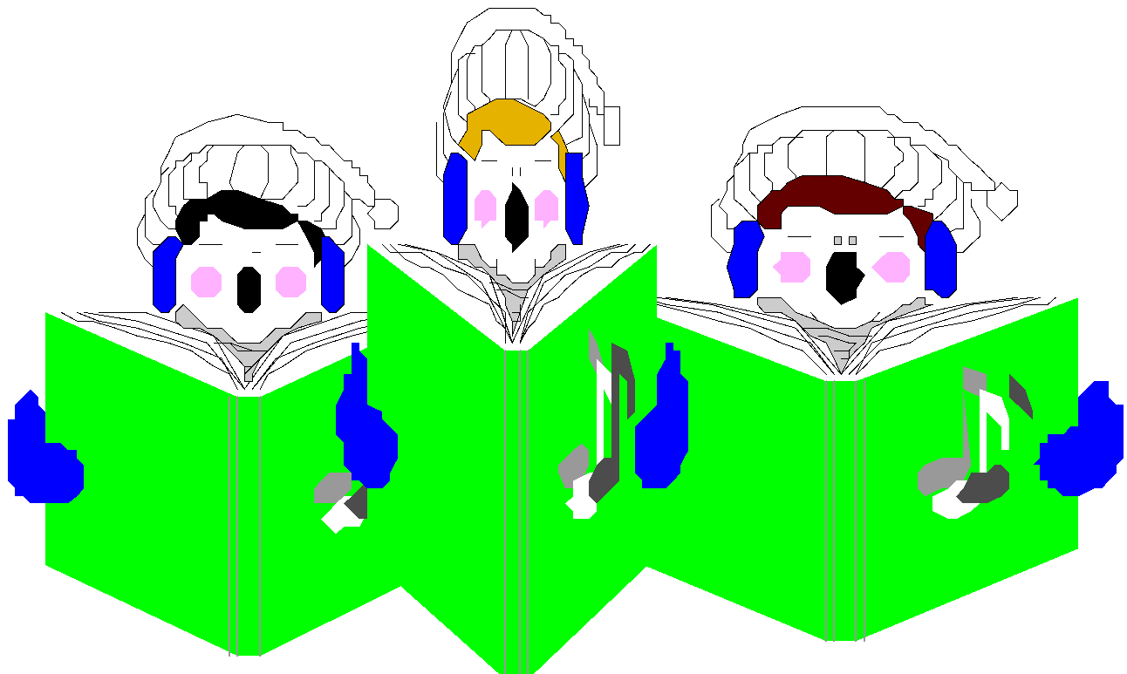
Christmas Show
The children of 3rd and 4th classes are performing on the 19th December at 7:00 pm. All tickets for this show have been SOLD OUT.
There is a MATINEE performance at 1:30pm on the 19th December and parents are also welcome to this show. Matinee tickets are now available in the office.
Tickets €4.00 per adult / €2.00 per child or €10.00 family ticket (2 adults and 2 children)
CHRISTMAS JUMPER SALE
We would like to thank you all for all your generous donations of pre-loved Christmas wear. We were delighted to have received so many lovely items.
There were a lot of very excited and eager shoppers visiting our pop-up shop and everyone had a great time! We are happy to let you know that the event raised €215 that will be donated to our local St
Vincent de Paul shop.
As always, we appreciate all your support.
We hope you all have a wonderful Christmas break and a well-deserved rest!
Adri O’Dea
Chairperson
Parents Association
Facebook Page

Slide 3
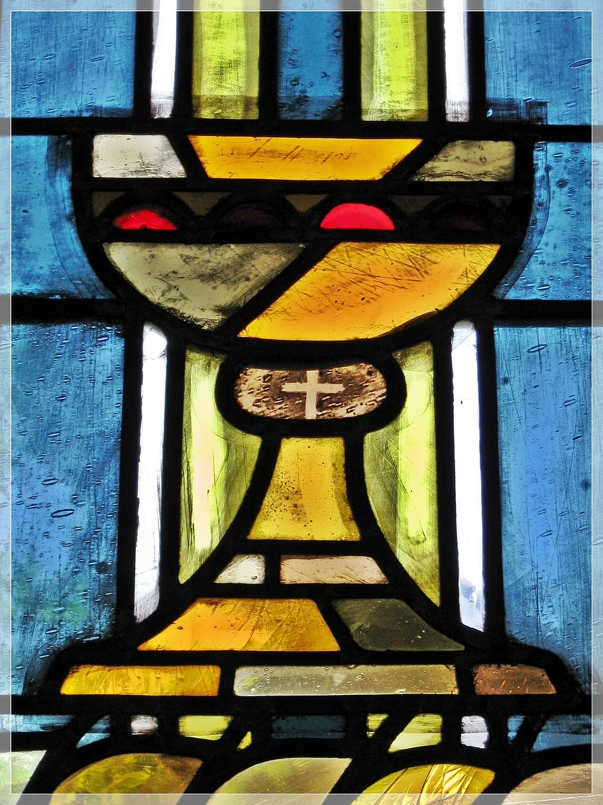
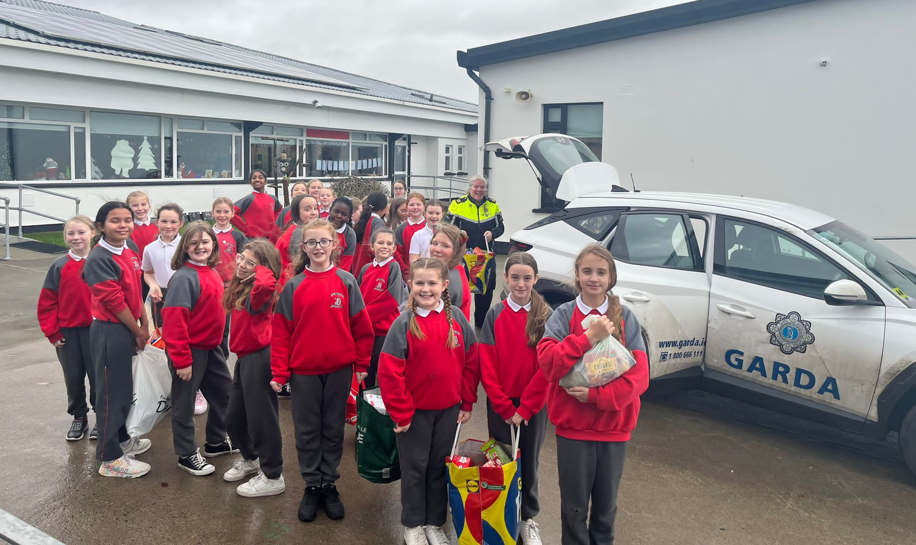
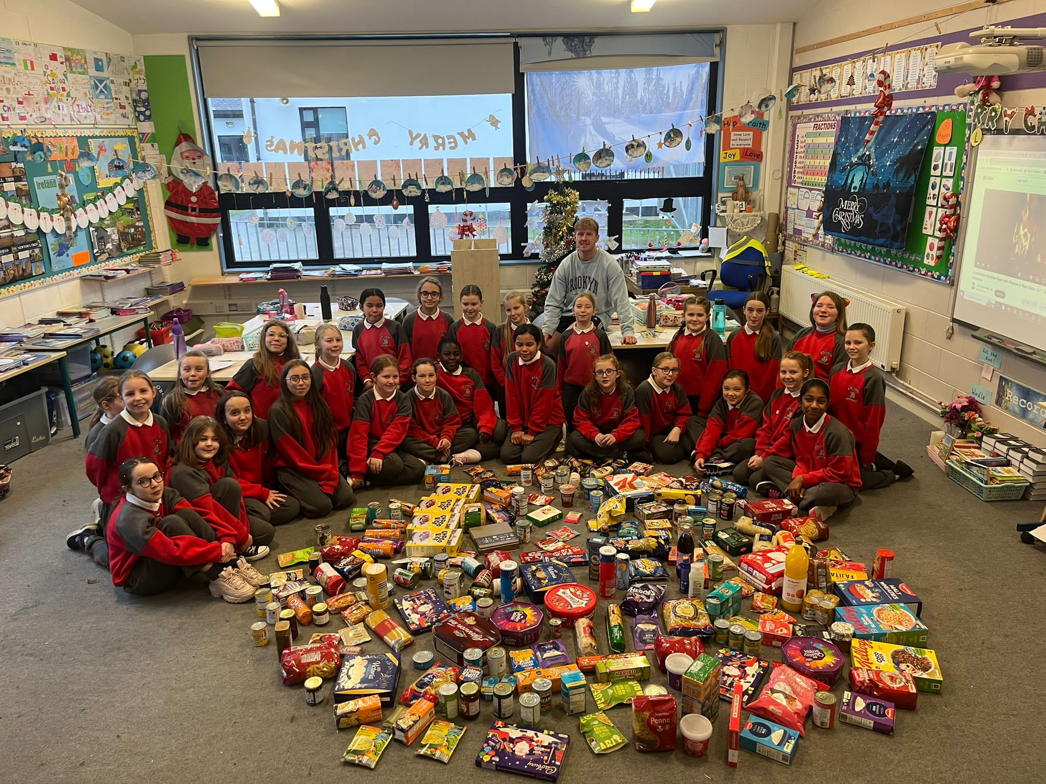
CONFIRMATION MESSAGE
For 6th Class Parents
MORE LOCAL NEWS
The next preparation for confirmation mass for 6th class is on 14th January at 12.30pm.
Thank you to our parent volunteers who were present during the last preparation mass which was held last 3rd December.
4th class students from Room 18 collected food for the local Garda station. Garda Edel will be delivering these goods to the local people in need here in Trim.
Mr. Carmody would like to thank the parents of his students for their generous donations.
Don’t forget tomorrow, December 12 will be the next Money Savings Club session. The Credit Union will be coming to our school.
DT News:
Students from some of the 1st classes have begun working on their typing skills. They are learning to log in to their Google Drive account and creating a new document for their lessons. The other 1st classes will begin this journey after Christmas.
From the Computer Room I would like to wish you all a very Happy Christmas.
Debby Walsh

Slide 4
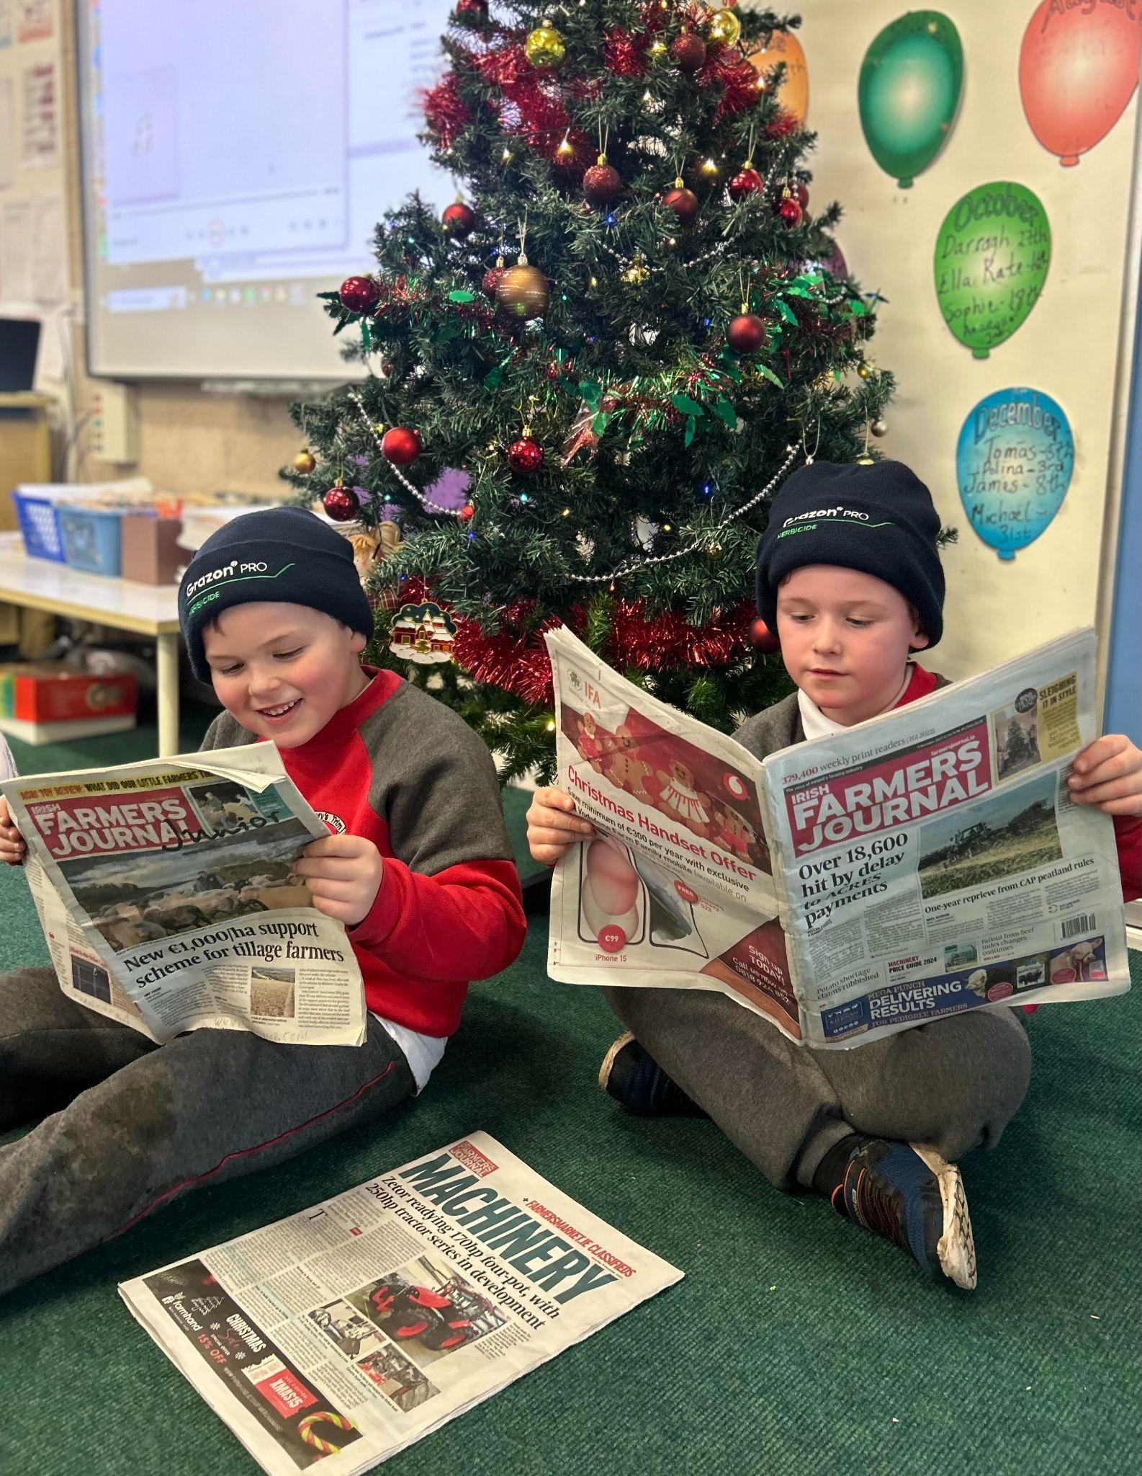
Banna (School Band): Tuesdays Rehearsal for 3rd - 6th Class 2:50 - 3:30pm
Football: FINISHED FOR 2023. Will restart after Christmas break
Camogie: Wednesdays 2:50-3:50pm
Rounders: FINISHED FOR THE YEAR
Confirmation: Friday Jan 26th @ 2pm
Communion: Saturday 11th May @ 2pm
Nathanna na Seachtaine: Ba mhaith liom…. I would like.
Seanfhocal na Míosa: Níl aon tinteán mar do thinteán féin
Recycling is a very important activity and is especially so around Christmas time. There are plenty of opportunities for recycling at this time of year. This was done was done by the Parents Association when they organised the Christmas Jumper Sale. Sr Claudia has also requested that we recycle Christmas Cards and stamps. Remove any personal greetings and send in the picture. With the postage stamps, we ask that you cut the stamp from the from the envelope leaving about an inch around the stamp. The MMM sisters in Drogheda use these stamps to help the sisters on the missions.
WOW will continue this week. Well done everyone who has been walking to school.
GREEN
NEWS
Remember green is cool
at home and at school!
Two little farmers in First Class doing some light festive reading!

Slide 5
