Slide 1
Imlitir 14
20th December 2023
Fergal Kelly M.Ed
Dear Parents / Guardians,
As we near the end of term I wish to thank you for visiting and supporting the school in the past few weeks to see your child in the various plays and activities. As you can see, December is one of the busiest but enjoyable months in the school calendar.
We hope that the children enjoyed all the festivities at home and at school over the Christmas period. Over these past few weeks the various Christmas plays and shows were a great expression of the Christmas spirit here in St. Mary’s. I would like to take this opportunity to thank our children, teachers, Special Needs Assistants, caretaker, cleaners and secretaries who give their time generously in support of all the activities that are planned and organised within and outside the school as we prepared for Christmas. I would also like to remind you that the school will close for Christmas Holidays on Friday, December 22nd at 11:50 am. The school will reopen on Monday, January 8th 2024 at 09:10 am. Finally, I hope that you all enjoy a happy and holy and peaceful Christmas and a healthy 2024.
Nollaig faoi shéan agus athbhliain faoi mhaise daoibh go léir.
Kind Regards,
Fergal Kelly
Principal
Say YES to Languages
at St. Mary’s
This is a language programme being rolled out in primary schools with the support of Languages Connect and PPLI (Post-Primary Languages Ireland), a unit of the Department of Education. It will be commencing in our school from January 15th to March 22nd. Third and Sixth class will be participating with Mr. Galligan, Ms. Minogue, Ms. Mallon and Ms. Dully as their tutors. French has
been the chosen language to be taught during this 8 week language course.
The aim of the programme is to:
● promote an awareness of different languages in our class, school and community
● promote inclusion and an appreciation of diversity
● increase the uptake of foreign languages in post primary schools.
It should be a very enjoyable experience for all involved.
S. Minogue

Slide 2
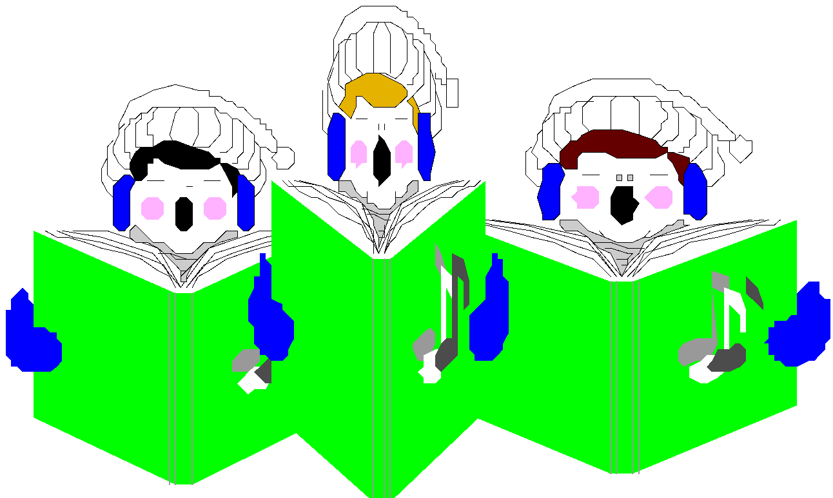
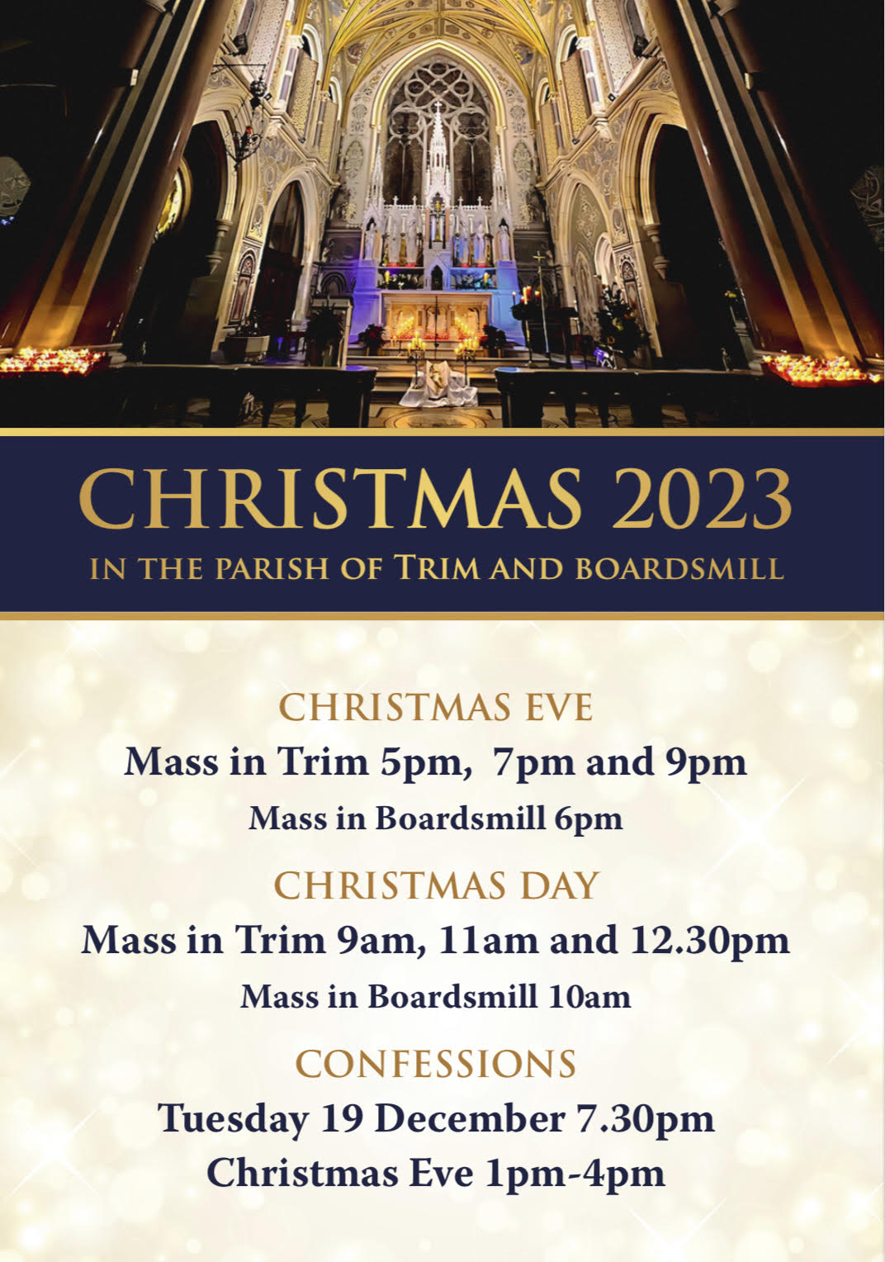
Christmas Show
Open Day 2024
Thank you the teachers/snas of third and fourth classes who prepared the children for our Christmas shows yesterday. Thank you to Mr Carmody, who also prepared our backdrop and Mr Madden, Ms Canny, Mr Savage and Ms Regan for all their preparation with the children over the past number of weeks. Thank you also to Ms Nally, Ms Hendrick and Ms McGale for their work with our Banna Ceoil who have been practising hard during the year.
Thank you to all parents who helped raise funds for St. Vincent de Paul and Trim Meals on Wheels. Total amount raised was €1470.00 so far.
Our Open Day for existing and prospective parents will be at 11.15 on Thursday 11th of January in The Dr Eileen Reilly Hall. A short talk will be followed by guided tours of our school by our current Sixth Class pupils. Light refreshments will be provided. All parents are welcome not just prospective parents.
Our Annual Admittance Notice has been updated on our website. It lists the various dates associated with enrolling new pupils in our school. Please click here to download an application for enrolment form.
Completed forms together with a birth certificate can be returned to the office. For more information please phone the office at 0469431919.

Slide 3
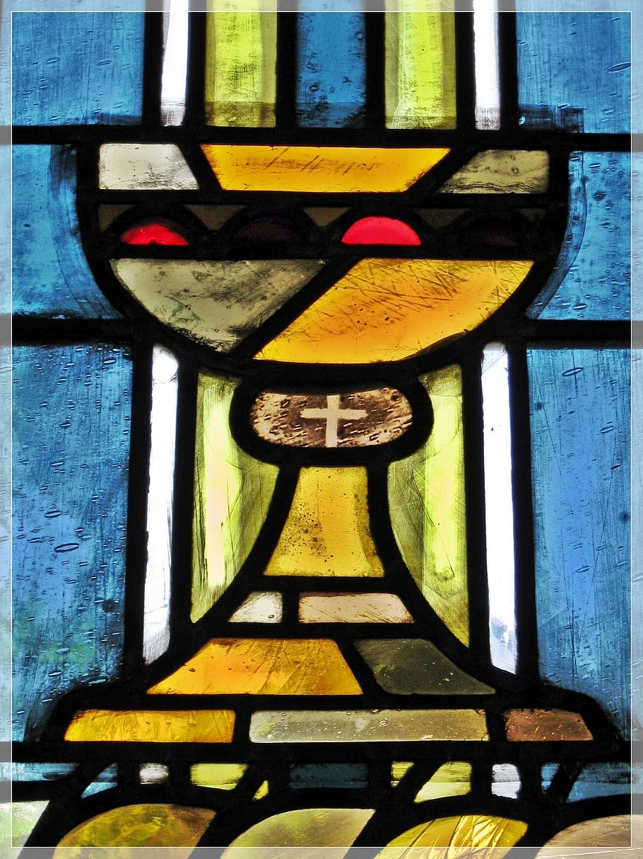
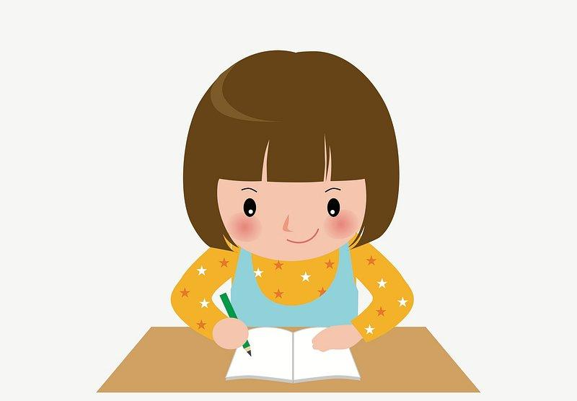
CONFIRMATION MESSAGE
For 6th Class Parents
MORE NEWS…
The next preparation for Confirmation Mass for 6th class is on 14th January at 12.30pm.
STAFF CHANGES
As one year ends, another soon begins. Ms Canny (3rd) will be leaving us to take up another position in the Southern Hemisphere in January. I would like to thank her for all her work with her class since September and particularly and most recently, her input into our Christmas show. We wish her well in her future endeavours. Ms. Canny will be replaced by Ms. Tallon who will take the class from the 8th January. We also say goodbye to Ms Walsh who has also made a great contribution to the school during her time here. We are delighted to welcome back Ms. Marmion from leave after the holidays.
INCLEMENT WEATHER
It is the policy of the school to open on every day scheduled in the school calendar provided the requisite number of teaching staff is available for duty. Red warnings may occur from time to time due to wind and snow but thankfully these occasions do not happen too often. Please ensure that the school has up to date mobile numbers for you so that information in this regard can be communicated swiftly.
The PA will be holding a Coffee Morning for all parents on Friday 12th January 2024 at 9:30. We will be holding our monthly meeting afterwards.
Wishing everyone a lovely Festive Season.
HOMEWORK
CLUB
Homework Club will run Monday to Thursday over 5 weeks, up to Feb Mid Term (January 8 to February 8, 2024).
Children will be assisted with homework, provided with a small snack and supervised in a quiet environment.
It runs from 2.50-3.50 but if your child is waiting on a sibling in St Michael’s they are welcome to stay until 4.00.
Application forms available from Ms Carr.
We are asking all families if they can collect
and send to the office USED POSTAGE STAMPS for the
fundraising initiatives of the
Medical Missionaries of Mary
Thank you.

Slide 4
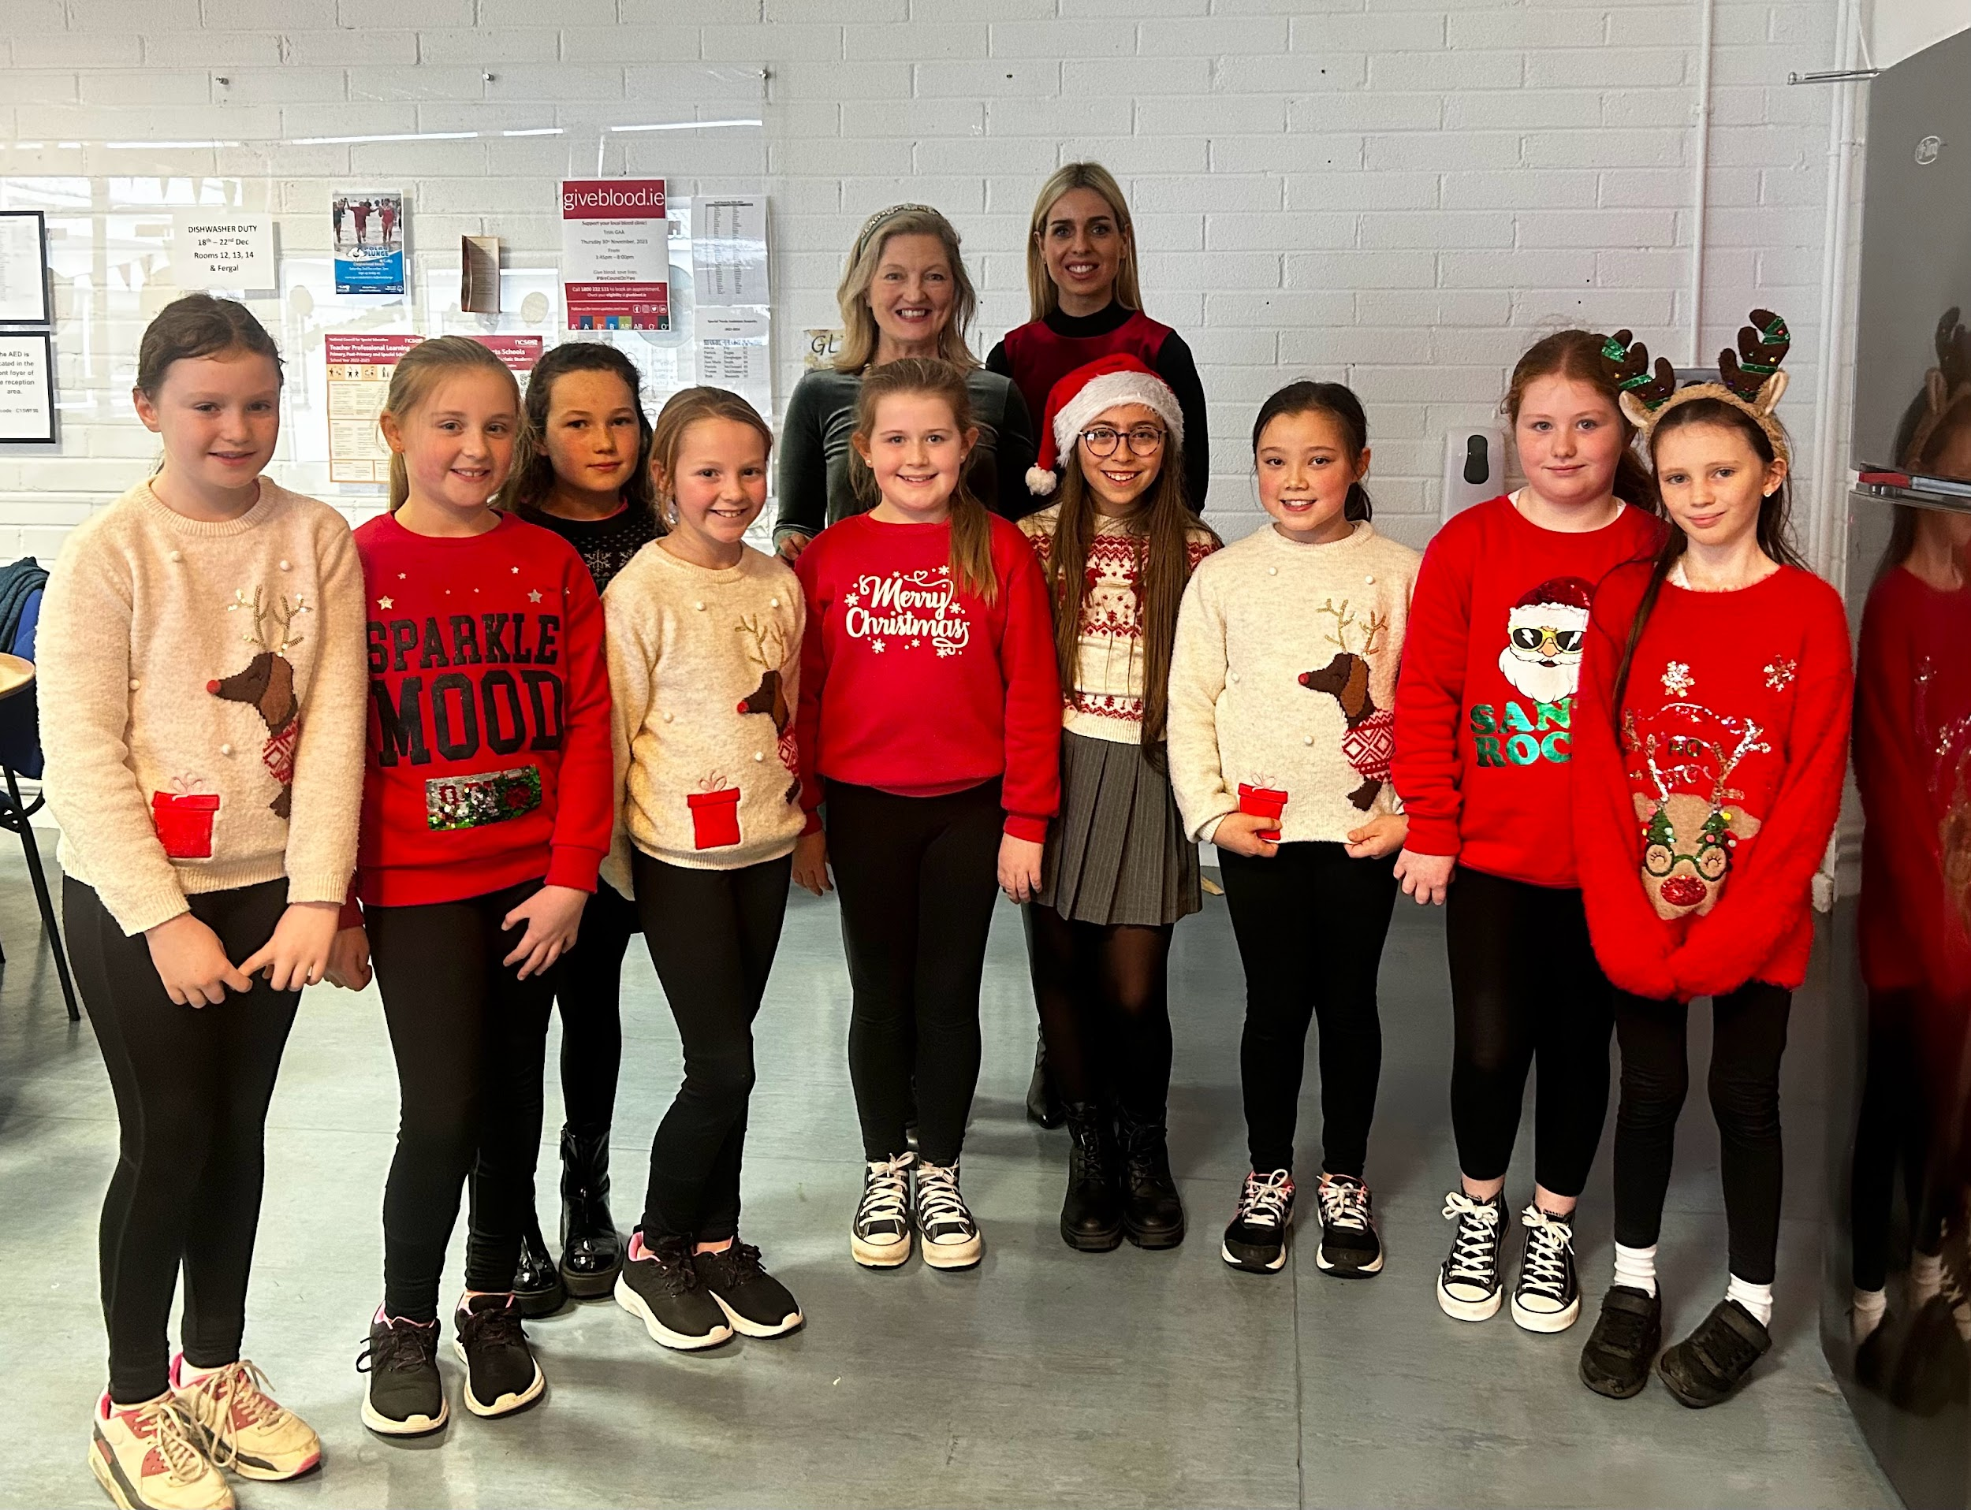
Banna (School Band): Tuesdays Rehearsal for 3rd - 6th Class 2:50 - 3:30pm
Football: FINISHED FOR 2023. Will restart after Christmas break
Camogie: Wednesdays 2:50-3:50pm
Rounders: FINISHED FOR THE YEAR
Confirmation: Friday Jan 26th @ 2pm
Communion: Saturday 11th May @ 2pm
Open Day: Thursday 11th Jan @ 11.15am
Nathanna na Seachtaine: Nollaig Shona duit/daoibh - Happy Christmas to you
Seanfhocal na Míosa: Níl aon tinteán mar do thinteán féin
Travel is the Green theme for these two years. We will continue our campaign after Christmas. Well done to all who are conscious of reducing fossil fuels.
WOW
A huge thank you to Mr Carmody and Ms Mallon for keeping the WOW campaign going all year. They had a wonderful group of loyal walkers every week. Well done everyone who has been walking to school.
Recycling is a very important activity and is especially so around Christmas time. There are plenty of opportunities for recycling at this time of year. Thanks again to the Parents Association who organised the Christmas Jumper Sale. Sr Claudia has also requested that we recycle Christmas Cards and stamps. Remove any personal greetings and send in the picture. With the postage stamps, we ask that you cut the stamp from the from the envelope leaving about an inch around the stamp. The MMM sisters in Drogheda use these stamps to help the sisters on the missions.
GREEN
NEWS
Some of the loyal WOW participants!
Remember green is cool
at home and at school!

