Slide 1
Imlitir 15
18th January 2024
Fergal Kelly M.Ed
Dear Parents / Guardians,
At this stage of the new year we are well and truly back into the routine of school after the Christmas break. Thanks to the staff, parents and children who worked hard during the month of December to support the wide range of activities going on in the school and the wider community. The varied Christmas Plays and concerts were greatly appreciated by the attentive audiences and it was nice to welcome many visitors to the school over the festive period.
The annual celebration of Catholic Schools takes place from Monday 22nd January to Friday 26th January inclusive. There will be a variety of activities in the classrooms to celebrate our Catholic School. Please see elsewhere in this Imlitir for more information. The week culminates in the Sacrament of Confirmation for our sixth classes on Friday 26th January at 2pm. I would like to take this opportunity to send our best wishes to all who are making their Confirmation and I hope they enjoy the celebrations.
Thanks to the Parents association who were very busy over the past few weeks with organising Activities In December and helping out on our open day last week which was well attended.
Kind Regards,
Fergal Kelly
Principal
CATHOLIC SCHOOLS WEEK
Next week is Catholic Schools Week when we celebrate the ethos and the faith of our school. Community is the overall theme of the week and there will be a particular aspect focussed on everyday at school.
On Wednesday we want to celebrate grandparents. For those children who may not have a grandparent available we would also welcome godparents on the day.
We invite any grandparents who are available to visit the school at 9:30 am to enjoy a cuppa and a chat. For those children who may not have a grandparent available, we would also welcome their godparents on the day. The early start time is to facilitate a prayer service in the church organised by Fr Paul which takes place at 11 am.
The grandparents/godparents may also like to visit classes that day. Please let your child’s teacher know by Monday if their grandparents/godparents will visit the school next Wednesday. This will help us to plan for the event. Thank you.

Slide 2
School Choir
OPEN DAY
School Choir for 5th and 6th class will start this Thursday, 18th January 2:50 - 3:30 pm.
We were delighted to welcome parents to our Open Day last Thursday.
The parents were brought on a tour of the school where they were able to get a sense of a typical school day in St Mary's. The parents saw examples of team teaching where a variety of staff collaborate in a classroom to deliver aspects of the curriculum in small groups. Children performed examples of project work, physical education, music, and poetry while also displaying computer work in our computer room as well as showcasing work on chromebooks and interactive boards within the classroom. Our magnificent library was also on display where storytelling was featured while infant classes displayed a wide range of teaching strategies to the prospective parents. Finally our visitors met with the parents association, Ms. Nally and Mr. Kelly for an informal session where their queries were answered. We hope that they enjoyed this visit to our school and we now welcome applications for enrolment for next September.
STUDENT COUNCIL
Our student council meet regularly where many aspects of school life are discussed. This is a really important forum where pupil voice is heard and great ideas often emanate from these sessions. Most recently, events around Open Day were planned and the roles of the Student Council and sixth class pupils explained. Yard games at break times were also high on the agenda and the selection of playground leaders to help promote fair play were examined. Thank you to Ms. O' Hare for facilitating these sessions.
HOMEWORK
CLUB
ASSEMBLIES
Homework Club will run Monday to Thursday over 5 weeks, up to Feb Mid Term (January 8 to February 8, 2024).
Children will be assisted with homework, provided with a small snack and supervised in a quiet environment.
It runs from 2.50-3.50 but if your child is waiting on a sibling in St Michael’s they are welcome to stay until 4.00.
Application forms available from Ms Carr.
Assembly takes place most Fridays where we are hosted by different classes who perform a song or two and this is followed by any important messages for the children. This is a good way to gather together and communicate up to date information to the pupils as well as highlighting good work during the week.

Slide 3
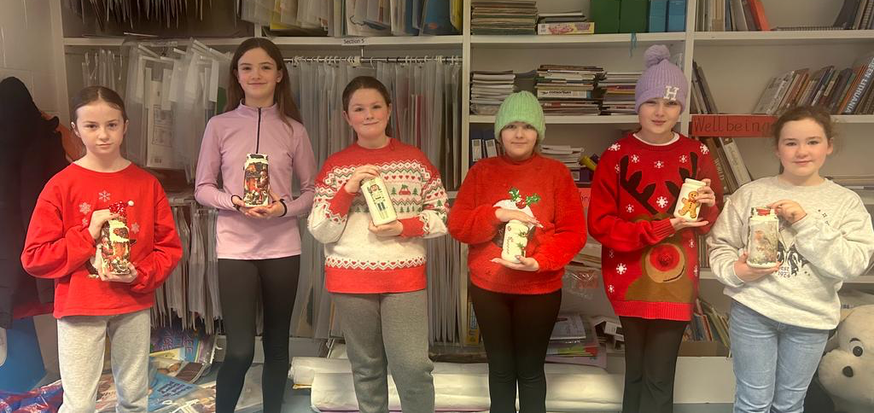
We are asking all families if they can collect and send to the office
USED POSTAGE STAMPS
and CHRISTMAS CARDS
(remove the personal greeting)
for the fundraising initiatives of the
Medical Missionaries of Mary
Thank you.
MORE NEWS…
INCLEMENT WEATHER
It is the policy of the school to open on every day scheduled in the school calendar provided the requisite number of teaching staff is available for duty. Red warnings may occur from time to time due to wind and snow but thankfully these occasions do not happen too often. Please ensure that the school has up to date mobile numbers for you so that information in this regard can be communicated swiftly.
Say YES to Languages
at St. Mary’s
This is a language programme being rolled out in primary schools with the support of Languages Connect and PPLI (Post-Primary Languages Ireland), a unit of the Department of Education. It will be commencing in our school from January 15th to March 22nd. Third and Sixth class will be participating with Mr. Galligan, Ms. Minogue, Ms. Mallon and Ms. Dully as their tutors. French has been the chosen language to be taught during this 8 week language course.
The aim of the programme is to:
● promote an awareness of different languages in our class, school and community
● promote inclusion and an appreciation of diversity
● increase the uptake of foreign languages in post primary schools.
It should be a very enjoyable experience for all involved.
S. Minogue
KINDLY LABEL ALL COATS, GLOVES, SCARVES, JACKETS, ETC. KEEP WARM AND WRAP UP WELL THIS WINTER.
CHRISTMAS JAR SALE
A huge thank you to all who contributed to the Christmas Decoupage jar sale in aid of the Irish Cancer Society.
The amount collected from our school was €224.10. Cecile, the lady who creates the items extends a huge thank you to all.

Slide 4
Thank you to all the parents who helped serving tea and coffee at the Open Day last week.
Thank you as well to those who attended our coffee morning last Friday. It was lovely to see you all.
Just a quick notice from the Green Flag Committee to all parents:
An Taisce carried out a Walkability Survey with the committee and they recommended that parents encourage their children NOT to walk through the car park when being dropped, but to rather walk straight to nearest footpath.
This way we can keep everyone safe.
They would also like to encourage parents to switch off their engines when they are waiting in the car park instead of leaving their cars idling to reduce exhaust fumes in the air.
Lastly, we have scheduled our next meeting for Friday 2nd February.
We aim to have a meeting the first Friday of the month, but this will be confirmed each month.
Thank you
Adri O’Dea
The 1st Money Club of 2024 will be Tuesday the 23rd of January at 12.15pm.
We continue our Cinema Ticket & combo giveaway for January lodgements for students who didn’t receive a cinema voucher in December.
Our Annual Admittance Notice has been updated on our website. It lists the various dates associated with enrolling new pupils in our school. Please click here to download an application for enrolment form.
Completed forms together with a birth certificate can be returned to the office. For more information please phone the office at 0469431919.
D.T. News
January sees the start of our ‘Scratch’ term. Students from 1st - 5th classes will work on animations and games using a free piece of online software that can be found and downloaded at www.scratch.mit.edu. Please remember to ask your children what they are doing in Computers each week - Debby Walsh

Slide 5
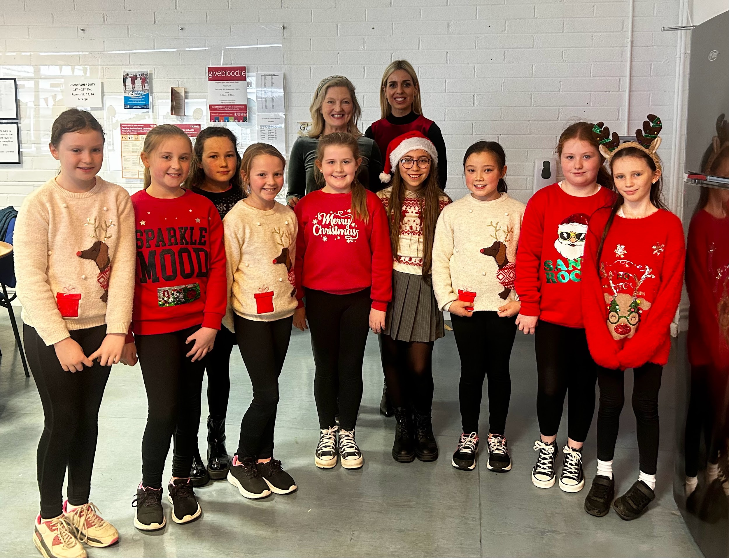
Banna (School Band): Tuesdays Rehearsal for 3rd - 6th Class 2:50 - 3:30pm
Camogie: Wednesdays 2:50-3:50pm
Confirmation: Friday Jan 26th @ 2pm
Communion: Saturday 11th May @ 2pm
School Choir: Thursdays 18th January @ 2:50-3:30pm for 5th & 6th class
Nathanna na Seachtaine: Tá sioc ar an talamh (There is frost on the ground)
Seanfhocal na Míosa: Mol an óige agus tiocfaidh sí (Praise the young people and they will flourish)
Travel is the Green theme for these two years.
WOW is taking a break for January as the weather is very cold and the paths are slippy.Thank you again to the pupils and teachers who kept the initiative going all these months.
As Travel is our Green Flag theme, the WOW initiative is very relevant. COW will resume when the weather is more suitable for cycling also. Well done to all the eco-warriors who walk, cycle and scoot to school themselves. Be sfew Míle buíochas!
WOW will resume when it's safer and more pleasant to do so.
GREEN
NEWS
Remember green is cool
at home and at school!
Some of the loyal WOW participants!

Slide 6
Attendance Information for Parents
Attendance is recorded daily by the class teacher on our online roll books via a school information programme.
There are two reporting mechanisms for attendance where attendance is reported to TUSLA, the child and family agency.
There are two reporting periods in the year, September to December and January to June. We are required to submit the school attendance returns now for September to December and again in June.
On this form we are required to list pupils, who have missed 20 school days for any reason. You will be informed if your child is included in the report. Explained absences, due to illness etc, are not a cause for concern and shouldn't cause any worry at all but a large number of unexplained absences may lead to further involvement from the Education Welfare Officer in TUSLA..
While attendance is hugely important and good attendance correlates strongly with improved outcomes, there are also very valid reasons that children miss school and this is understood.
Discretionary Referrals
Discretionary referrals are made where a school has concerns about the attendance of a pupil. This might be due to a lot of unexplained absences, a pattern of absence, significant ongoing issues with punctuality leading to a lot of missed learning time etc. A school will refer a child to the Education Welfare Officer where they have these concerns. The role of the Education Welfare Officer is primarily to offer support to families to improve attendance. The school will always contact parents before referring to the Education Welfare Officer and support where possible.
Key things to note
The aim of attendance and punctuality procedures are to ensure the child gets the best experience of education and maximises learning time. We are available to support as needed
There is no need for concern if you get a letter saying your child has been included on the attendance report. Explained absences are recorded as such.
Be sure to inform the school as to reason for absence so that this can be recorded. You can also do this on the Aladdin system.

Slide 7
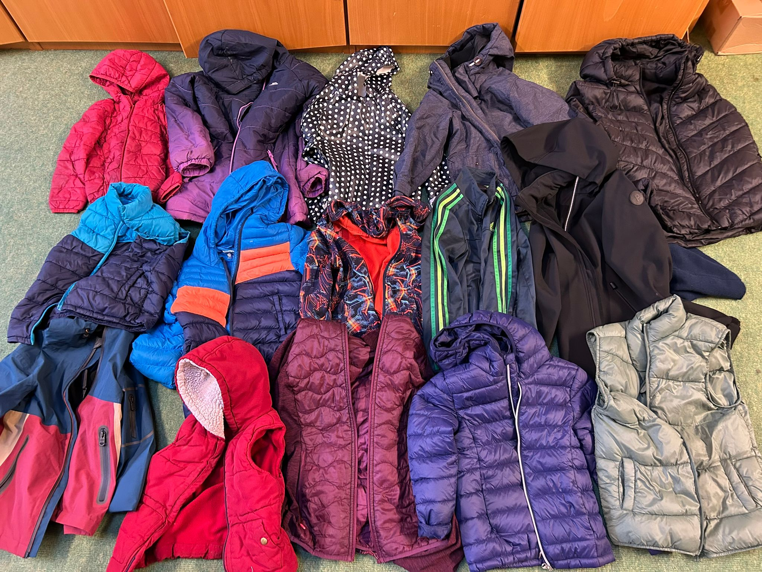
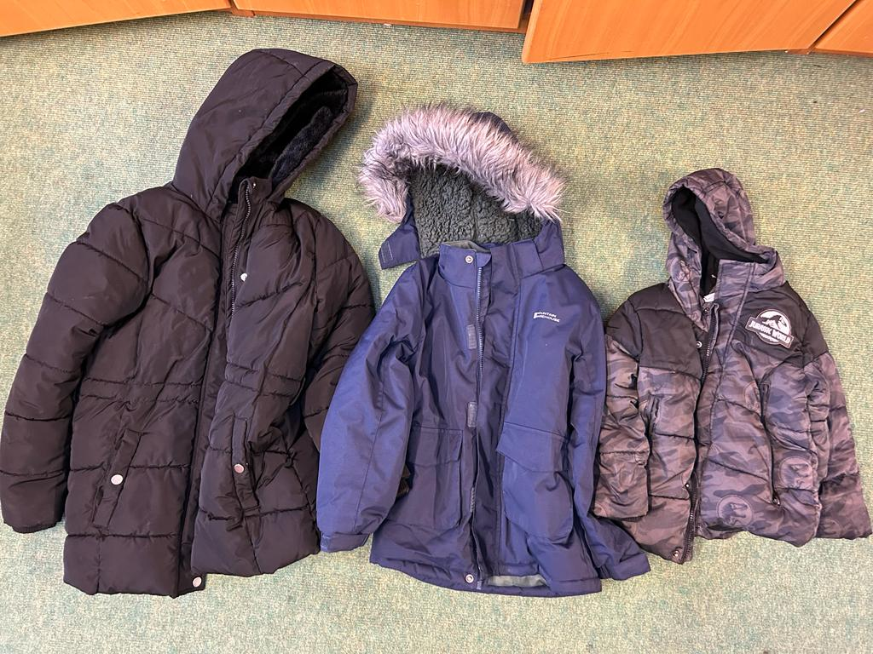
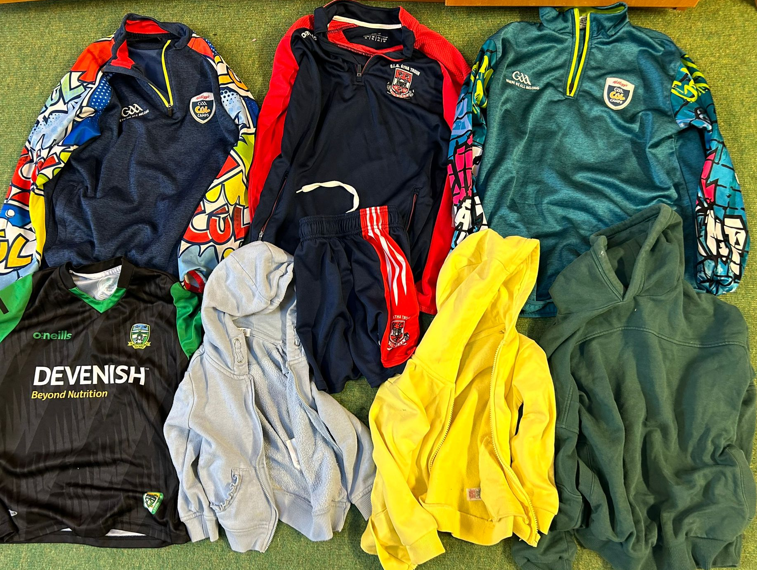
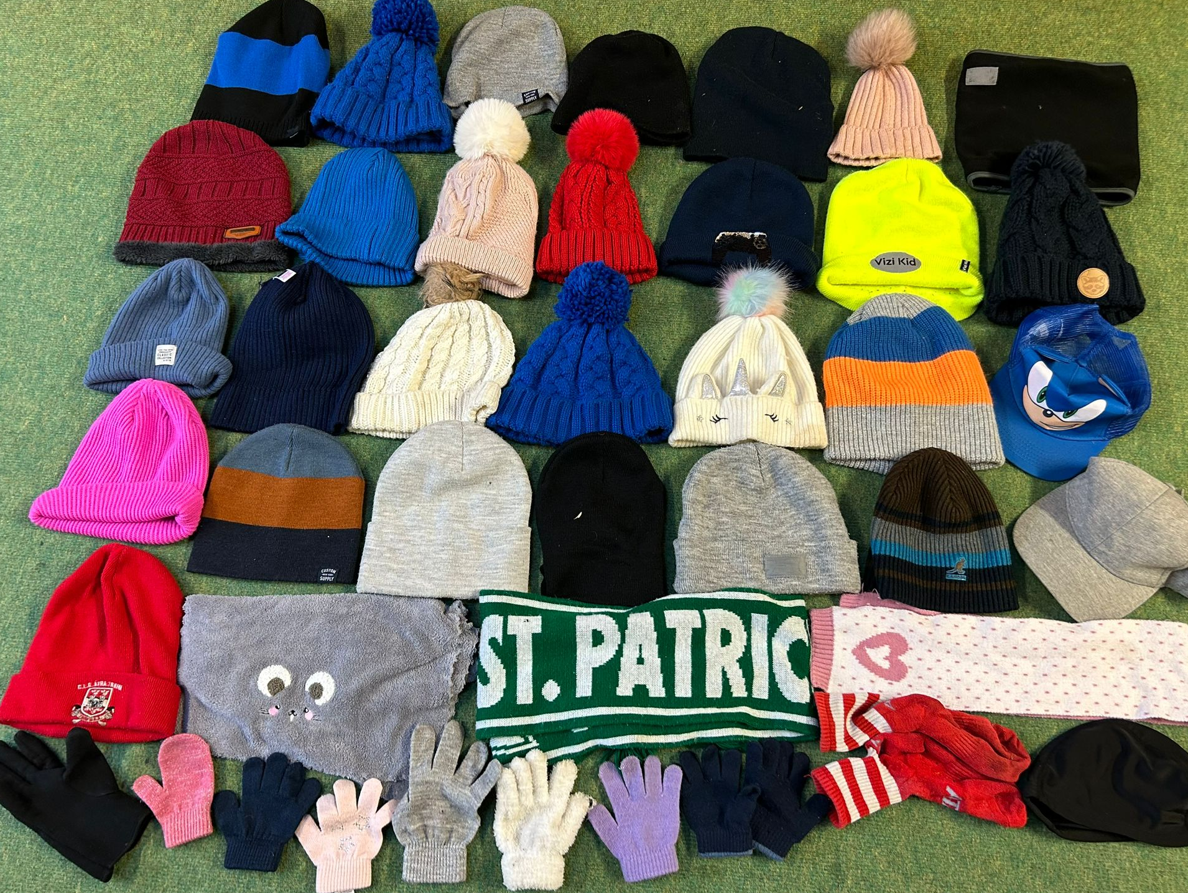
LOST AND FOUND
Kindly see attached photos of items in our lost and found. If any of these belong to your child, please collect in the office as soon as possible.
All uncollected items will be donated to St. Vincent de Paul by Friday, 26th January.

