Slide 1
Imlitir 16
6th February 2024
Fergal Kelly M.Ed
Dear Parents / Guardians,
I hope you all enjoyed the Bank Holiday and were able to get some quality family time during the long weekend.
The school followed a busy schedule in January when Catholic Schools, Confirmation and St Brigid’s day were celebrated. The main event was Confirmation when the children in 6th class received the Sacrament. Congrats to the children in 6th class who were involved and well done to the readers and children who had important tasks on the day.
Our Open Day in January was also a great success with many parents visiting and getting a great sense of the school and its resources.
Parent/Teacher Meetings for Junior Infants are due on Wednesday February 28th and Thursday, February 29th Appointments have already been sent through Aladdin Connect. If you have not received your appointment, please contact the class teacher.
A reminder that the school is closed next week for mid-term (12-16th February) and it will be closed for the Referendum on Friday 8th March.
With today being Safer Internet Day please see this Imlitir for supports and initiatives in this area.
Kind Regards,
Fergal Kelly
Principal
Safer Internet Day
Today is Safer Internet Day. Please use the opportunity to have an age appropriate chat with your children. It is very important that parents and guardians monitor their child(rens) access to the internet and social media. I have been informed on a number of occasions about unsuitable messages being sent about among children in the school on social media recently. Children under 13 years of age should not have unsupervised access to these forums. Please be consistently vigilant in this regard.
The following websites may be helpful:
https://www.webwise.ie/parents/
https://www.saferinternetday.org/
https://digital-strategy.ec.europa.eu/en/policies/safer-internet-day.
The Department of Education has also launched a recent publication, Keeping Childhood Smartphone Free which will also assist parents in dealing with this issue.
In school, the students are working on various projects on how to stay safe on the Internet. We will talk through the dangers and ask students how they feel they can stay safe while playing their online games etc.

Slide 2
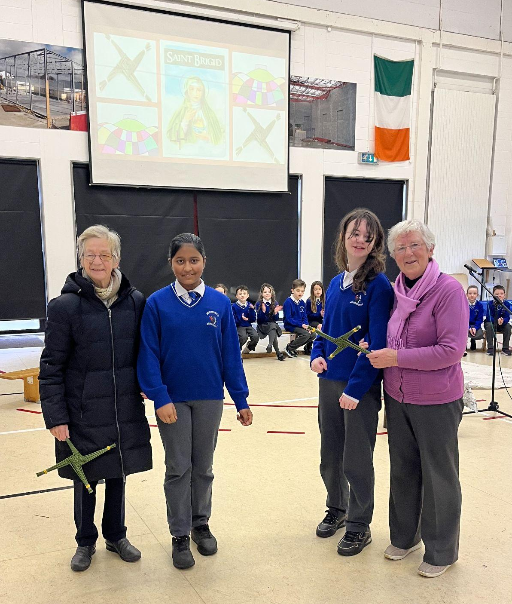
Catholic Schools Week
School Choir
Last week we celebrated CATHOLIC SCHOOLS WEEK. At Friday’s assembly, the children in Room 13 performed a beautiful song to St. Brigid and pupils from Room 30 read the story of St. Brigid.. We were honoured by a visit from Srs. Paula and Claudia. We presented them with two hand-made St. Brigid’s crosses.
As part of Catholic Schools Week, the school hosted grandparent’s/godparent’s day on the 24th January and we were delighted that so many came to see their children in the classes. The visitors had a short tour of the school followed by class visits. They then enjoyed a recital from the Banna Ceoil in our school hall and had some refreshments prepared by the parents association. Fr Paul had a ceremony organised in the church and many of our visitors were able to attend. It was a good day as all the Catholic Schools in the parish came together in prayer.
St Mary's school choir will be performing again this year at The Big Sing. We have started to rehearse all of the songs and are looking forward to a great performance! The Big Sing will take place on the 19th of April in the National Boxing Arena. We will update you with more details as we receive them.
Ms. Austin and Ms. O’Connor
HOMEWORK
CLUB
The next session of Homework Club starts on 19th February until 21st March (5 Weeks) Homework club runs Monday, Tuesday, Wed & Thursdays, from 2.50-3.50, but children waiting on siblings in St. Michaels are welcome to wait until 4.00.
Registration Forms are available from Ms Carr
First batch of offer letters for school year admissions 2024-2025 have been sent out on 2nd February.
Completed forms together with a signed acceptance letter or a non acceptance letter should be returned to the office as soon as possible.
Enrollment for next school year is still ongoing. Kindly contact the office at 0469431919 for more information.

Slide 3
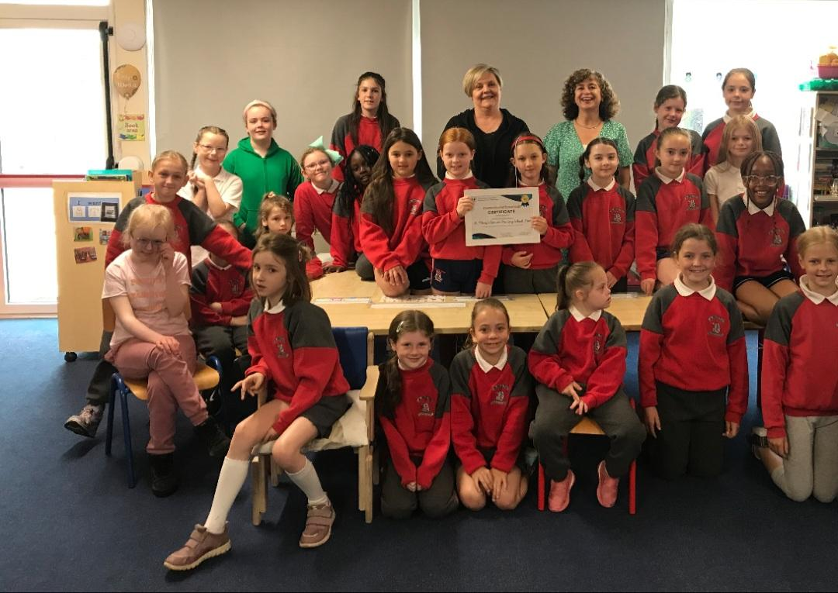
Good News
EVENT: Bake Sale and Pink and Red Day
WHEN: Friday 9th February.
Wear Pink or Red on Friday to celebrate Valentine's day.
We are asking children from Junior Infants and 1st , 3rd and 5th Class to be our bakers.
Buns will be 50 cents each. We recommend that children do not bring more than €2, so
that everyone can get their fair share.
DO’S:
- Buns, biscuits and bars are recommended
- Label any special dietary buns/ biscuits and hand them in separately
- Cereal boxes with one side cut as a flap/lid and lined with tin foil works well for sending buns in
- If you send in containers, please mark them clearly with your child’s name
DONT’S:
- No whole cakes – they can be difficult to cut
- No fresh cream please
- No nuts – due to nut allergies in school
Please bring buns straight into the hall from 8:50 am. We’ll be there to collect them.
See poster on the next page.
Some staff recently attended Ceannródaithe Cumarsáide Celebration evening for the 2023 award winners!
This was an evening to celebrate the work and achievements of participating schools and was facilitated by HSE Meath Speech and Language Team. There were 12 worthy winners and St. Mary's were delighted to be one of them.
Last May, students from Room 17 and 20 sang and signed "What a Wonderful World" during assembly using Lámh (Available to view on our school facebook page - click on link below)
https://www.facebook.com/groups/StMarysConventPrimarySchoolTrimMeath/permalink/1735267710242300/
Lámh is a manual signing system used by many pupils in our schools. Signing encourages eye contact and attention to movement , skills that really help children to communicate. We were delighted to be part of this initiative
Meitheal
We are looking for parents who are in a position to do voluntary work. We have a Tuesday morning group, Meitheal, who meet from 9.30-10.30. Parents help prepare work for the younger pupils. Meitheal involves a bit of cutting, pasting, photocopying, and a chance to socialise with fellow parents. This year, we are looking for volunteers to “listen” to Junior Infants reading, to help with ICT, and to help with Library (on Fridays). If interested kindly contact us in the office,
D.T. News
Room 18 are busy working on their Green Screen projects which they will begin filming this week. They are very excited about these projects and we will endeavour to put them up online for parents to see so watch this space. - Debby Walsh

Slide 5
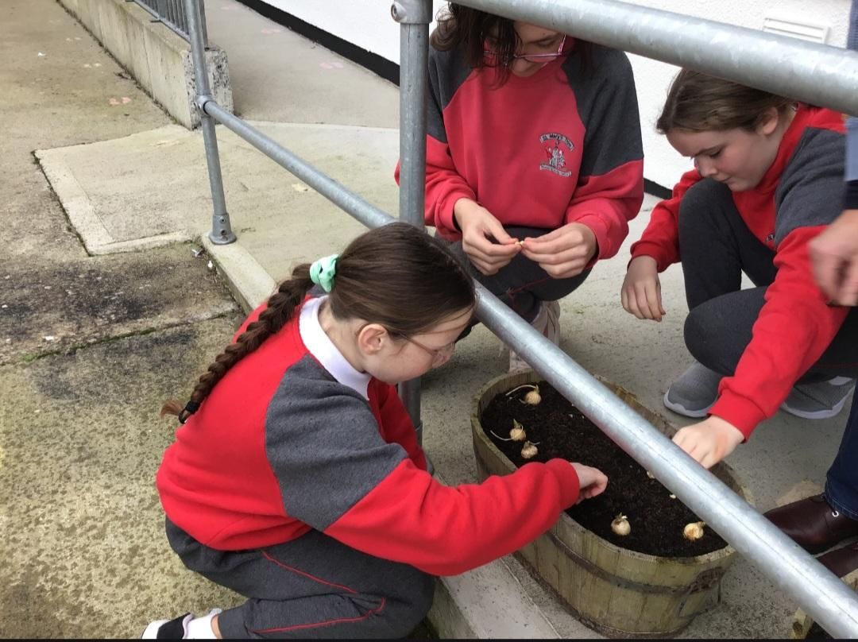
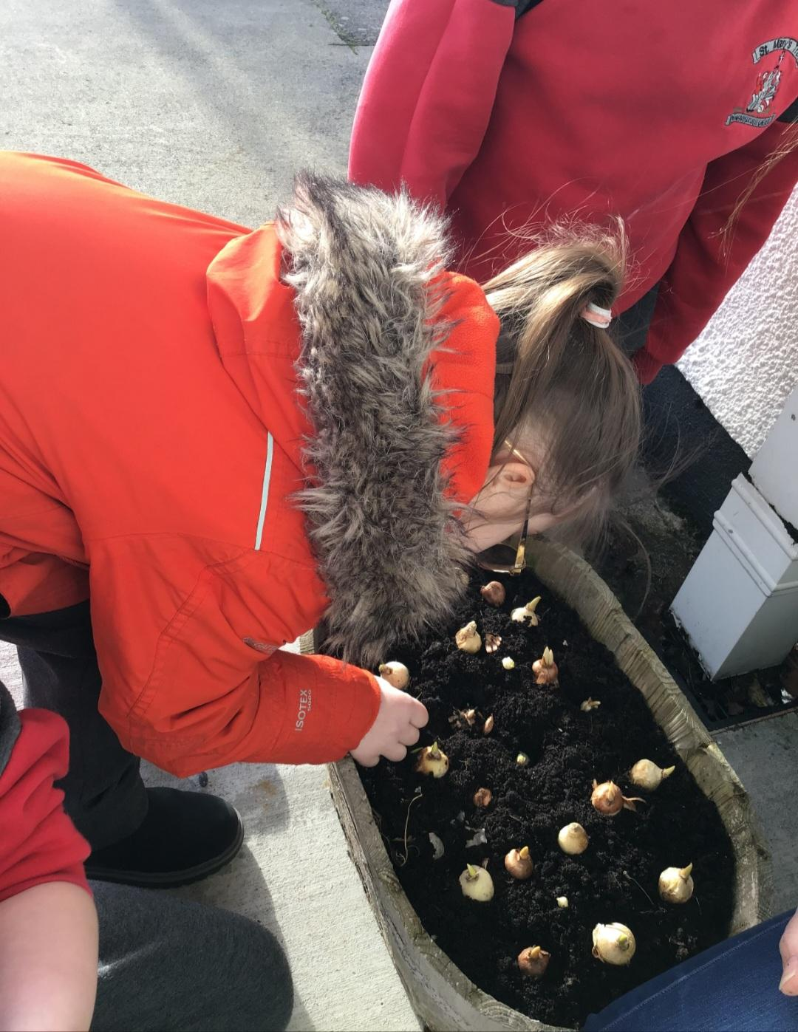
Banna (School Band): Tuesdays Rehearsal for 3rd - 6th Class 2:50 - 3:30pm
Camogie: Wednesdays 2:50-3:50pm
Communion: Saturday 11th May @ 2pm
School Choir: Thursdays 2:50-3:30pm for 5th & 6th class
Nathanna na Seachtaine: Tá sé scamallach (Is it cloudy?)
Seanfhocal na Míosa: Nuair a bhíonn an cat amuigh bíonn na lucha ag damhsa (when the cats away the mice play)
Travel is the Green theme for these two years.
WOW
WOW is resuming this Wednesday, weather permitting. Meet up at Gulliver’s at 8:50 a.m. Wrap up well as it is still cold. Thank you again to the pupils and teachers who keep this initiative going.
As Travel is our Green Flag theme, the WOW initiative is very relevant. COW will resume when the weather is more suitable for cycling also. Well done to all the eco-warriors who walk, cycle and scoot to school themselves. Be safe. Míle buíochas!
GARDENING
Room 17 got busy planting spring flowers. Looking forward to seeing them sprout and bloom.
Remember green is cool
at home and at school!
GREEN
NEWS

Slide 6
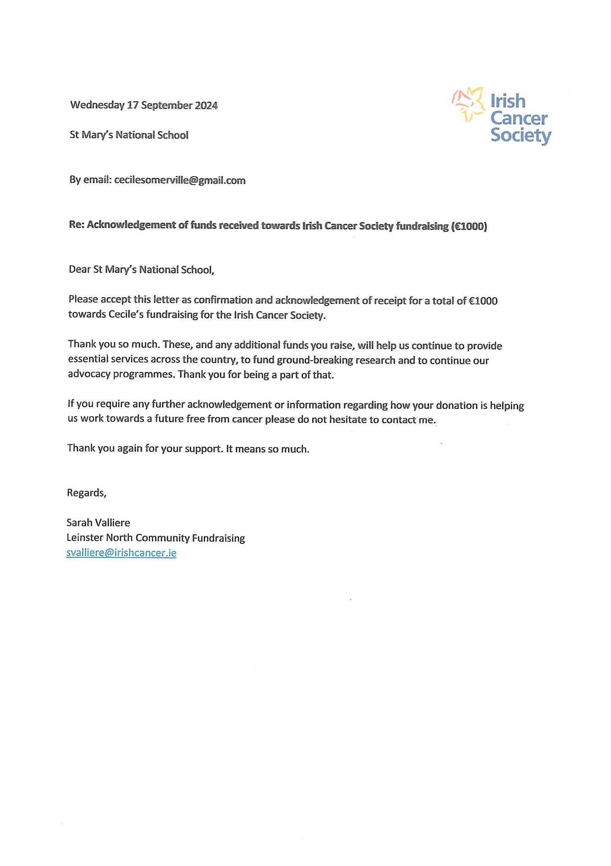
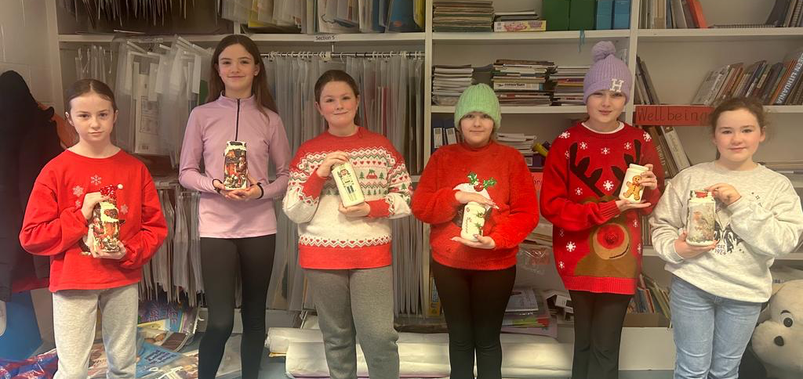
Kindly see below the acknowledgement letter sent by the Irish Cancer Society regarding Cecile’s fundraiser. Thank you for your continued support.

Slide 7
Community News
To whom it may concern,
We wanted to invite your students to RCSI’s 10th annual Teddy Bear Hospital which will be on February 24th and 25th 2024. Teddy Bear Hospital will be held at the RCSI 123 St. Stephens Green campus in the Exam hall. Please see the attached flyer.
Teddy Bear Hospital is a free ticketed event that aims to alleviate childhood fears about healthcare environments and increase health literacy in school-aged children.
Tickets can be booked through Eventbrite which will open in February and be advertised on our social media as seen below.
This event is aimed at children aged 4-10, though children outside those ages are encouraged to come if parents feel it would be beneficial or if a family wishes to attend with their siblings. Older children for whom this event would be developmentally appropriate are welcome to the Sunday session where we will have a higher ratio of volunteers to children.
We encourage all children to attend with their Teddy so that the Teddies can get their annual check-up, fix up any rips or tears, and learn how to keep healthy. There will be 12 different stations that teach children and their teddies about different aspects of healthcare such as, surgery, food and nutrition, first aid and so much more! Description of session details for Teddy Bear Hospital weekend below:
Saturday, February 24th, 2023 Sessions 1, 2 & 3: All children aged 4-10 years old Sunday, February 25th, 2023 Session 4, 5 & 6: Inclusive smaller sessions in a quieter environment for children with disabilities or chronic illnesses. There will be more volunteers to individualise the session for each child.
We really do appreciate you advertising this to the parents and children at your school.
Connor Mabbott
RCSI Paediatric Society's Teddy Bear Hospital Committee Member

Slide 9
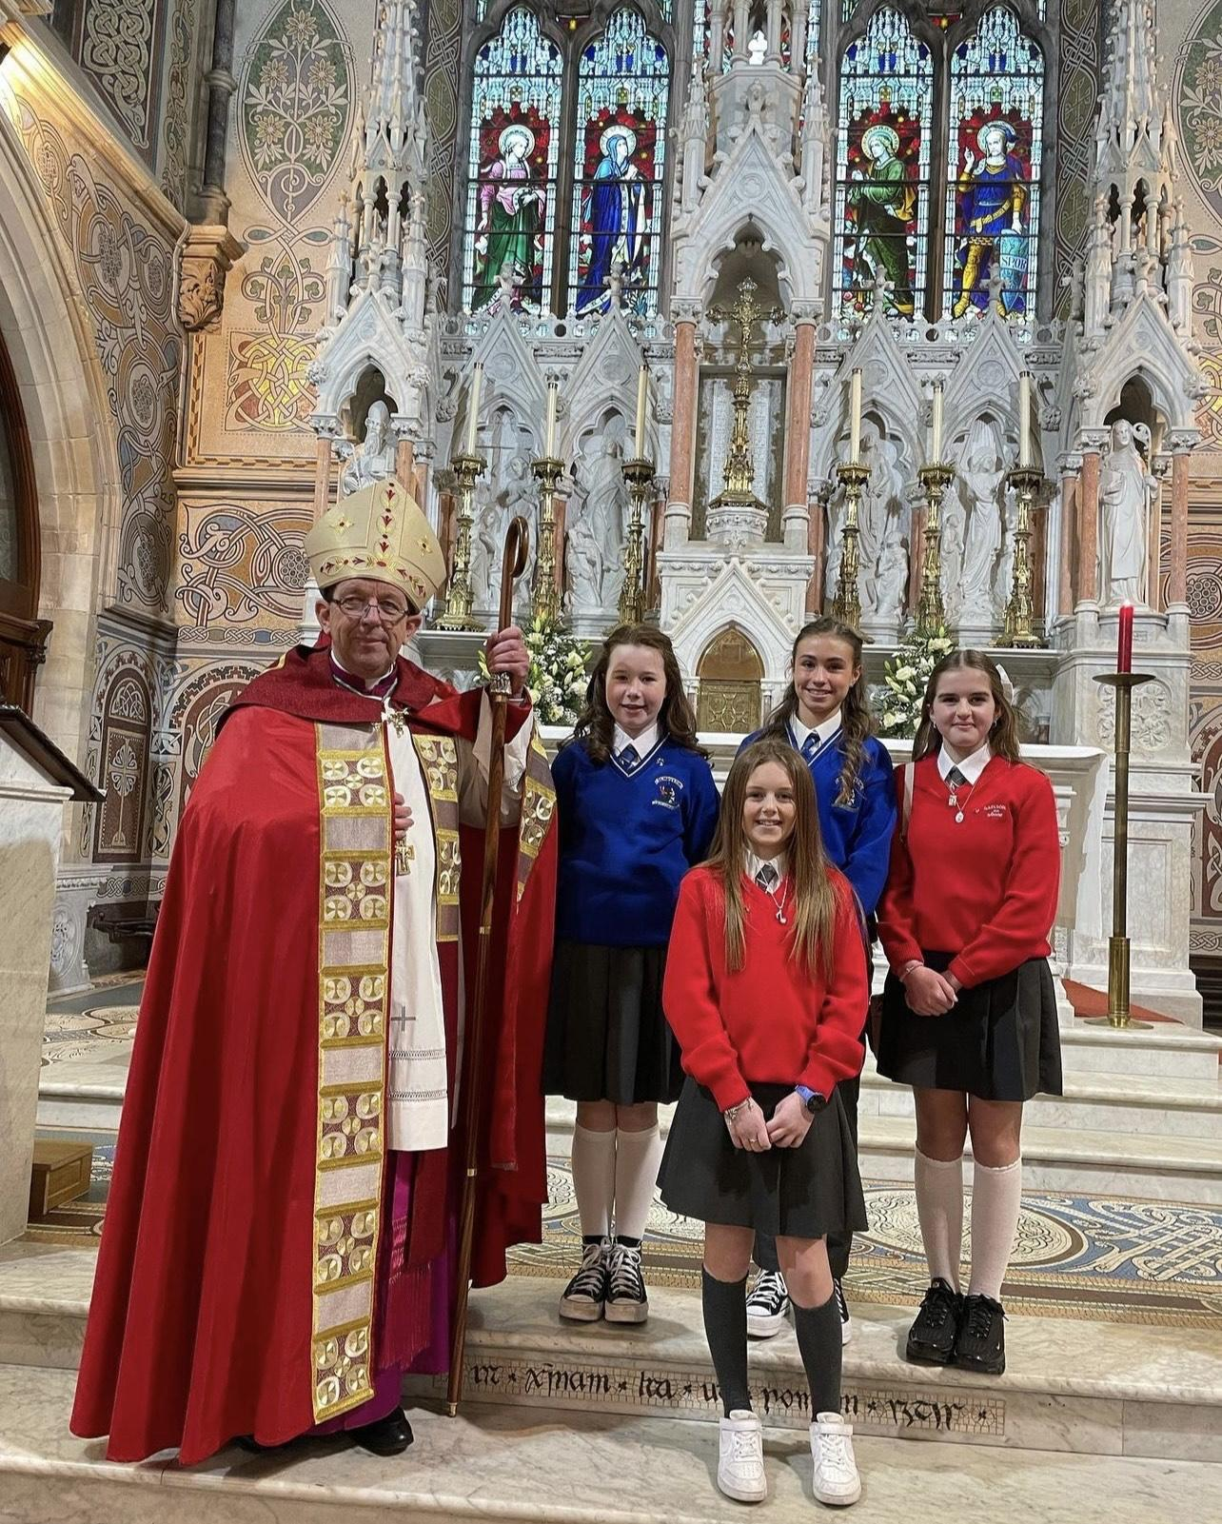
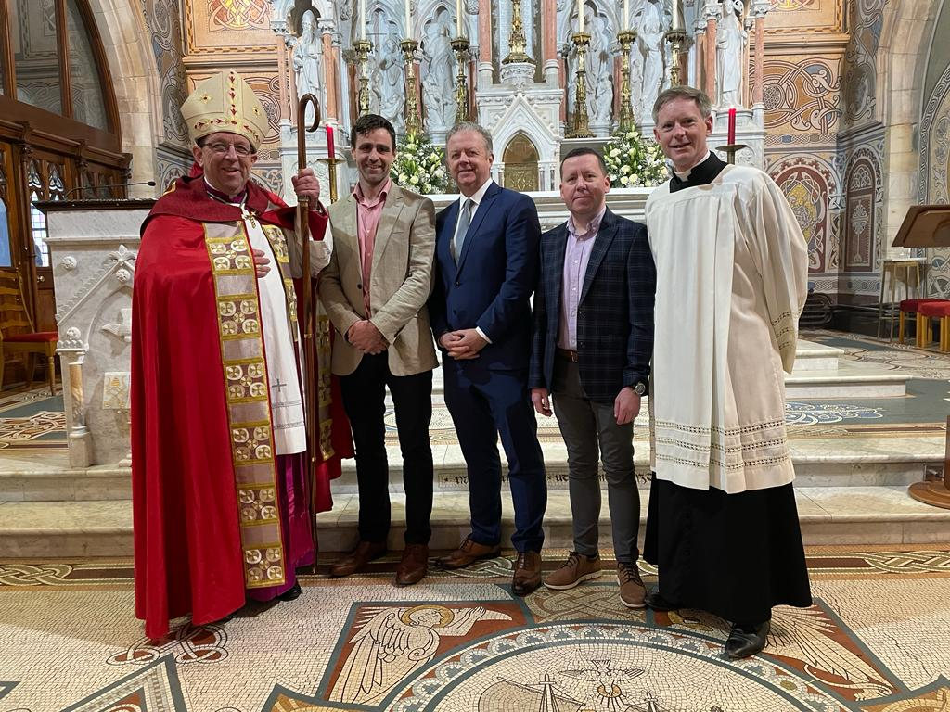
And last but not least,
We would like to congratulate all 6th class students who received the Sacrament of Confirmation last January 26th.
Be a blessing to others and be blessed.

