Slide 1
Imlitir 7
9th October 2023
A Chairde,
As you can see we have finally updated our Imlitir. It was in the pipeline for a while and we are indebted to a parent for helping us get it across the line. It’s fab! Later in the year, we hope to update our website, so exciting times ahead on the publishing front.
St Mary’s Student Counci/An Chomhairle Scoile was first established in 2004 and its aim was to give students a greater voice in the decision-making process of our school.
In September, representatives from First to Sixth class are elected by secret ballot and take a seat on the council for the duration of the academic year. Nominees may canvass prior to the election. The newly elected Student Council members wear specially designed badges for easy identification.
Our first Student Council meeting took place on Tuesday, 19th September and members were given their badges and their role explained to them.
We had our second meeting on October 3rd and there were lots of items on the agenda for discussion including having a Wellbeing Wednesday every month or two with active homework, purchasing jerseys for rounders and some events for charity.
We have a very proactive and enthusiastic group of children on our Student Council with lots of ideas on improving our school. We look forward to working with An Chomhairle Scoile members during the school year. Mary O’Hare Student Council Coordinator
Improvements and Repairs:
We have just secured €49,000 from the Department of Education to repair the leaks in the hall roof. Works should start in November.
Junior Infants Vaccinations:
11th October 2023 – 9.40 a.m.
A vaccination team from the HSE, will be arriving on Wednesday 11th October 2023 at 9.00 a.m. for the Junior Infant Vaccine MMR & 4 in 1. They hope to start vaccinating at approx. 09.40 a.m. Junior Infants are asked to wear their PE uniform as this will help with the administration of the vaccines on the day.

Slide 2
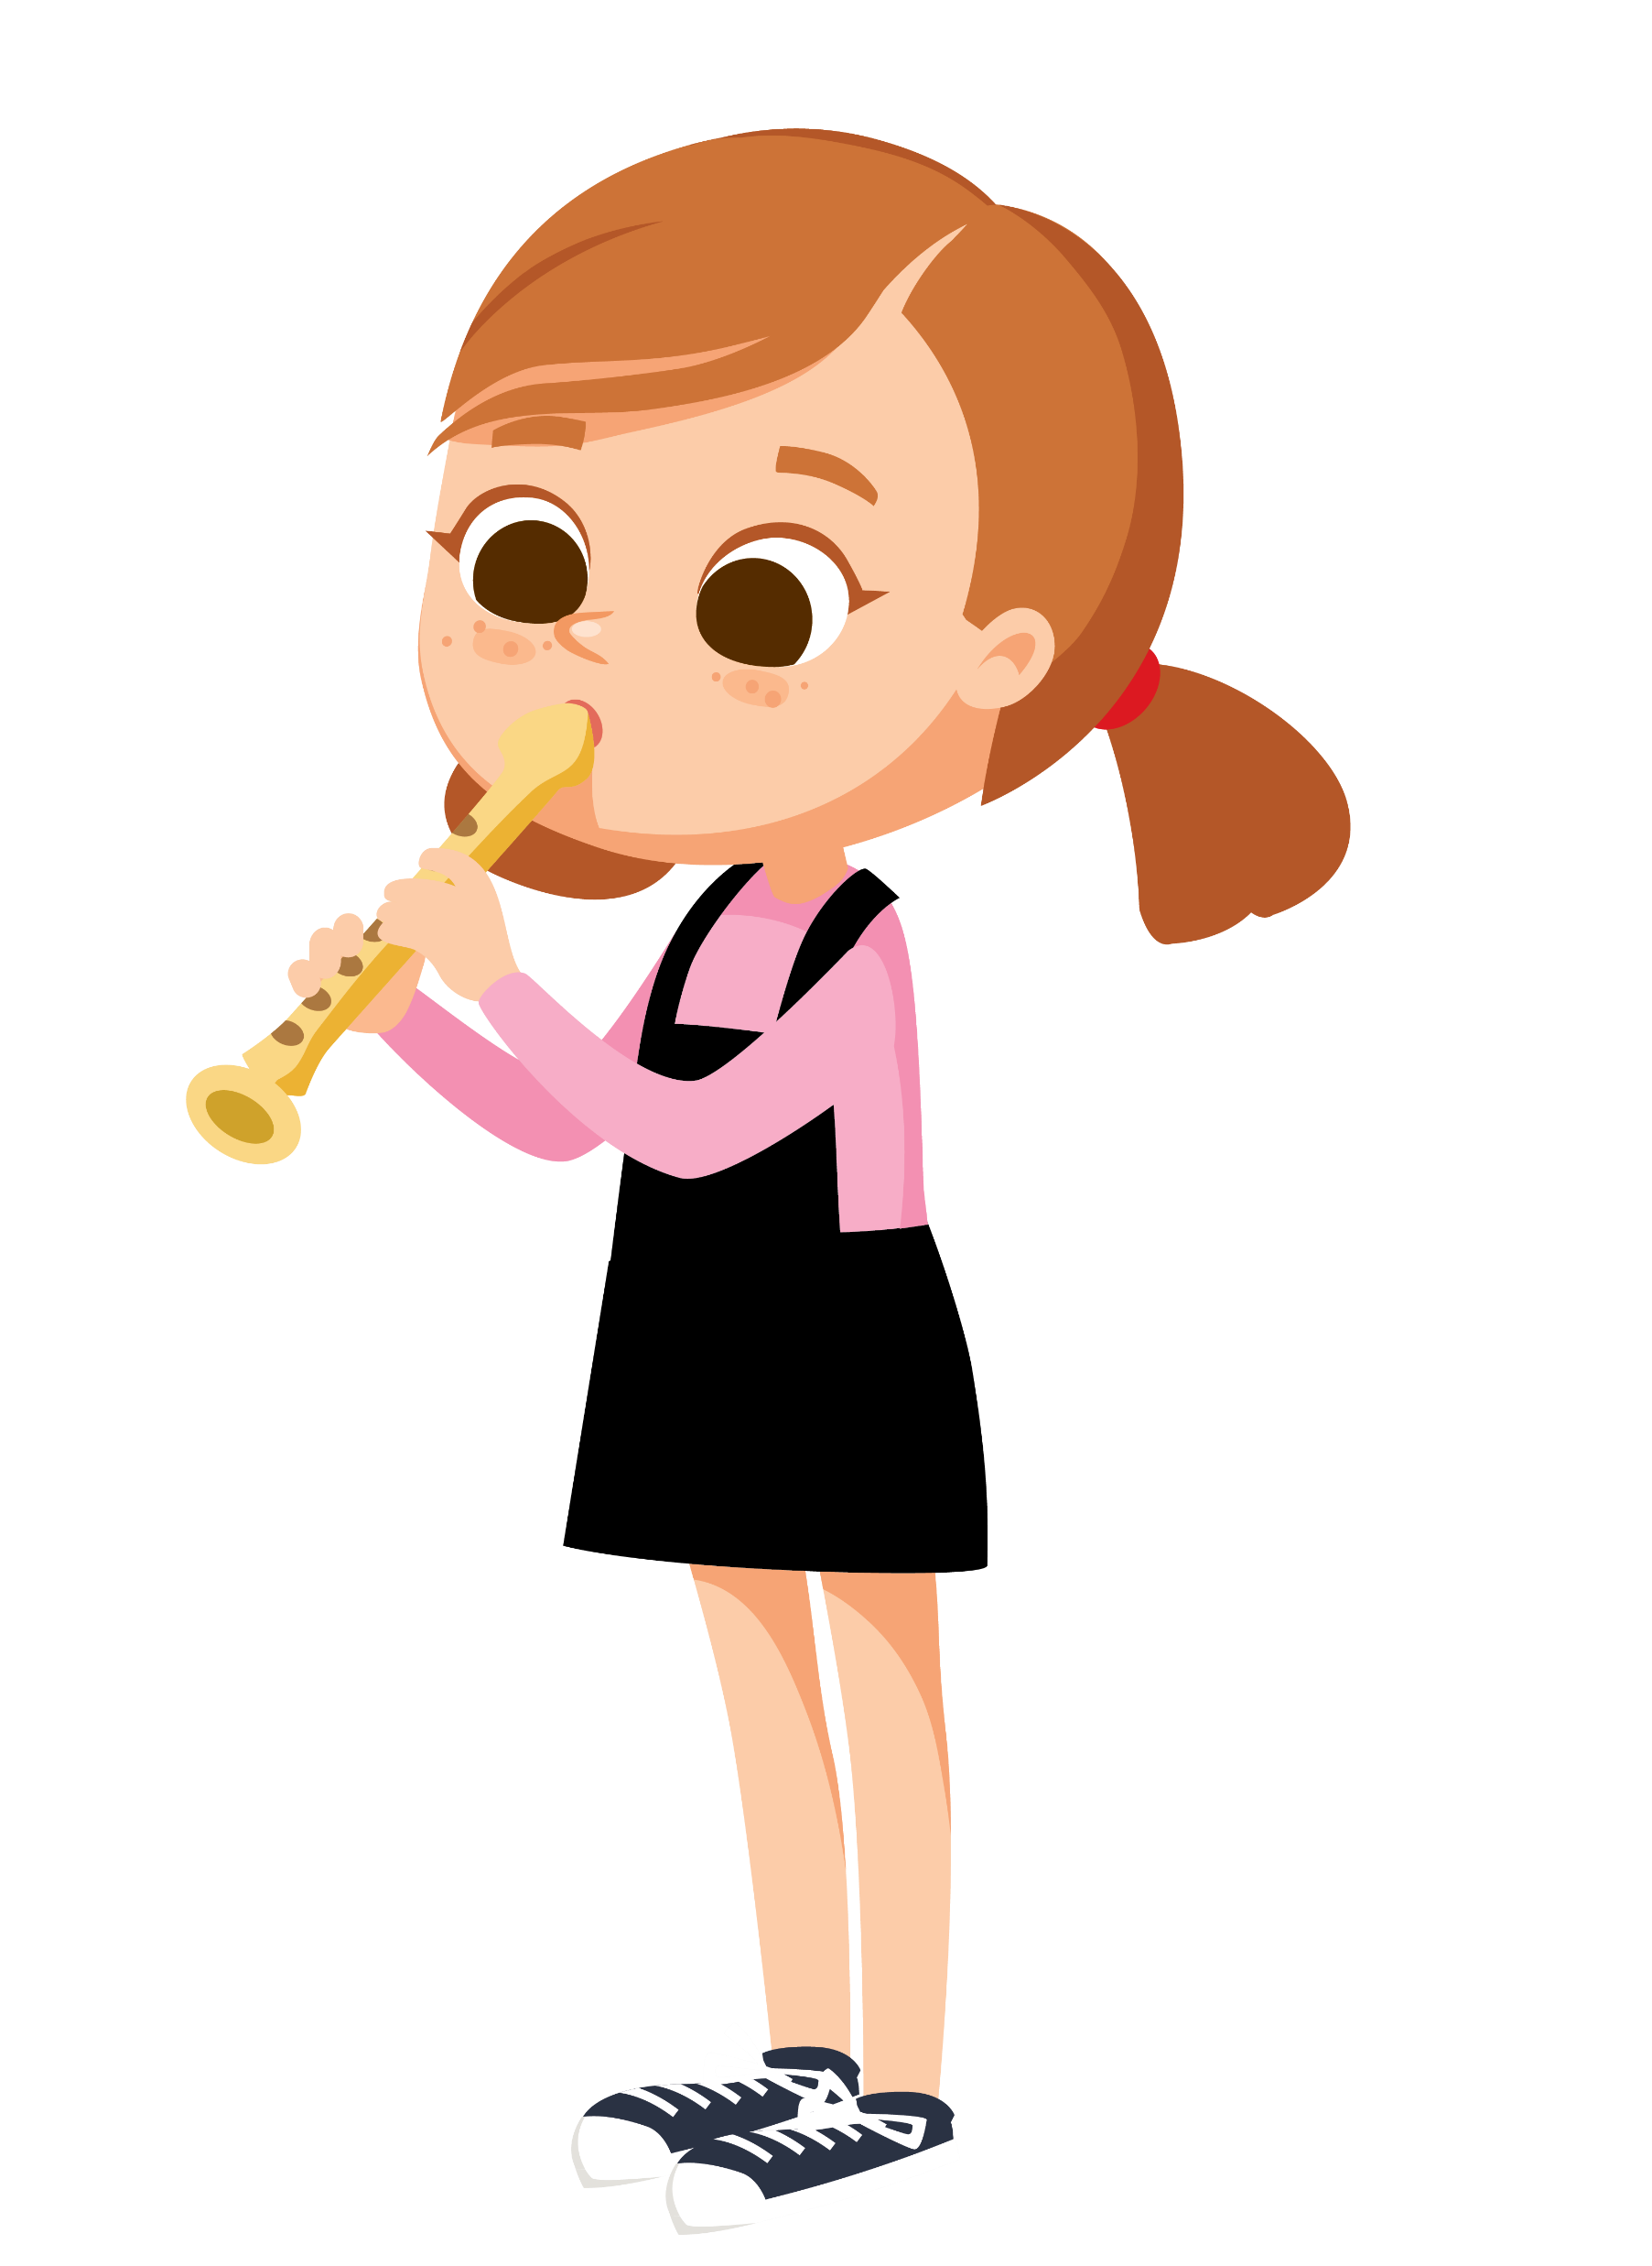
Aladdin Connect:
Please note that you can enter your child’s absence and the reason for it on the Aladdin Connect App. There is no longer a need to phone or email the school. If you are not on Aladdin Connect, please contact Rebecca in the office and she will assist you. Thank you in advance.
Contact Details:
Please also check on Aladdin Connect that we have the most up-to-date phone numbers and email address for you. For example, we may need to contact a family when a child has an accident in the yard or we may need to email you if there is Covid in your child’s classroom. Aladdin Connect allows you to make the changes yourself directly.
The girls’ football team have gone 4 out of 4 games unbeaten this year so far - something the school has never done before!!
This should see the girls through to a quarter final, with one game remaining.
Well done girls, keep up the good work!
Mr. Carmody
DT News:
Rounders:
This week students in both 1st and 2nd classes will learn all the keys on the keyboard using a program called BBC Dance Mat. This is a free piece of online software that can be accessed on https://www.bbc.co.uk/bitesize/topics/zf2f9j6/articles/z3c6tfr
Students in 6th class started working on their HTML websites. They will learn how to create menus and how to insert their text under each heading. All this is done using code so I am very proud of them all as it is not an easy thing to learn! Debby Walsh
Continues Mondays after school until 4:00pm. All pupils in fifth and sixth class are welcome.
Banna Ceoil:
Banna Ceoil (the school band) will take place every Tuesday in the Hall at 2:50 pm. and will finish at 3:30 pm. All pupils from 3rd class up to 6th are welcome.
€10 admin fee applies.
Our Annual Admittance Notice has been updated on our website. It lists the various dates associated with enrolling new pupils in our school. Please click here to download an application for enrolment form.
Completed forms together with a birth certificate can be returned to the office. Please phone the office if you need assistance or have any queries on 046/9431919.

Slide 3
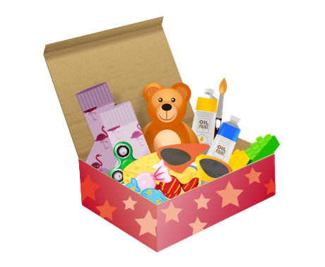
Christmas Shoebox Appeal 2023 | St. Mary’s Primary School, Trim
It is that time of year again and the families in St Mary’s are once again invited to join in the shoebox appeal sharing Christmas with children who may not receive gifts otherwise.
Last year our 175 shoeboxes were delivered to children in Transnistria who were delighted to open up the beautiful gifts. Thank you!
Good things come in small parcels and there are few parcels shared that are as small as a shoebox. Through the Christmas Shoebox Appeal children in Africa and Eastern Europe can enjoy this special time of year. Children in St Mary’s and in Ireland are lucky to have lovely things at home and at school and we have an opportunity to share some kindness with these children who have little and will be so grateful and excited to receive the gift.
The shoebox appeal is based on children/families filling a shoebox with 4 W's- something to Wear(hat, scarf, hairbands etc) something to Write with (crayons, pencils, notebooks etc) something to Wash with(toothbrush, facecloth etc) and something to WOW (teddy, small toy, sunglasses etc). Follow the link to see how to fill a shoebox – click here.
The appeal also asks for a small donation of €5 to cover the transport cost of the gifts. It is a lovely way for children in our school to share with less fortunate children in another country.
As previously, it is optional for the children of St Mary’s to get involved with the Shoebox Appeal. Families or friends can pool together gifts to fill one box if they prefer.
Children will get a leaflet today with more information.
The shoeboxes will be collected from the school after the Halloween holidays. We will begin collecting them the week after Halloween holidays 6th Nov -13th Nov. Shoeboxes can be dropped into the school/Room 2.
Míle buíochas for always being so generous with these appeals for very worthy causes.
Thank you for your kindness.
Ms. Dalton
Mise le meas,
Cóilín Ó Coigligh P.O.

Slide 4
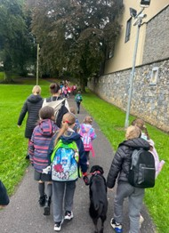
Banna (School Band): Rehearsal for 3rd - 6th Class 2:50 - 3:30pm
Football: Wednesdays 2.50 - 3.50 for 4th - 6th Class
Camogie: Date TBC – will start later in the year
Rounders: Mondays 3.00 - 4.00 for 5th & 6th Class weather permitting
Assembly: Launch of Maths Week
Confirmation: Friday Jan 26th @ 2pm
Communion: Saturday 11th May @ 2pm
Nathanna na Seachtaine: Is maith liom /Ní maith liom (I like/I don’t like)
Seanfhocal na Míosa: Ní neart go cur le chéile (there is no strength without unity)
Walking to School
Well done to all who participated in National Walk to School Week. It was great to see the numbers increasing again. Let’s keep it up while the weather is still conducive to walking to school.
Walking Bus
If the weather is good next Thursday, we would like to start up our walking bus again from the three meeting points: Knightsbrook (beside Muse), the car park up near Lidl and The Gallops.
GREEN
NEWS
If your child is going to participate, please complete the consent form saved here.
If anyone would like to volunteer, please contact the school. An initiative like this requires parental involvement. Huge thanks to the parents who kept the campaign going last year. Our travel officer is visiting us very soon. He will advise us about other ways in which we will be able to work with our Travel theme this year.
Cycling to School
Cycling on Wednesdays will start next week also. Anyone interested in cycling with the school must be in fourth class up or must have a parent or guardian with them.
Hi-viz vests and helmets are essential.
Recycling continues at school. We accept ink cartridges, small plastic bottles, postage stamps, cans and batteries. Well done to everyone for managing their waste in a sustainable way.

Slide 5
Our Green Flag theme is Global Citizenship - Travel. This is National Walk to school week. Of course our Walking on Wednesday, WOW will go ahead on Wednesday but we are asking that everyone try to walk to school even more this week. Let’s walk, cycle and scoot more to reduce carbon emissions and keep our air clean.
Unfortunately the weather has made it challenging to get our WOW and COW campaigns started. WOW will resume on Wednesday if it is dry. Meet up at Gullivers at 8:50 am. We will also resume On Foot Friday on Friday (Walking to school from Gullivers down at the castle car park).
Walking is such a mindful activity. We miss so much when we are travelling in a vehicle. As we walk to school this week let us take note of all we see, hear and smell along the way. Autumn offers many lovely sights.
Next week we will concentrate on Cycling. We have a lovely new Bike shed so let’s put it to good use when the weather picks up and it is safer to cycle.
Ms Nally
WOW
Remember green is cool at home and at school!

Slide 6
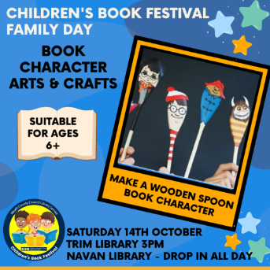
Christmas Cards 2023
Bun Sale
Friday 20th October 2023
Friday 20th October 2023
Yes, it’s that time of year again when the children have the opportunity to show off their artistic talents and design their own personalised Christmas cards!
A blank Christmas card template will be sent home with your child this week, so please check school bags!
An accompanying email will be sent to all with further details about the Christmas cards.
Please ensure all completed templates are returned to the school by Friday 20th October in order for us to meet the deadline set by the printing company.
No payment is required at this stage.
Tasty buns and treats on 20th October
We are having our Bun Sale on Friday 20th October as we will be saying goodbye to Mr. O’Coigligh on the last Friday of the school term. More details to follow.
It is children in Senior Infants and 6th class who will be our handy bakers this time.
Please drop off buns and biscuits to the school hall for 9am. Please do not use nuts as an ingredient when baking.
Many thanks,
Adri O’Dea
Chairperson
E. pa@stmarystrim.ie
Parents Association
Facebook Page
Children's Book Festival Family Day
Trim Library - Saturday 14th October.
Booking is essential for most of these events.

