Slide 1
Imlitir 8
16 October 2023
A Chairde,
There has been a very positive response to our new Imlitir format. Thanks again to Bernie for her assistance. It’s smashing!
School Choir 2023
.
The choir will begin rehearsals on Thursdays after school in the New Year.
The Choir will be voluntary and will be made up of girls from 5th & 6th Class.
We will be rehearsing for “The Big Sing” a large choir concert in Dublin in April.
We will be in touch over the coming months
Ms. O’Connor & Ms. Austin
Assemblies: There will be no assembly on Friday of this week, due to the Bunsale. We will have a “Welcome Blessing Assembly” @ 9.20 on Wednesday morning for the new Junior Infants (Rooms 1,2,3 and 4.) Rooms 30 and 31 will welcome them to our school. You are welcome to attend. On Thursday we will have a “Sing Song Assembly” for Second to Sixth Classes. We will be singing our anti-bullying song “Brave” our Green Flag song “Do It Now-Sing For The Climate” and Ireland’s Call. The two sixth classes will be performing the famous Saw Doctors song “N17” on the Ukuleles. They were unable to get the Saw Doctors to join them but they will have another Galwayman instead. That song does not sound the same without a good Galway accent! There is great work going on with the Ukulele classes every Monday, many thanks to Stephen for his enthusiasm and knowledge. We will get to see the fruits of his and the pupils' labours on Thursday. This assembly will also be at 9.20 and all (particularly parents/guardians of the Sixth Classes) are welcome.
This week is Maths Week. At school the children will be involved in games and activities which help to promote Maths in a positive and enjoyable manner. We also plan on focusing on Maths in our STEAM Room this week.
At home, we can use this opportunity to focus on Maths in the environment eg shapes of buildings, telling the time, handling money in shops and getting change etc
For more details, information and to check out online events see www.mathsweek.ie
I Hope it will be a fun Maths Week for everybody!

Slide 2
Aladdin Connect:
Please note that you can enter your child’s absence and the reason for it on the Aladdin Connect App. There is no longer a need to phone or email the school. If you are not on Aladdin Connect, please contact Rebecca in the office and she will assist you. Thank you in advance.
Please support our Parents’ Association Bunsale on Friday Next October 20th. More details below.
I would like to wish our new Parents’ Association committee Adri O’ Dea, Natache Sadler,Vicky Clarke and Fiona Ryan every success in the year ahead. We are indebted to our Parents’ Association for all their support and commitment down through the years. I would also like to thank the outgoing committee member Caroline Smith for her great service to our school, especially during Covid. It is amazing to think that they continued through the many challenges they (and we) faced. Nár laige Dia iad ar fad.
Contact Details:
Please also check on Aladdin Connect that we have the most up-to-date phone numbers and email address for you. For example, we may need to contact a family when a child has an accident in the yard or we may need to email you if there is Covid in your child’s classroom. Aladdin Connect allows you to make the changes yourself directly.
DT News:
I am so proud of Room 30 who have taken on the challenge to create a website from scratch using HTML code. This is a first for the school and the girls have stepped up and are working hard. The plan is to host this as an entire combined website for a short while when we are done. So watch this space!
This week is Maths week so we will be doing Mangahigh in our computer classes.
Debby Walsh
Important Reminders for Parents/Guardians of 6th Class Pupils
Closing dates for secondary school enrolments are fast approaching:
Boyne Community School - Friday 20th October 2023 at 1pm
Scoil Mhuire - Thursday 26th October 2023 at 4pm
Our Annual Admittance Notice has been updated on our website. It lists the various dates associated with enrolling new pupils in our school. Please click here to download an application for enrolment form.
Completed forms together with a birth certificate can be returned to the office. Please phone the office if you need assistance or have any queries on 046/9431919.

Slide 3
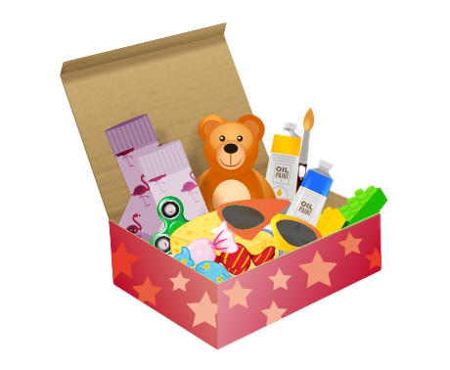
Christmas Shoebox Appeal 2023 | St. Mary’s Primary School, Trim
It is that time of year again and the families in St Mary’s are once again invited to join in the shoebox appeal sharing Christmas with children who may not receive gifts otherwise.
Last year our 175 shoeboxes were delivered to children in Transnistria who were delighted to open up the beautiful gifts. Thank you!
Good things come in small parcels and there are few parcels shared that are as small as a shoebox. Through the Christmas Shoebox Appeal children in Africa and Eastern Europe can enjoy this special time of year. Children in St Mary’s and in Ireland are lucky to have lovely things at home and at school and we have an opportunity to share some kindness with these children who have little and will be so grateful and excited to receive the gift.
The shoebox appeal is based on children/families filling a shoebox with 4 W's- something to Wear(hat, scarf, hairbands etc) something to Write with (crayons, pencils, notebooks etc) something to Wash with(toothbrush, facecloth etc) and something to WOW (teddy, small toy, sunglasses etc). Follow the link to see how to fill a shoebox – click here.
The appeal also asks for a small donation of €5 to cover the transport cost of the gifts. It is a lovely way for children in our school to share with less fortunate children in another country.
As previously, it is optional for the children of St Mary’s to get involved with the Shoebox Appeal. Families or friends can pool together gifts to fill one box if they prefer.
Children will get a leaflet today with more information.
The shoeboxes will be collected from the school after the Halloween holidays. We will begin collecting them the week after Halloween holidays 6th Nov -13th Nov. Shoeboxes can be dropped into the school/Room 2.
Míle buíochas for always being so generous with these appeals for very worthy causes.
Thank you for your kindness.
Ms. Dalton

Slide 4
On Thursday, 19th October, 2023, as a school we will be celebrating DLD Awareness Day. On the parents’ association notice board, just inside the school front door, there will be information leaflets about Developmental Language Disorder (D.L.D) and useful tips/ activities how to encourage children’s speech and language development.
Please see https://docs.google.com/document/d/1_rkCLdFz0Q02QUaK9IwoT7HouwMLOsW2/edit
For more information
Board of Management Elections
A new Board will start their four year term at the end of November. All families were emailed last week asking fathers and mothers if they were willing to stand for nomination in that election. Forms indicating your willingness were to be returned to the school by tomorrow October 17th. Please contact the school if you need clarification or assistance.
Mise le meas,
Cóilín Ó Coigligh P.O.

Slide 5
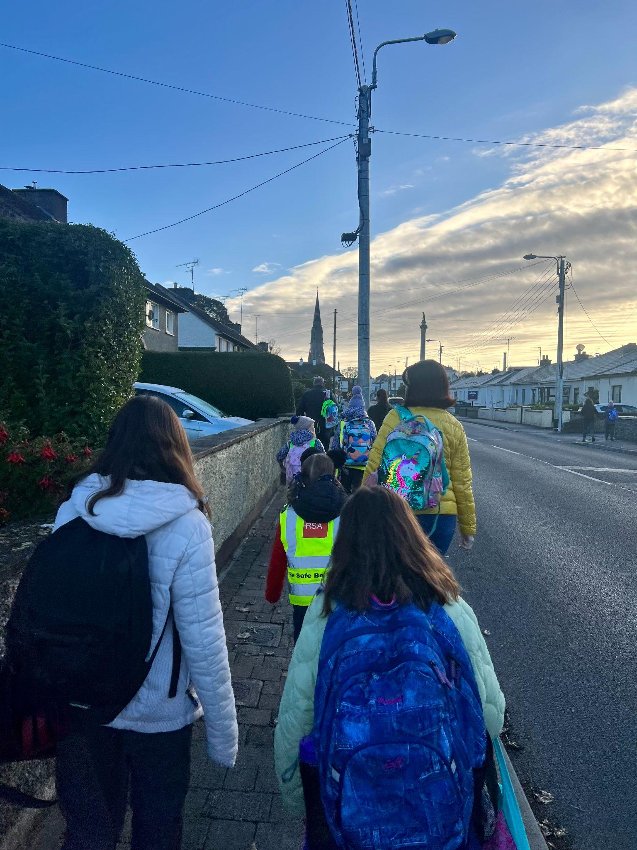
Banna (School Band): Rehearsal for 3rd - 6th Class 2:50 - 3:30pm
Football: Wednesdays 2.50 - 3.50 for 4th - 6th Class
Camogie: Date TBC – will start later in the year
Rounders: Mondays 3.00 - 4.00 for 5th & 6th Class weather permitting
Assembly: Launch of Maths Week
Confirmation: Friday Jan 26th @ 2pm
Communion: Saturday 11th May @ 2pm
Nathanna na Seachtaine: Bí cúramach (Be Careful)
Seanfhocal na Míosa: Ní neart go cur le chéile (there is no strength without unity)
Walking to School
Well done to all who participated in National Walk to School Week. It was great to see the numbers increasing again. Let’s keep it up while the weather is still conducive to walking to school.
Walking Bus
If the weather is good next Thursday, we would like to start up our walking bus again from the three meeting points: Knightsbrook (beside Muse), the car park up near Lidl and The Gallops. Well done to the children from The Gallops, who were the first ones to saddle up!!
GREEN
NEWS
If your child is going to participate, please complete the consent form saved here.
If anyone would like to volunteer, please contact the school. An initiative like this requires parental involvement. Huge thanks to the parents who kept the campaign going last year. Our travel officer is visiting us very soon. He will advise us about other ways in which we will be able to work with our Travel theme this year.
Cycling to School
Cycling on Wednesdays will start soon. Anyone interested in cycling with the school must be in fourth class up or must have a parent or guardian with them.
Hi-viz vests and helmets are essential.
Recycling continues at school. We accept ink cartridges, small plastic bottles, postage stamps, cans and batteries. Well done to everyone for managing their waste in a sustainable way.
Remember green is cool at home and at school!

Slide 6
Our Green Flag theme is Global Citizenship - Travel. This is National Walk to school week. Of course our Walking on Wednesday, WOW will go ahead on Wednesday but we are asking that everyone try to walk to school even more this week. Let’s walk, cycle and scoot more to reduce carbon emissions and keep our air clean.
Unfortunately the weather has made it challenging to get our WOW and COW campaigns started. WOW will resume on Wednesday if it is dry. Meet up at Gullivers at 8:50 am. We will also resume On Foot Friday on Friday (Walking to school from Gullivers down at the castle car park).
Walking is such a mindful activity. We miss so much when we are travelling in a vehicle. As we walk to school this week let us take note of all we see, hear and smell along the way. Autumn offers many lovely sights.
Next week we will concentrate on Cycling. We have a lovely new Bike shed so let’s put it to good use when the weather picks up and it is safer to cycle.
WOW

Slide 7
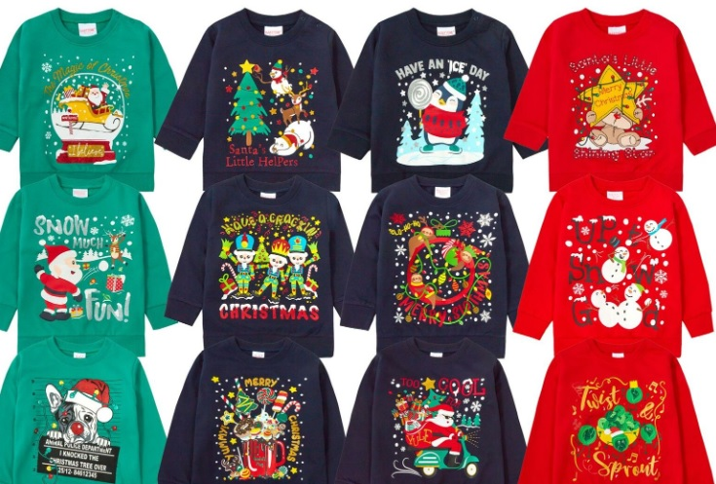
Christmas Cards 2023
Bun Sale
Friday 20th October 2023
Friday 20th October 2023
CHRISTMAS CARD TEMPLATES
Just a gentle reminder that the deadline for returning the Christmas Card Templates is Friday 20th October as well. We are looking forward to seeing all your lovely artwork!
CHRISTMAS JUMPER SALE
In the spirit of Reducing, Re-using and Recycling we are hoping to do a Christmas Jumper Sale in November. If you have any previously worn Christmas Jumpers that you would like to donate, we would be happy to receive them.
We will give more information on this project in the next Imlitir.
HALL0WEEN BUN SALE AND ‘HALLOWEEN HAIRSTYLES’
Our Halloween Bun sale is on Friday 20th October. As always, this promises to be lots of fun for everyone!
For a bit of extra fun, you can WOW us with your SCARY, SPOOKY, FUNNY, CRAZY HALLOWEEN HAIRSTYLES on the day. We can’t wait to see what creative ideas you have!
We recommend that children do not bring more than €2, so that everyone can get their fair (and more healthy) share.
We are asking children from Senior Infants and 6th Class to be our bakers this time.
Tips for Bakers:
Do’s:
Buns, biscuits and bars are recommended
Label any special dietary buns/ biscuits and hand them in separately
Cereal boxes with one side cut as a flap/lid and lined with tin foil works well for sending buns in
If you send in containers, please mark them clearly with your child’s name
Don’ts:
No whole cakes – they can be difficult to cut No fresh cream please
No nuts – due to nut allergies in school
Please bring buns straight into the hall from 8:50 am. We’ll be there to collect them.
Many thanks,
Adri O’Dea
Chairperson
E. pa@stmarystrim.ie
Parents Association
Facebook Page

