Slide 1
Imlitir 9
23rd October 2023
A Chairde,
School closes for the Mid-term Break at 1.50 and 2.50 on Friday next October 28th. It reopens again on Monday November 7th. We hope that an enjoyable break is had by all.
Parent Teacher Meetings take place on Tuesday November 14th and Thursday November 16th, this year, except for Junior Infants and the Language Classes. Appoint slots will be released on Aladdin Connect tomorrow, Tuesday. The link will close on Friday of this week. Please book at your earliest convenience. If you are not on Aladdin Connect, please contact Rebecca in the Office. Thanks.
The Digital Schools Committee will meet on Wednesday October 25th @ 8.30 in the school Boardroom.
Homework Club
Homework Club is starting on Mon 6th - 21st Dec, for children from 1st-6th class. It runs Monday, Tuesday and Thursday from 2.50-3.50.
Please Note: Children with siblings attending homework club in St Michaels or the secondary schools are welcome to wait until 4.00.
Cost is dependent on how many days you attend, but works out at €5 a day, full details on forms, available in the school.
Thank you,
Ms Carr.
Congratulations to Noah McGrath, Senior Infants Rm5 for winning 1st prize in the Drogheda Credit Union Annual Art Competition in the under 7 special category. Noah's entry will go on to the next level to be judged. Well Done Noah. We are so proud of you and we wish you all the best in the next level of this competition.
Mise le meas,
Cóilín Ó Coigligh P.O.
Board of Management: As we have received only one nomination for the mother and also the father nominee, Caroline Buckley and Dave Ryan are deemed elected. Congratulations to them both. The new Board will meet in early December and I would like to wish them every success.
Spooky Walk
Our annual Spooky Halloween Dress Up day will take place on THURSDAY 26th October. The children can dress up if they wish.

Slide 2
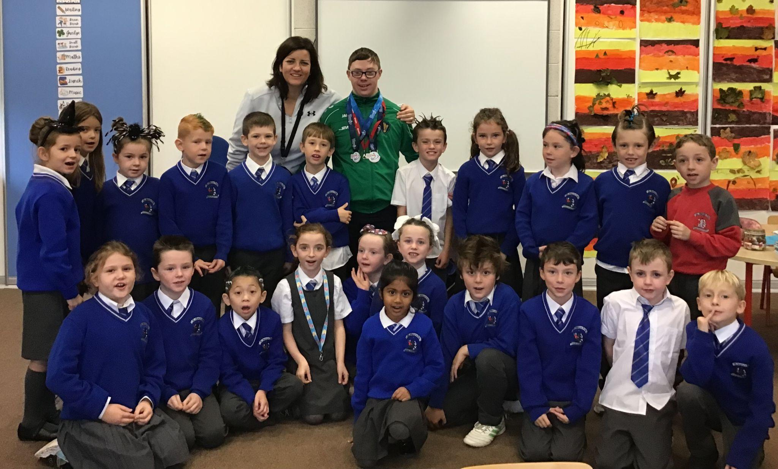
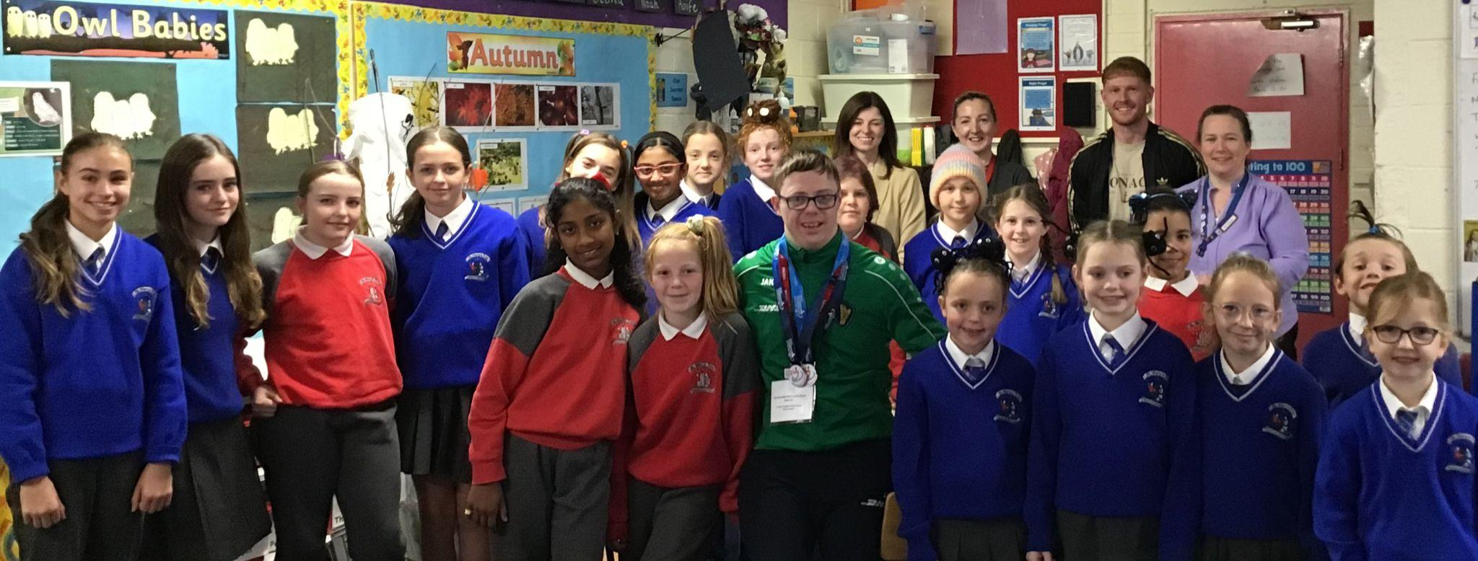
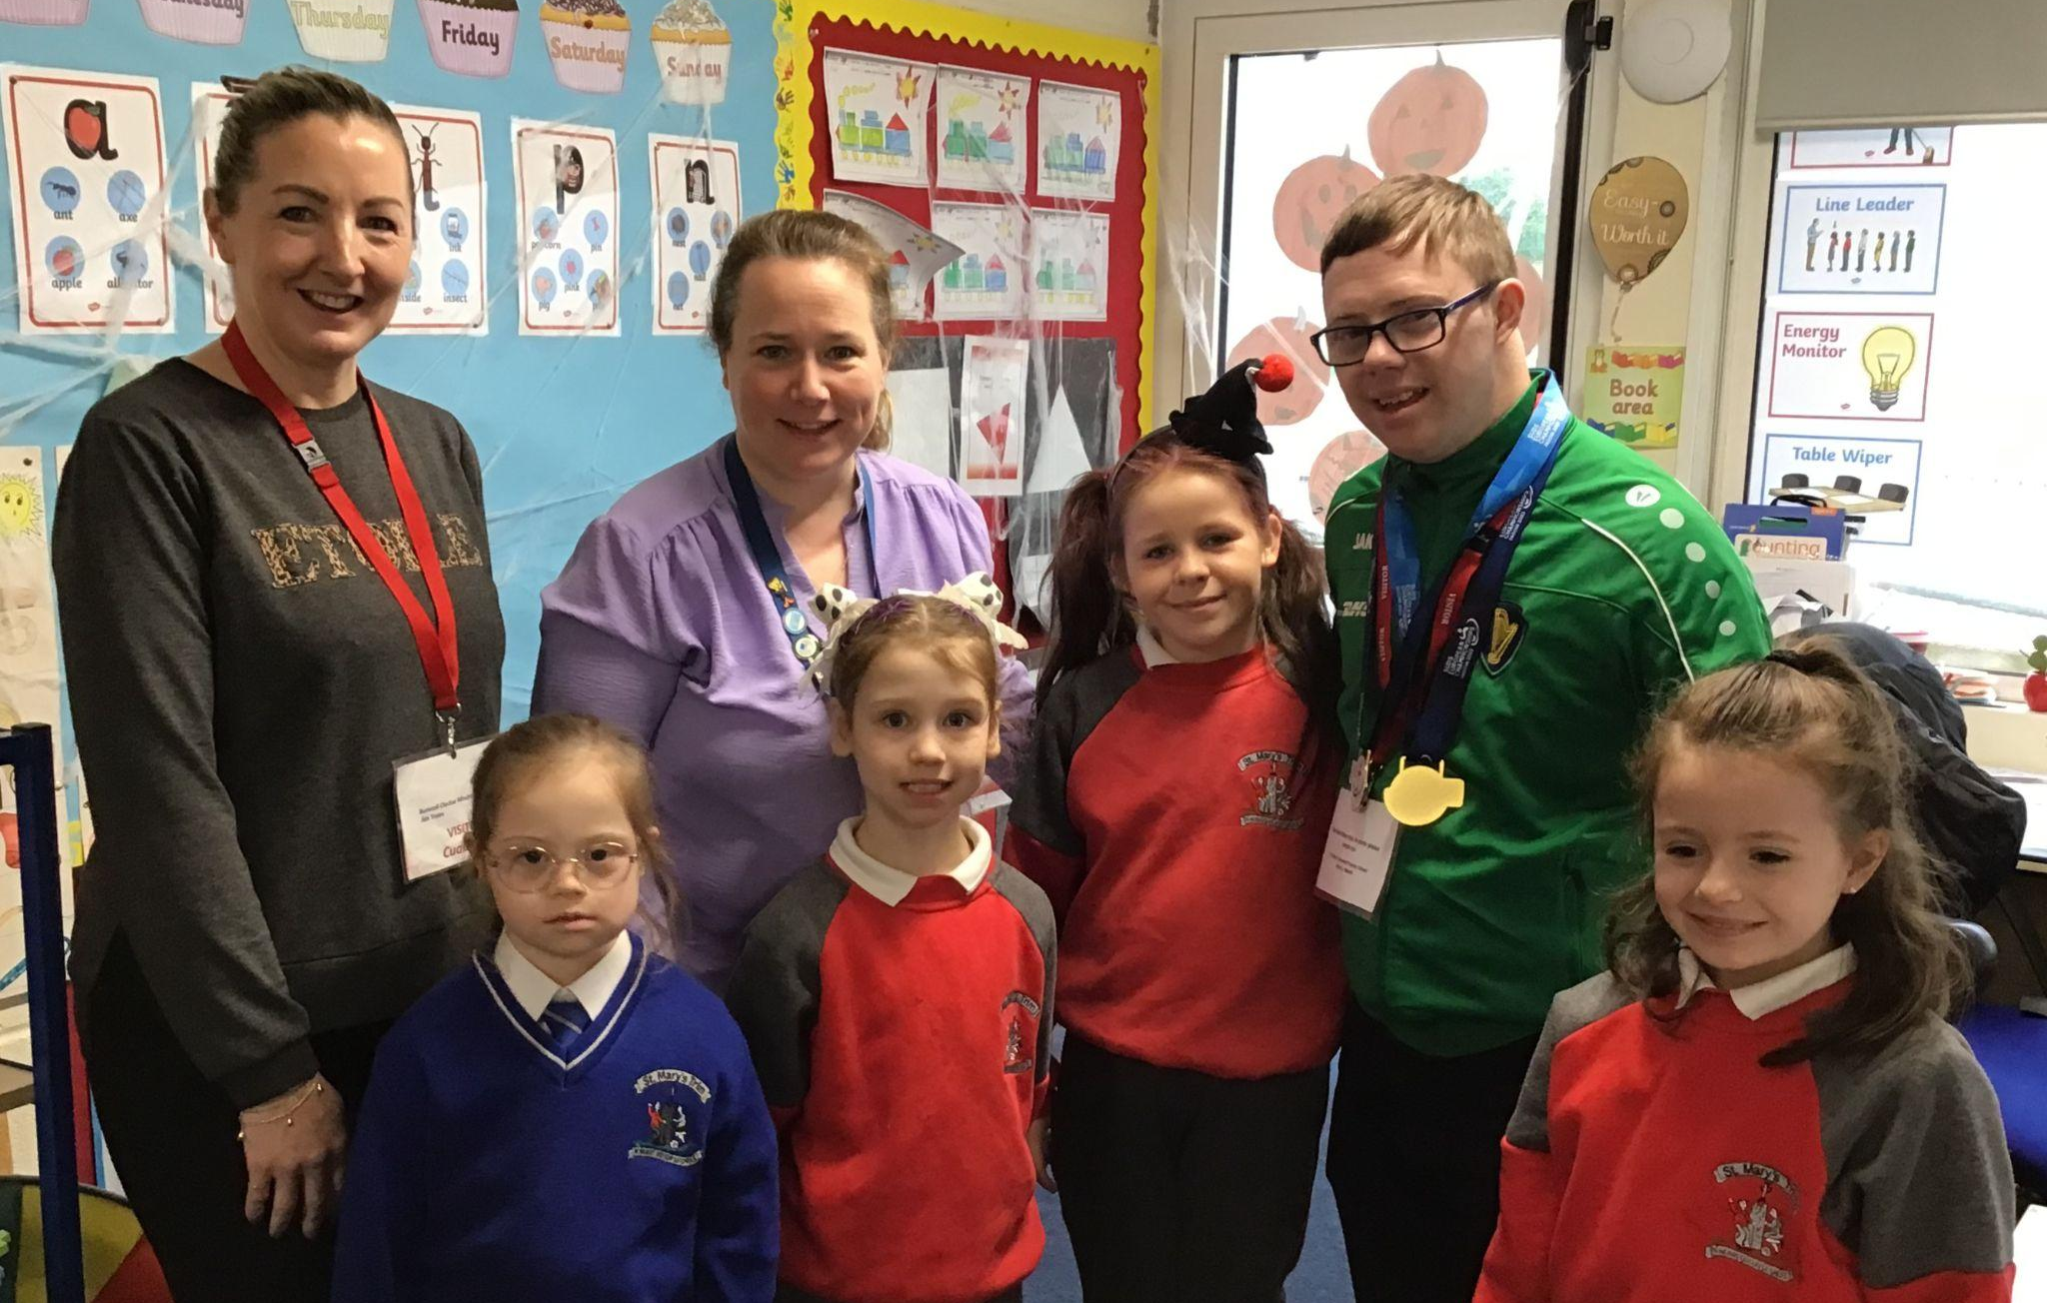
We were delighted to welcome Liam Foley to our school last Friday.He competed in May in the European Championship for athletes with Downs Syndrome representing Ireland. He visited many classes today and met the Active Committee too.
1st class were delighted to share their news with him that they ran 179km on our school track in September alone.
He showed the pupils his two GOLD MEDALS for winning the 800m and 1500m events and set a new European championship record in the 800m, 2min55sec.
Liam created a great buzz and brought wonderful energy to the school on such a wet day. Mr Carmody & Liam were caught on camera, shaking hands - a promise for Liam to return and run the track with pupils and teachers!!
A great way to launch our focus strand Athletics with the pupils today
DT News:
Our Annual Admittance Notice has been updated on our website. It lists the various dates associated with enrolling new pupils in our school. Please click here to download an application for enrolment form.
Completed forms together with a birth certificate can be returned to the office. Please phone the office if you need assistance or have any queries on 046/9431919.
I would like to say a huge thank you to Mr Ó Coigligh for having given me the opportunity to join his staff and teach all students IT skills. Without his vision this would never have been possible. So I would like to wish him well as he retires and he can be assured his legacy will continue!
Debby Walsh

Slide 3
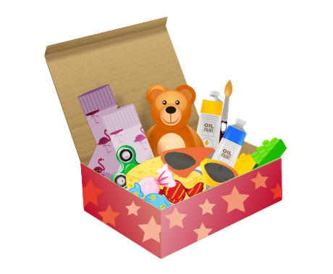
Christmas Shoebox Appeal 2023 | St. Mary’s Primary School, Trim
It is that time of year again and the families in St Mary’s are once again invited to join in the shoebox appeal sharing Christmas with children who may not receive gifts otherwise.
Last year our 175 shoeboxes were delivered to children in Transnistria who were delighted to open up the beautiful gifts. Thank you!
Good things come in small parcels and there are few parcels shared that are as small as a shoebox. Through the Christmas Shoebox Appeal children in Africa and Eastern Europe can enjoy this special time of year. Children in St Mary’s and in Ireland are lucky to have lovely things at home and at school and we have an opportunity to share some kindness with these children who have little and will be so grateful and excited to receive the gift.
The shoebox appeal is based on children/families filling a shoebox with 4 W's- something to Wear(hat, scarf, hairbands etc) something to Write with (crayons, pencils, notebooks etc) something to Wash with(toothbrush, facecloth etc) and something to WOW (teddy, small toy, sunglasses etc). Follow the link to see how to fill a shoebox – click here.
The appeal also asks for a small donation of €5 to cover the transport cost of the gifts. It is a lovely way for children in our school to share with less fortunate children in another country.
As previously, it is optional for the children of St Mary’s to get involved with the Shoebox Appeal. Families or friends can pool together gifts to fill one box if they prefer.
Children will get a leaflet today with more information.
The shoeboxes will be collected from the school after the Halloween holidays. We will begin collecting them the week after Halloween holidays 6th Nov -13th Nov. Shoeboxes can be dropped into the school/Room 2.
Míle buíochas for always being so generous with these appeals for very worthy causes.
Thank you for your kindness.
Ms. Dalton

Slide 4
Book Fair in the School Hall
TIME | TUESDAY NOVEMBER 7th | WEDNESDAY NOVEMBER 8th
9.10-9.40 | Rooms 23, 24 & Room 18-Lang.Unit & Fourth Class | Room 12-First Class
9.40-10.10 | Room 10-First Class | Room 13-First Class
10.10-10.40 | Room 9-First Class | Room 16-Third Class
11.10-11.40 | Room 31-Sixth Class | Room 20-Third Class
11.40-12.10 | Room 35-Fourth Class | Room 30-Sixth Class
12.50-1.20 | Room 27-Fifth Class | Room 26-Fifth Class
1.20- 2.20 | Rooms 1, 2, 3 & 4 Junior Infants (accompanied by their parents) | Rooms 5, 6, 7 & 8 Senior Infants (accompanied by their parents)
2.20-2.50 | Rooms 14 & 15 Second Classes | Pupils with money for books from any classes
2.50-3.50 | Open to the public | Open to the public
St. Mary’s School Book Fair will take place in St Mary’s school hall, after the mid-term break,
on Tuesday, 7 th and Wednesday, 8 th of November.
The school runs the Book Fair, in conjunction with our local bookshop, Antonia’s
Bookstore. Antonia kindly donates 20% of her book sales back to the school in the form of
books and resources for our classrooms and our School Library.
We are also running some competitions in school to promote our Book Fair and to encourage
more reading at school and at home.
Parents/guardians of children in Junior and Senior Infants need to collect their children
from their classes, at their allocated times, and bring them to the Book Fair, if they wish
them to attend.
Many thanks for your continued support of our School Book Fair.
Mary O’Hare School Book Fair Coordinator

Slide 5
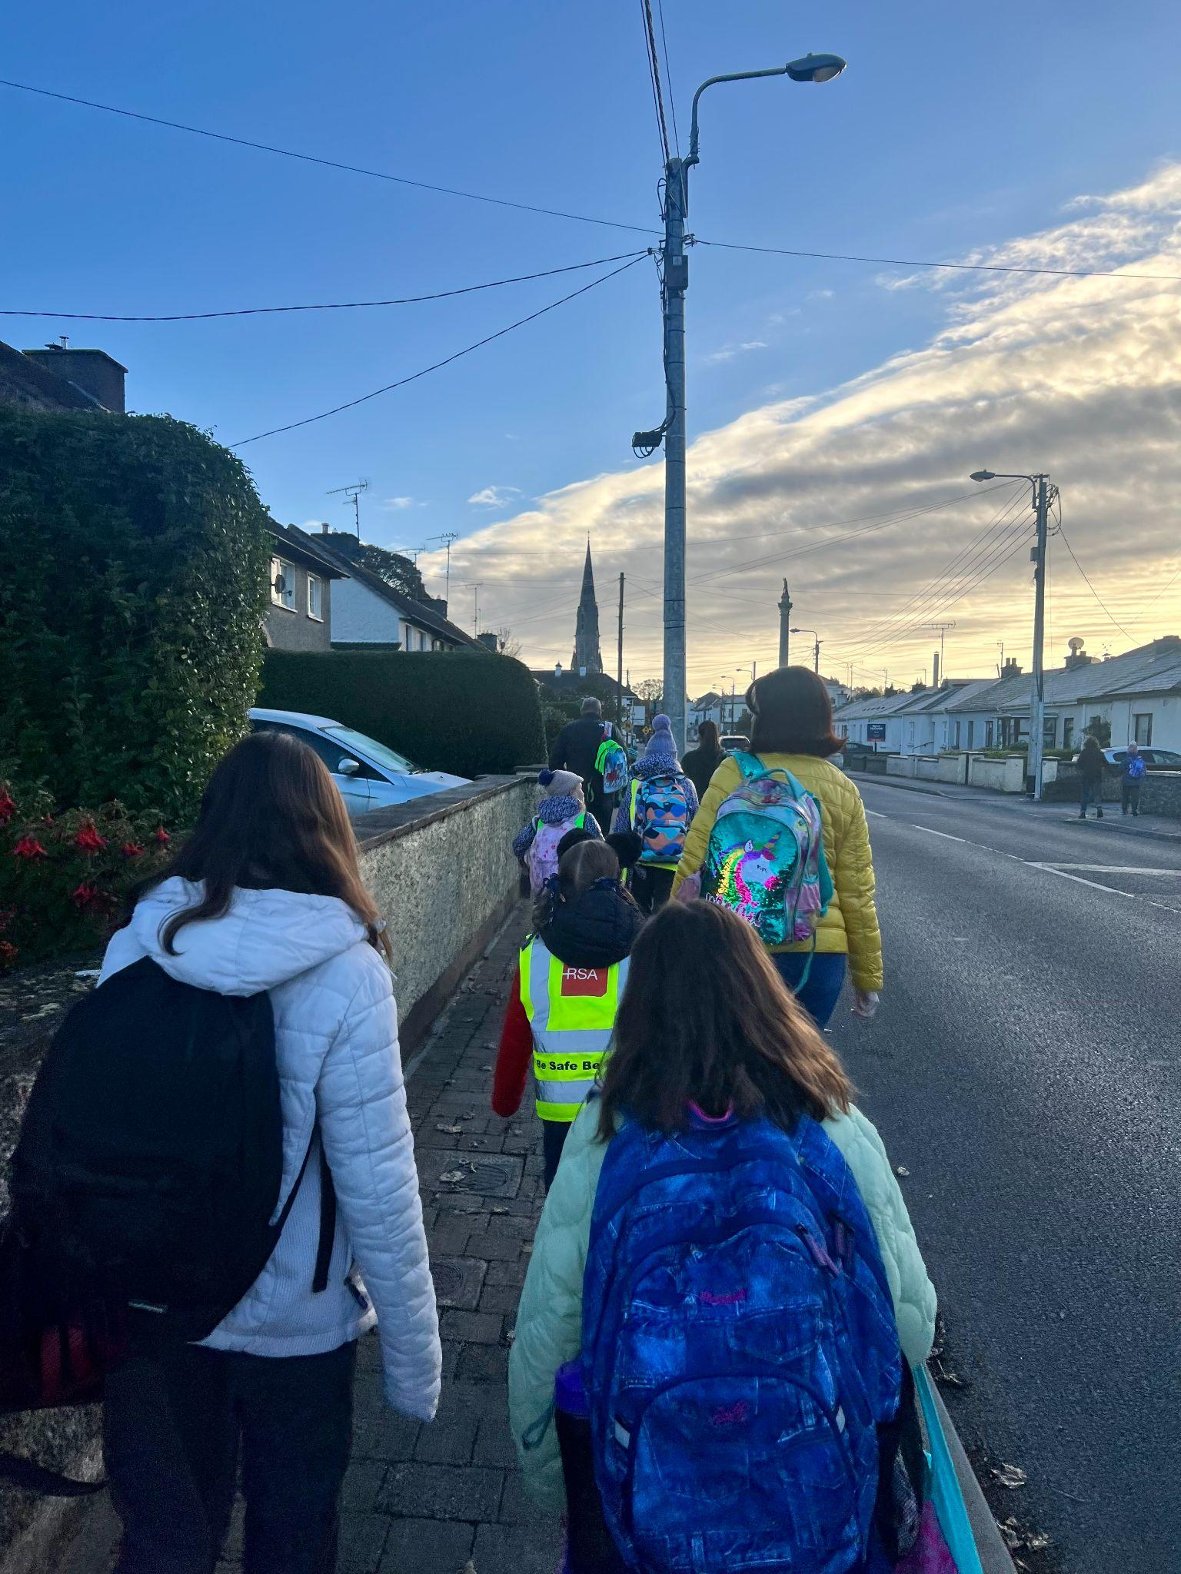
Banna (School Band): Rehearsal for 3rd - 6th Class 2:50 - 3:30pm
Football: Wednesdays 2.50 - 3.50 for 4th - 6th Class
Camogie: Date TBC – will start later in the year
Rounders: Mondays 3.00 - 4.00 for 5th & 6th Class weather permitting
Assembly:
Spooky Walk: Thursday 26th October - Halloween Dress up
Confirmation: Friday Jan 26th @ 2pm
Communion: Saturday 11th May @ 2pm
Nathanna na Seachtaine: Slán leat agus go raibh maith agat, Mr O’Coigligh!
Seanfhocal na Míosa: Ní neart go cur le chéile (there is no strength without unity)
Visit from the Travel Officer
On Friday last, October 20, we had a visit from the Travel Officer from An Taisce. His name is Thomas Hegarty. He was delighted to meet with the Green Flag committee and take us through the seven steps of the programme. The girls explained how we have WOW, COW and the Walking Bus already in motion in St Mary’s and he was very impressed. He will help us plan our Action day by carrying out a Walkability survey around Trim and he will also facilitate workshops on the impact of Food Miles and Fast Fashion on the environment. We have pencilled in dates for November. Mr Hegarty also distributed new Green Flag badges and included one to be given to Mr Kelly when he starts. We discussed the problem of engines idling outside the school at drop off and collection times and the possibility of writing to the bus companies to encourage the drivers to switch of the engines. Mr Hegarty would like us to carry out a travel survey and to promote more sustainable ways to come to school. Park and Stride… etc. Results to be posted on the Green Flag Noticeboard. He will also help us with mapping out the area around Trim to show where our pupils live in order to work out safe routes to walk to school. This map of Trim will be enlarged and displayed on the Green Noticeboard. WOW continues this Wednesday. Meet at Gullivers at 8:50am Thank you Mr Carmody and Ms Mallon.
The Walking Bus has been going really well from the Gallops! Well done all. Perhaps this week if the weather allows, the ‘Bus’ will depart from the car park up on the Athboy Road. Any volunteers who are available, please let the school know asap.
GREEN
NEWS
Remember green is cool at home and at school!

Slide 6
Our Green Flag theme is Global Citizenship - Travel. This is National Walk to school week. Of course our Walking on Wednesday, WOW will go ahead on Wednesday but we are asking that everyone try to walk to school even more this week. Let’s walk, cycle and scoot more to reduce carbon emissions and keep our air clean.
Unfortunately the weather has made it challenging to get our WOW and COW campaigns started. WOW will resume on Wednesday if it is dry. Meet up at Gullivers at 8:50 am. We will also resume On Foot Friday on Friday (Walking to school from Gullivers down at the castle car park).
Walking is such a mindful activity. We miss so much when we are travelling in a vehicle. As we walk to school this week let us take note of all we see, hear and smell along the way. Autumn offers many lovely sights.
Next week we will concentrate on Cycling. We have a lovely new Bike shed so let’s put it to good use when the weather picks up and it is safer to cycle.
WOW

Slide 7
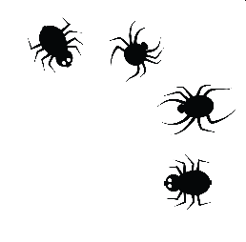
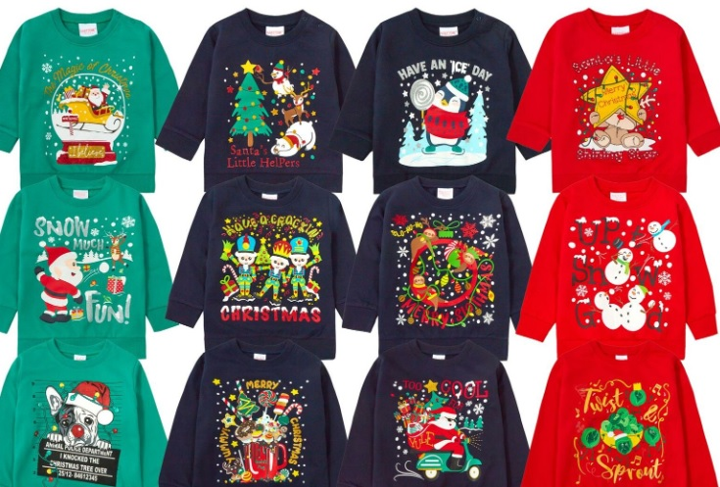
Christmas Cards 2023
HALL0WEEN BUN SALE AND ‘HALLOWEEN HAIRSTYLES’
A big ‘Thank You’ to our lovely helpers, handy bakers and supporters.
We had a great time, and hope you did too.
We hope you all have a great Mid-term Break and a Spooktacular Halloween!
Thank you returning your lovely templates for your Christmas Cards. A sample card and the
order information will be sent home after the mid-term break.
CHRISTMAS JUMPER SALE
We are looking forward to collecting your pre-loved Christmas Jumpers and Tops in the new
term.
You are welcome to leave them in the office and we will collect them from there.
We appreciate your support!
Many thanks,
Adri O’Dea
Chairperson
E. pa@stmarystrim.ie
Parents Association
Facebook Page

Slide 9
